Slide 1
MDS Transmission and Section X
Chapter 5
January 21, 2016
1-3PM

Slide 2
Objectives
Understand the transmission process
Understand how to correct and inactivate a MDS
Understand the Validation Reports and what to do with them

Slide 3
Transmission of MDS
Submit all assessments and entry/tracking forms within 14 days
Feedback or Final Validation Report received within 48 hours
Casper Reporting Guide https://www.qtso.com/mds30.html
  Transmission Information including understanding error and warning messages
MDS 3.0 Submission, Submission Status, and Final Validation Reports Helpful Hints https://www.qtso.com/download/mds/MDS_3.0_Helpful_Hints.pdf
Notes:
3

Slide 4
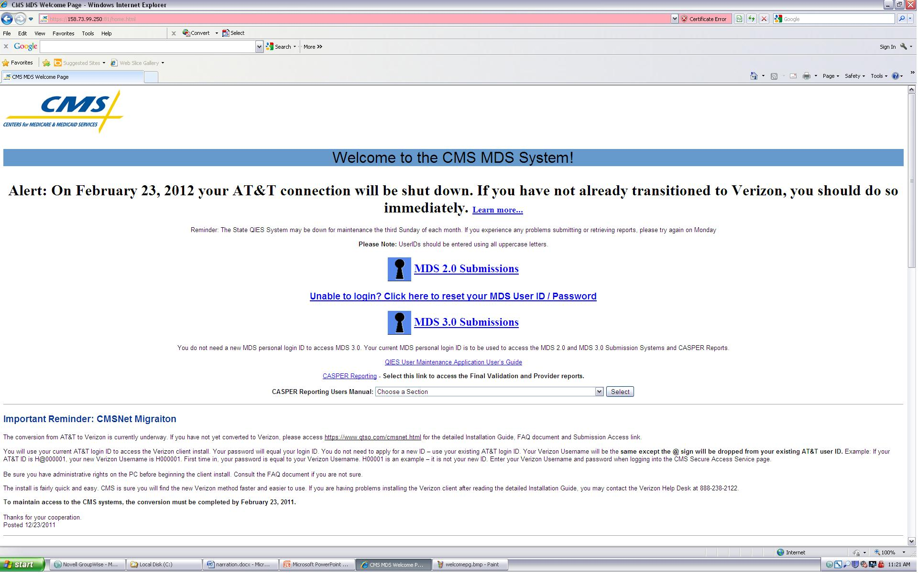
CMS MDS Welcome Page

Slide 5
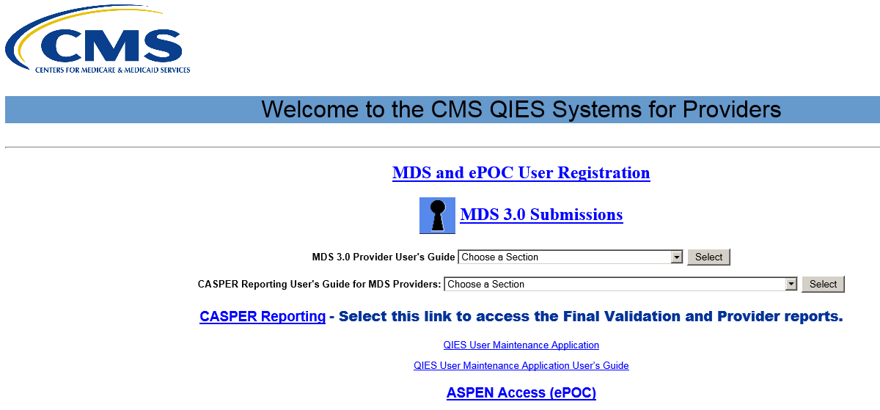
aaaaaaaaaaaaaaaaaaa
25.Depending on your selection from the Web Bookmarks page, a Welcome page will display. This example shows the Welcome to CMS QIES Systems for Providers page for an MDS / ePOC user

Slide 6
Depending on your selection from the Web Bookmarks page, a Welcome page will display. This example shows the Welcome to CMS QIES Systems for Providers page for an MDS/ePOC user
Once you have finished with your work at the CMS site
      Do not close the Juniper page until you have signed out
      To sign out select the “Sign Out” tab on the Juniper page
      Close the entire browser
      IMPROTANT NOTE: If you do not SIGN OUT you may be blocked from some of your network service. This will release after 20 minutes or a reboot of your PC. Remember always sign out and close the browser (Internet Explorer)

Slide 7
Final Validation Reports
CASPER Reporting - Select this link to access the Final Validation and Provider reports

Slide 8
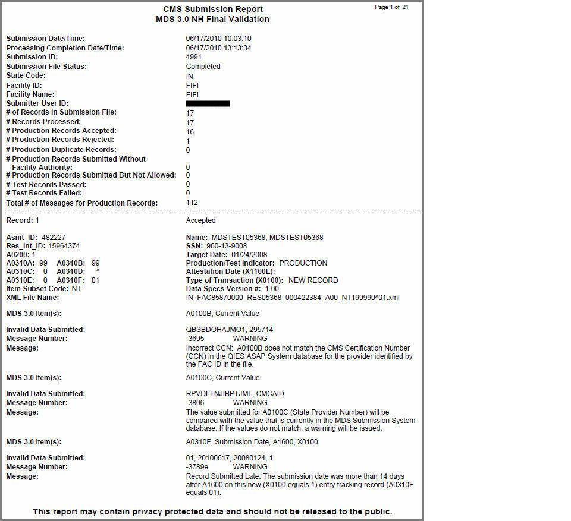
Final Validation Report

Slide 9
Medicare Billing
A Medicare Claim can not be submitted until a Final Validation Report is generated from the QIES ASAP system that shows that the assessment has been accepted to the system.
Notes:
9

Slide 10
Warning Message -3616
Incorrect HIPPS/RUG Value: Submitted value of HIPPS/RUG code does not match value calculated by QIES ASAP System.
Information Submitted in Item Z0100 A & B does not match RUG value calculated by the QIES ASAP System.
When submitting Medicare Claim for assessment that received this warning message:
  Submit recalculated value (value calculated by the QIES ASAP System) indicated on the final validation report.
  Do not submit values from Z0100 A & B when you receive this warning message.
Notes:
10

Slide 11
Error Notification
Warning or non-fatal errors
  Assessment and tracking form data accepted but may need correction
Fatal errors
  Submission rejected
  Must correct problems and re-submit
Notes:
11

Slide 12
Special Manual Record
Correction Request
Error types cannot be corrected with automated modification or inactivation request
  Test record submitted as production
  Wrong submission requirement in A0410
  Wrong facility ID in control item FAC_ID
Contact State Automation Coordinator to fix problem
  Kristy Burns 785-228-6700
Notes:
12

Slide 13
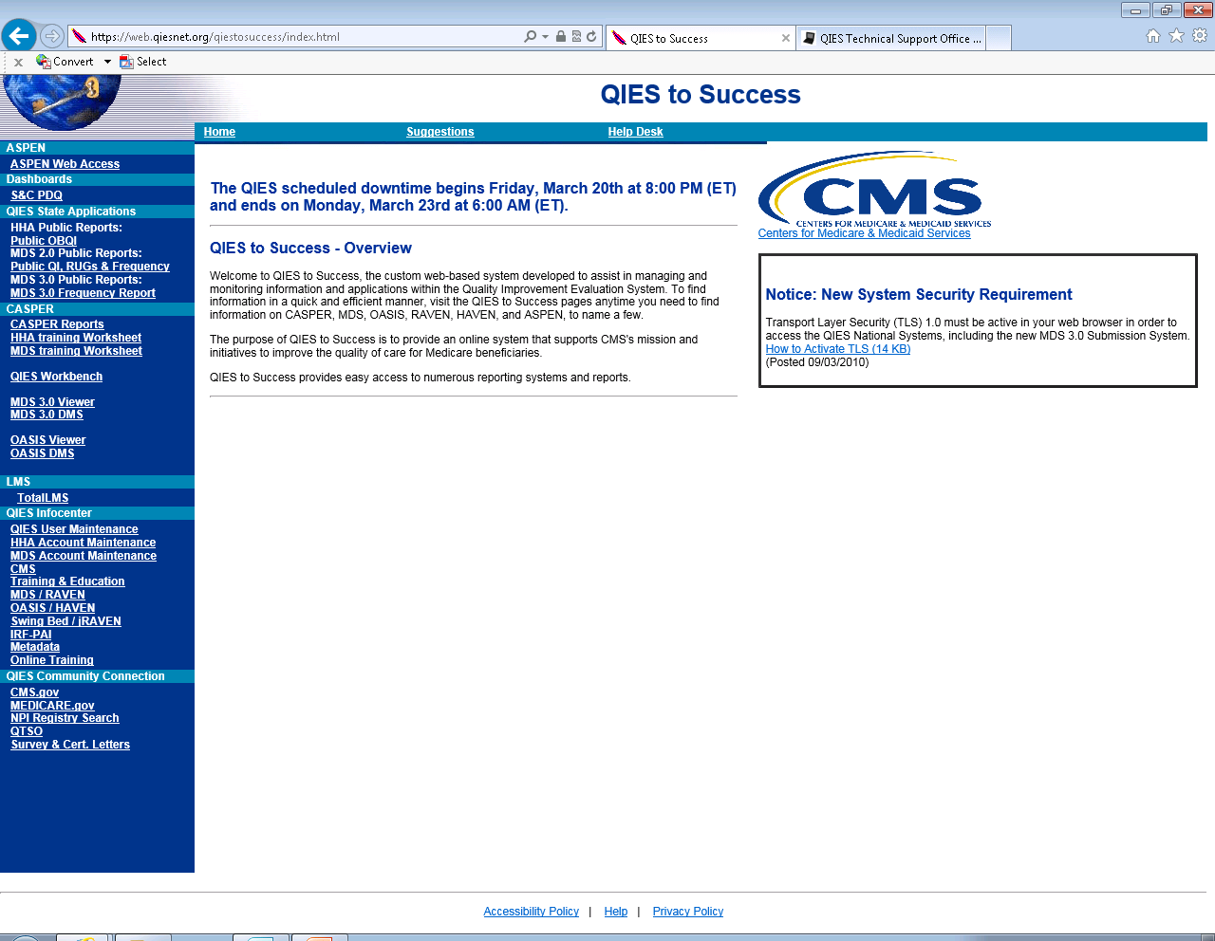

Slide 14

CASPER Reporting User’s Guide

Slide 15
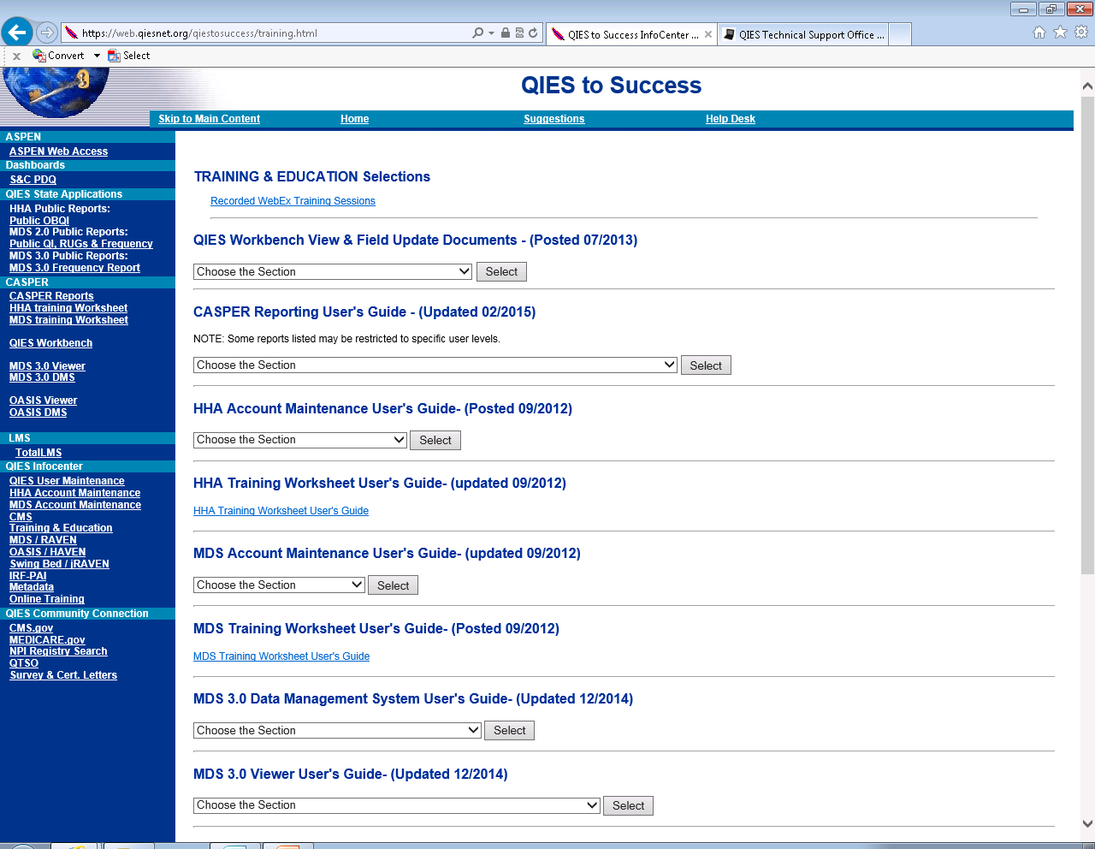

Slide 16
SECTION X
CORRECTION REQUEST
MODIFY OR INACTIVATE
Chapter 5

Slide 17
X0150: Type of Provider (A0200 on existing record to be modified/inactivated)
Code 1. Nursing Home (SNF/NF)
Code 2. Swing Bed
This item contains the type of provider identified from the prior erroneous record to be modified/inactivated.

Slide 18
X0200 through X0700
  Reproduce information exactly as appeared in record that needs correction even if information wrong
  If information not 100% same, correction process will not work because system not be able to find prior document
A0200 | Name of Resident
A0300 | Gender
A0400 | Birth date
A0500 | Social Security Number
A0600 | Type of Assessment/Tracking
A0700 | Date on Assessment to be Modified /Inactivated

Slide 19
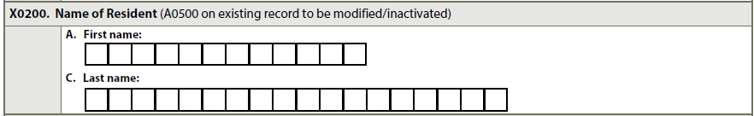
X0200-X0500

Slide 20
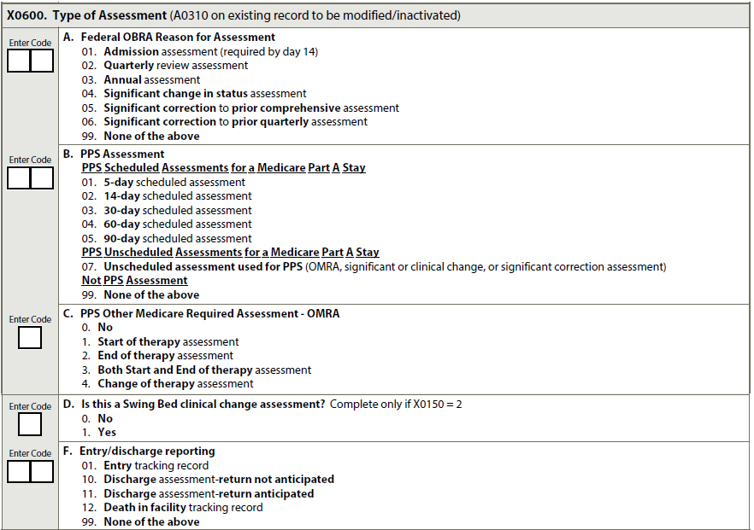

Slide 21
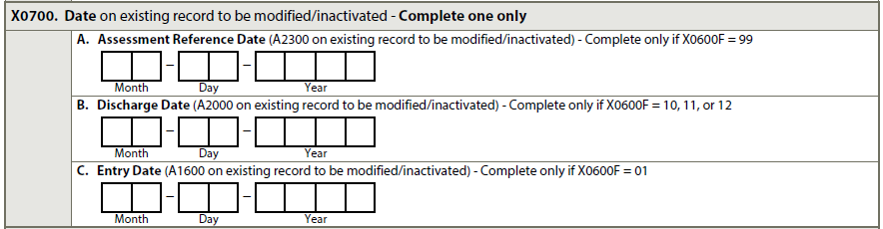
X0700: Date on Existing Record to Be Modified/Inactivated
Code as follows:
  Complete only A, B, OR C
    A. ARD. If prior, erroneous assessment OBRA or PPS assessment - X0600F = 99
  B. Discharge Date. If prior assessment discharge record - X0600F = 10, 11, or 12
  C. Entry Date. If prior assessment entry record - X0600F = 01

Slide 22
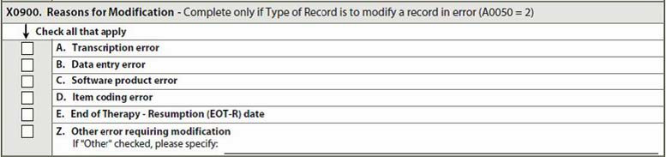
Correction Attestation Section
X0800: Correction Number - Use leading zero
X0900: Reason for Modification – Check all that apply

Slide 23
X1050: Reasons for Inactivation
Check all that apply
A. Event did not occur
  Prior record does not represent event that actually occurred
Z. Other error requiring inactivation

Slide 24
Inactivation Requirements
An assessment with an incorrect date field or assessment reason item, requires the assessment be inactivated.
A new assessment is then completed with a new ARD from the date that the assessment was determined to be in error.
Please make sure all the date required fields and assessment reason items are correct before the assessment is submitted.

Slide 25
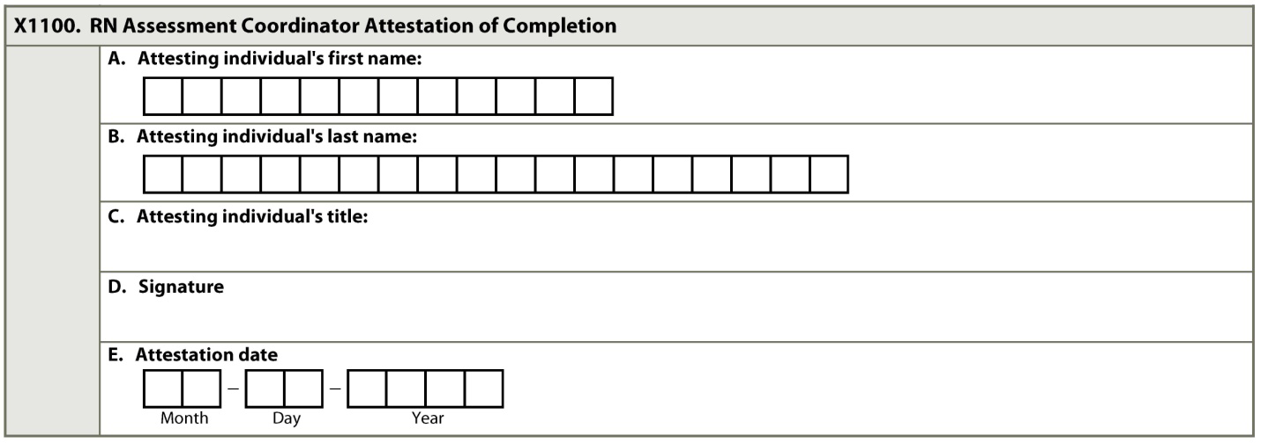
X1100: RN Assessment Coordinator
Attestation of Completion
Complete within 14 days of identification of errors

Slide 26
Questions?
I’ll take a few minutes to answer any questions you might have.

Slide 27
Thank you!!
Please feel free to contact me at any time.
Shirley L. Boltz, RN
RAI/Education Coordinator
785-296-1282
shirley.boltz@kdads.ks.gov

