Slide 1


SECTION V
CAA SUMMARY
January 21, 2016 1-3PM
Most Recent Prior Assessment
Type
ARD
BIMS Summary Score
Mood Interview Severity Score
CAA Results of Current Assessment

Slide 2
Objectives
Understand that the CAA forms a critical link between the MDS and decisions about care planning
Understand how to write a CAA and what resources are available in the RAI Manual
Understand what to do with the information put in the CAA

Slide 3
V0100: Items from Most Recent Prior Assessment

Slide 4
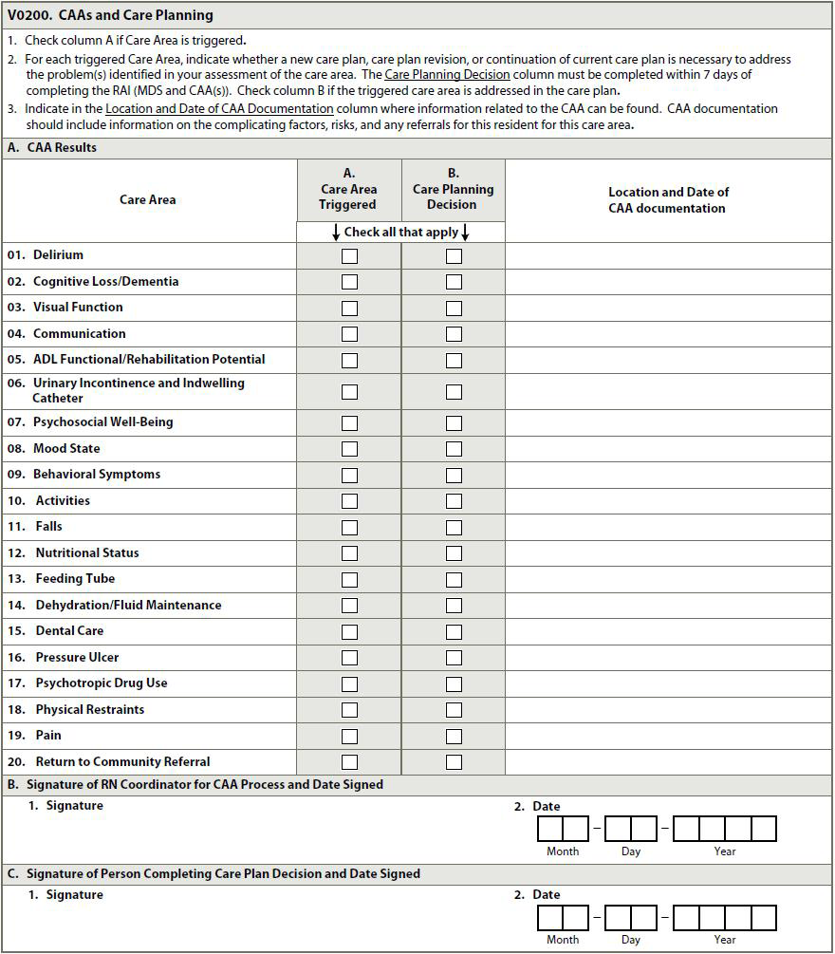
V0200: CAA
& Care Planning
Care Area
A.A. Care Area Triggered
A.B. Addressed in Care Plan
Location & Date of CAA information (in clinical record)
B.1. & 2. Signature of RN Coordinator of CAA Process & Date CAAs Completed
C.1. & 2. Signature of Person Facilitating Care Plan & Date Care Plan Completed

Slide 5
Completion
Comprehensive Assessment
V0200B2. Completion Date of CAAs
  No later than 14th day of
    Entry/Admission
    Determination of need for SCSA or SCPA
  Within 14 days of ARD of Annual Assessment
V0200C2. Completion Date of Care Plan
  Within 7 Days completion of CAAs
Transmission of MDS
  Within 14 days completion of care plan (V0200C2)

Slide 6
CHAPTER 4
CAA PROCESS
CARE PLANNING
Seamless circular process begins at admission
and continues until discharge

Slide 7
Care Area Assessment - Completion
Only Comprehensive OBRA Assessments
  Admission
  Annual
  Significant Change
  Significant Correction of one of the above assessments
Not required for Swingbed facilities

Slide 8

Care Areas
1. Delirium
2. Cognitive
Loss/Dementia
3. Visual Function
4. Communication
5. Activity of Daily
Living (ADL) Functional/
Rehabilitation Potential
6. Urinary Incontinence
& Indwelling Catheter
7. Psychosocial Well-Being
8. Mood State
9. Behavioral Symptoms
10. Activities
11. Falls
12. Nutritional Status
13. Feeding Tubes
14. Dehydration/Fluid
Maintenance
15. Dental Care
16. Pressure Ulcer
17. Psychotropic
Medication Use
18. Physical Restraints
19. Pain
20. Return to Community
Referral

Slide 9

Care Area Trigger(s)
Triggers need for further assessment
Care Area Indicator
  Actual Problem
  Potential Problem (At Risk)
  Rehab Candidate
  Not Problem
Triggered Care Area must be assessed
  may or may not warrant being care planning
Focus search for root cause of Care Area
MDS may not trigger every relevant issue

Slide 10
In-depth Assessment
CAA Tools and Resources
CMS does not mandate or endorse use of any particular resource(s) including those in Appendix C
Facility choice of tool or resource
  grounded in current standards of practice
  evidence based or expert endorsed research
  clinical practice guidelines
Adequate to guide thorough assessment of Care Area Condition

Slide 11

Care Area Assessment
Problem
1. Define or Describe the Care Condition or
Problem
Diagnosis
Physician/Consultant Exams, Diagnostic Tests
Nursing Assessments
Signs, Symptoms
    Resident Observation
    Resident & Staff Interview
  What exactly is the resident’s problem?

Slide 12
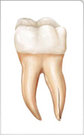


Care Area Assessment
Cause and Effect Analysis
2. Identify Cause and Effect of the Problem
    Root Cause
    Contributing factors
    Risk factors
    Complications affecting or
caused by care area
What is causing the problem?

Slide 13
Care Area Assessment
Cause and Effect Analysis
3. Determine effect or impact of the
Condition or Problem on the resident’s
physical, functional, psychosocial status.
Strengths & abilities to improve.
Why is it a problem for
the resident?

Slide 14

Care Area Assessment
Outcome
4. Decide Care Plan Objective
(a) Resolve Care Condition/Problem - Cause, Complication, Risks - when possible
(b) Minimize Effect/Impact of Condition/Problem - Cause, Complication, Risks

Slide 15
CAA Summary
DESCRIBE
Cause and contributing factor of Care Area Condition
Description of Condition
  What exactly is the issue/problem for this resident and Why is it a problem?
  Objective or Subjective Data
Physical, functional, and psychosocial strengths, problems, needs, deficits, and concerns related to the condition
Strengths and abilities that can improve or maintain current functional status
Complications affecting or caused by care area for resident

Slide 16
CAA Summary
DESCRIBE
Risk factors related to presence of condition that affect decision to care plan
Causes and contributing factors of resident’s resistance to care
Need for additional evaluation by physician or other health professional
Factors to consider in developing individualized care plan interventions.
Name of research, resource(s), or assessment tool(s) used CAA process
For triggered condition that does not warrant care planning: Why determined triggered condition not problem for resident?

Slide 17
CAA Summary
Accurately and comprehensively reflect resident’s status or condition:
  Identifies causal factors
  Risk or contributing factors for decline or lack of improvement
  Causes or contributing factors of any resistance to care
  Identifies strengths or abilities that can contribute to improvement

Slide 18
Chapter 4
Brief Overview of Condition
UI is …
Types …
Aging impact …
Is risk factor for complications …
Affect ….
Catheter Use… problem, risk

Slide 19
UI & Catheter Use Triggers
Triggering Conditions (any of the following):
1. ADL assistance for toileting was needed as
indicated by: G0110I1 >= 2 AND G0110I1 <= 4)
2. Resident requires an indwelling catheter as
indicated by: H0100A = 1
3. Resident requires an external catheter as indicated
by: H0100B = 1
4. Resident requires intermittent catheterization as
indicated by: H0100D = 1
5. Urinary incontinence has a value of 1 through 3
as indicated by: H0300 >= 1 AND H0300 <= 3

Slide 20
Brief Overview of Condition
Chapter 4 Cont.
Manage Condition:
  Identify underlying cause(s) of UI
  Reason for indwelling catheter
Why do you need to know?
  Reduce or eliminate incontinence episodes OR reason for catheter use
  If can’t -- manage to prevent complications
Need more information – Go back to Section/ Item in Manual read Health-related Quality of Life and Planning for Care

Slide 21
CMS Resource Appendix C
#16 Urinary Incontinence & Indwelling Catheter
Review of UI and Indwelling Catheters
Supporting Documentation
Modifiable Factors contributing to transitory UI
Other factors that contribute to UI or catheter use
Laboratory Tests
Disease and Conditions
Types of UI
Medications
Use of Indwelling Cath
Basis/reason for checking the item, including the location, date, source (if applicable) of that information
NOT JUST CHECK MARKS
NOT RESTATING MDS

Slide 22
Supporting Documentation
Critical Thinking
Focus on relationship of checked item to Care Area
  Sign & Symptom, Description
  Causal Factor
  Contributing Factor
  Risk Factor
  Affect on physical, mental, psychosocial, functional status
  Strength
  Preference

Slide 23
Input from resident and family/representative regarding the care area.
(Questions/Comments/Concerns/Preferences/Suggestions
Analysis of Findings
Review indicators and supporting documentation, and draw conclusion.
Document:
  Description of Problem
  Causes and contributing factors
  Risk factors related to care
Care Plan Considerations
Document reason(s) care plan will/will not be developed.
Care plan focus or objective
NOT Care Plan Interventions or CAA Summary
Referral(s) to another discipline(s) is warranted (to whom and why)

Slide 24
Analysis of Findings/CAA Summary
Care Planning
Identify and Address underlying causes of care area condition, contributing factors → develop individualized care plan
Objective, Goal, and Interventions to promote resident’s highest level of well-being of physical, mental, and psychosocial functioning
  Improve to extent possible
  Maintain current level
  Prevent decline to extent possible
    If at risk for decline minimize decline to extent possible
  Palliative care – Keep comfortable
Notes:
jde

Slide 25
Care Plan Development
Comprehensive and Individualized
Care Plan
Objective
Goal Statement
Problem
Interventions
Based on Assessment

Slide 26
Care Plan Development
INDIVIDUALIZE
Use information gathered as worked CAA & CAA Summary
  Care Area Condition, cause, contributing factors, risk, complication
  Resident’s needs, behaviors, characteristics, strengths, preferences
Input from resident and family
Standards of practice
Review current care plan to see if condition already addressed and revise if needed based on new assessment

Slide 27
Objective and Goal Statement
Reasonable Expected Outcome of Care
Quantifiable, Measureable with Time Frames
Improvement, Prevention, Maintenance, Palliative
Subject
  Who is expected to achieve goal? (Resident)
Verb
  What action must take place to achieve goal?
Modifier
  Under what circumstances is the action performed?
  How well or often must the action be performed
Time frame
What is the time period during which the action must be performed?
Goal
What is the reasonable expected outcome?

Slide 28
Objective and Goal Statement
Subject
  I
Verb
  will use the bedpan
Modifier
  before I get out of bed and when I return to bed
Time frame
for the next 4 weeks
Goal
  to decrease my incontinent episode to less than 3 per day & to reduce my embarrassment of being incontinent.

Slide 29
Select & Implement Interventions
Approaches to Achieve Objective/Goal Statement
INDIVIDUALIZE
Instructions to provide consistent care
Relieve or lessen
  cause or symptoms of condition
  limitations to physical, functional, or psychosocial functioning
Identify current treatment and services
  Monitor effectiveness & possible adverse consequences
Medication - Black Box Warnings

Slide 30
Select & Implement Interventions
Do not need to list all DX – S/S, Notify Dr.
  Standard of Practice
Protocols when same interventions for several residents
  Staff need to know location of protocols
  Identify resident-specific approaches different than protocol
Alternative to Refusals
Advanced care planning and palliative care
Resources – RAI Manual, Federal Regulation IG, QIS, Standards of Practice
WHO KNOWS THE CARE PLAN?

Slide 31
Care Plan Interventions
1. Give me the bedpan:
  when I wake up in the morning
  8 am
  before I get out of bed for lunch (11:30)
  when I go back to bed at 1:30
  after my afternoon nap (3:00 PM)
  before I to supper at 5:00 PM
  after I go to bed at 7:00 PM
  12 midnight.
2. Elevate the head of bed when you place me on the bed pan.
3. If I ask for the bedpan more frequently, take a few minutes to visit with me about my day and tell me how long it has been since I just used the bedpan. If I tell you I still need it, please let me use it.
4. When I am wet or had a BM cleanse my bottom with soap and water. Peri wash burns. Use the barrier cream in my top drawer.
5. Please offer me water when you come into my room, cappuccino at breakfast, and yogurt for an evening snack.

Slide 32
Monitor Progress
Evaluate Care Plan
Review progress toward goal
Identify if objectives achieved or condition worsened requiring revision
Evaluate response to interventions & treatments
Identify factors affecting progress towards achieving goals
Determine need to stop or modify interventions

Slide 33
Questions?
I’ll take a few minutes to answer any questions you might have.

Slide 34
Thank you!!
Please feel free to contact me at any time
Shirley L. Boltz, RN
RAI/Education Coordinator
785-296-1282
shirley.boltz@kdads.ks.gov

