Slide 1
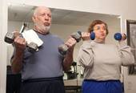

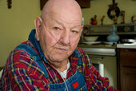
SECTION O
SPECIAL TREATMENTS, PROCEDURES and PROGRAMS
January 21, 2016 1-3PM

Slide 2
Objectives
Understands this section captures special treatments, procedures, and programs the resident received
Understand how to code Section O correctly
Understands which information from this section needs to be on the care plan

Slide 3
O0100: Special Treatments, Procedures, Programs
Review medical record for special treatments & programs received in 14 day look back period
Do not code services provided solely in conjunction with surgical procedure (including pre and post op) or diagnostic studies
Code treatments, procedures, programs, including those performed by staff or resident independently or after set-up help from staff

Slide 4
O0100: Special Treatments, Procedures, and Program

Slide 5
O0100: Special TX & Programs
All treatments received
Column 1.
Not a Resident
Column 2.
While a Resident
14 day look-back period
Prior to admission/entry or reentry
Leave Blank if admitted or reentered >14 days ago
Z. None of above
After admission/entry or reentry
14 day look-back period
Z. None of above
  Did not receive any of the treatments in 14 day look back period while a resident

Slide 6
O0100: Cancer Treatments
A. Chemotherapy
  Agent administered as antineoplastic by any route only for cancer treatment
  Long acting agents only if administered in look back period
B. Radiation
  Intermittent or via radiation implant

Slide 7
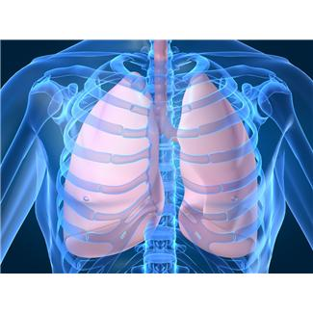
O0100: Respiratory
Treatments
C. Oxygen Therapy
    Continuous or intermittent oxygen administered to relieve hypoxia
    Oxygen used in BIPAP/CPAP
    Not hyperbaric oxygen for wound therapy
    Staff or resident placing or removing mask or cannula
D. Suctioning
    Only tracheal and/or nasopharyngeal suctioning
    Not oral suctioning
    Staff or resident performing suctioning

Slide 8
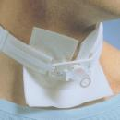
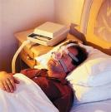
O0100: Respiratory Treatments
E. Tracheostomy
  Cleansing of trach and/or cannula
  Staff or resident performing care
F. Ventilator or respirator
  On vent or respirator or as being weaned off
  Not if used only in place of BIPAP or CPAP
G. BIPAP/CPAP
    Vent or respirator if used as BIPAP or CPAP
    Staff or resident placing or removing mask

Slide 9
O0100: Other
H. IV Medications
  Any med or biological given by IV push, epidural pump, or drip through a central or peripheral port
  Meds via epidural, intrathecal, and baclofen pumps
  Not:
      Saline or heparin flushes to keep heparin lock patent
      IV fluids without medication
      Subcutaneous pumps
      IV meds administered during dialysis or chemotherapy
      Dextrose 50% or Lactated Ringers

Slide 10
O0100: Other
I. Transfusions
Blood or any blood products (e.g., platelets, synthetic blood products), administered directly into bloodstream.
Not transfusions administered during dialysis or chemotherapy.
J. Dialysis
Peritoneal or renal dialysis at NH or
another facility
Staff or resident performing dialysis
K. Hospice
Medicare Certified Hospice provider
L. Respite Care
In facility 30 or less consecutive days to provide relief
to home-based care giver

Slide 11

O0100: Other
  M. Isolation for active infectious disease (does not include standard precautions)
    Active infection with highly transmissible or epidemiologically significant pathogens.
    Over & above standards precautions.
    Transmission based precautions (contact, droplet, and/or airborne)
    Alone in room due to active infection. No roommate. No cohorting.
    In private (single) room due to active infection
    Must remain in room. All services brought to Room
  Z. None of the Above

Slide 12
O0250: Influenza Vaccine
Flu season varies every year
  Check CDC websites & Local Health Depts.
Review medical record to determine:
  If received influenza vaccination
  Location vaccination administered
Ask resident if received influenza vaccine outside facility for year’s flu season
If resident unable to provide information, ask responsible party/legal guardian and/or primary care physician
Administer vaccination according to standards of clinical practice if vaccine status cannot be determined

Slide 13
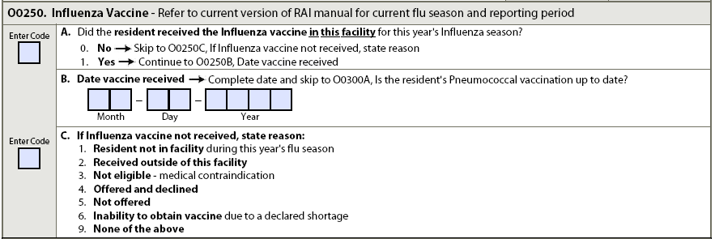
O0250A. Did Resident receive vaccine in facility for this year’s influenza season?
Once vaccine administered for current influenza season carry value forward until new season begins
Code 0. No. Did not receive vaccine in facility for this year’s flu season.
→Skip to Reason Item (O0250C)

Slide 14
O0250B. Date Vaccine Received
  mm-dd-yyyy
If date is unknown or information is not available, only a single dash needs to be entered in the first box

Slide 15
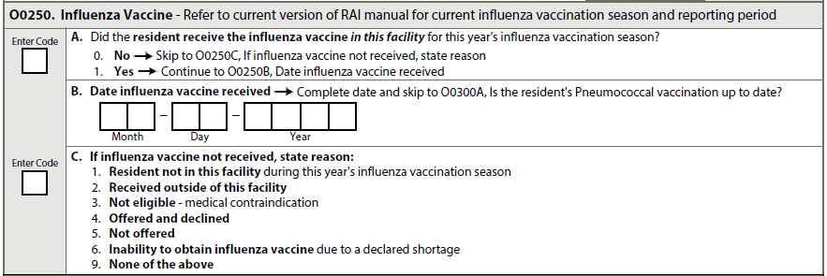
O0250C. If Influenza vaccine not received, state reason
Reason vaccine not administered in facility
Code 9. None of above or if reason unknown

Slide 16
Continued
The annual supply of inactivated influenza vaccine and the timing of its distribution cannot be guaranteed in any year. Therefore, in the event that a declared influenza vaccine shortage occurs in your geographical area, residents should still be vaccinated once the facility receives the influenza vaccine.
A “high dose” inactivated influenza vaccine is available for people 65 years of age and older. Consult with the resident’s primary care physician (or nurse practitioner) to determine if this high dose is appropriate for the resident.

Slide 17
O0300: Pneumococcal Vaccine
Review medical record to determine whether received PPSV
Ask resident
Ask responsible party/legal guardian and/or primary care physician if resident unable to answer
Administer vaccine according to standards of clinical practice if unable to determine PPSV status

Slide 18
O0300A. Is the resident’s Pneumococcal Vaccine up to date?
Code 0. No. PPSV status not up to date or cannot be determined.
  Proceed to 0300B. Reason
Code 1. Yes. PPSV status up to date.
  →SKIP to O0400 Therapies
Is the resident’s Pneumococcal Vaccination up to date?
0. No →Continue to O0300B. If Pneumococcal Vaccine not received, state reason
1. Yes → Skip to O0400, Therapies
If Pneumococcal Vaccine not received, state reason:
1. Not eligible – medical contraindication
2. Offered and declined
3. Not offered

Slide 19
O0300B. If vaccine not received, state reason
Code 1. Not eligible. Due to medical contraindications, including life-threatening allergic reaction to vaccine or any vaccine component(s) or physician order not to immunize.
Code 2. Offered and declined. Informed of what being offered and chooses not to accept vaccine.
Code 3. Not offered.

Slide 20
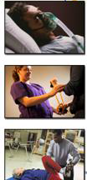
O0400: Therapies
Criteria:
  Medically Necessary & Reasonable
  Physician ordered (NP, PA, CNS)
  Qualified therapist assessment
  Treatment plan
  Documented
  Care planned
  Periodically evaluated

Slide 21
O0400: Non-Skilled Services
Do not Code
Therapy provided at request of resident or family that not medically necessary
Services provided by therapy aide
Maintenance treatments or supervision of aides performing maintenance services
  Consider for Restorative Nursing Care

Slide 22
O0400: Therapies
7 day look-back period, while resident
Skilled Therapy – Medicare A & B
A. Speech-Language Pathology and
Audiology
B. Occupational
C. Physical
D. Respiratory
E. Psychological
F. Recreation

Slide 23
O0400: Therapies
Mode of Therapy
  1. Individual
  2. Concurrent
  3. Group
Total number of Minutes in each Mode of therapy
Number of Days of therapy
Start Date and End date of each therapy

Slide 24
O0400: Therapy
Individual (Medicare A & B)
  One therapist/assistant treating only one resident
  Resident receives therapist/assistant’s full attention
Concurrent (Medicare Part A)(Can’t do for Part B)
  Two residents treated at same time
  Not performing same or similar activities
  Both residents must be in line-of-sight of treating therapist or assistant

Slide 25
O0400: Therapy - Modes
Group (Medicare Part A)
  Treatment of 4 residents, regardless of payer source
  Performing same or similar activities,
  Supervised by therapist/assistant not supervising any other individuals
Group (Medicare Part B)
  Treatment of 2 or more residents simultaneously
  May or may not be performing same activity

Slide 26
O0400 Therapies (continued)
Co-treatment (Part A) – two different disciplines treat one resident at the same time with different treatments. Code the treatment session in full. The need for co-treatment should be well documented for each resident.
Co-treatment (Part B) – cannot bill separately for the same or different service provided at the same time.

Slide 27
O0400: Time Determination - Minutes
Starts when resident begins first treatment
activity or task
Ends when resident finishes last apparatus
or activity or task
Actual minutes – no rounding
Software will calculate for payment

Slide 28
O0400: Number of Days, Start Date
Day = At least total of 15 minutes
  May be provided at different times, e.g. 5 minutes in morning, 10 minutes in afternoon
    Individual + Concurrent + Group Minutes
Start Date
  First date therapy regimen started since most recent admission/entry or reentry
  If more than one therapy discipline use date first discipline began
  Look at A1600 Date (Admission/Entry or Reentry)
    Determine if had skilled therapy since that date to present date – Enter date of that therapy.
  If EOT-R – Use that date on next assessment as the Therapy Start Date

Slide 29
O0400: End Date
End Date
  Last date of most recent therapy regimen since most recent admission/entry or reentry
  Enter “dashes” if still ongoing beyond ARD
  If EOT-R & therapy still ongoing – enter “dashes”
Ongoing
  Resident discharged & therapy was planned to continue if resident had remained in facility
  SNF benefit exhausted & therapy continued
  Payer source changed and therapy continued

Slide 30
O0400A. SLP & Audiology; O0400B. Occupational
O0400C. Physical

Slide 31
O0420. Distinct Calendar Days of Therapy.
  Record the number of calendar days that the resident received Speech-Language Pathology and Audiology Services, Occupational Therapy, or Physical Therapy for at least 15 minutes in the past 7 days.
Watch manual for guidance, will likely impact RUGS – 5 Distinct Days of Therapy required to qualify for Skilled Therapy.
Example:
  OT & PT - M, W, F = 3 Distinct Days
  OT - M, W, F & PT - T, Th, S = 6 Distinct Days

Slide 32
O0420. Distinct Calendar Days of Therapy

Slide 33
O0450: Resumption of Therapy
EOT OMRA completed AND
Therapy resumed within five calendar days after last day of therapy was provided AND
Therapy services resumed at same level for each discipline
Code 0. No. →Skip to O0500, Restorative
Nursing Programs
B. Date on which therapy regimen resumed

Slide 34
Restorative Nursing Program Criteria
Measureable objective and interventions documented in care plan and medical record
Evidence of periodic evaluation by licensed nurse in medical record
Nursing assistants/aides trained in techniques
Licensed nurse as supervisor
No more than 4 residents per 1 staff

Slide 35
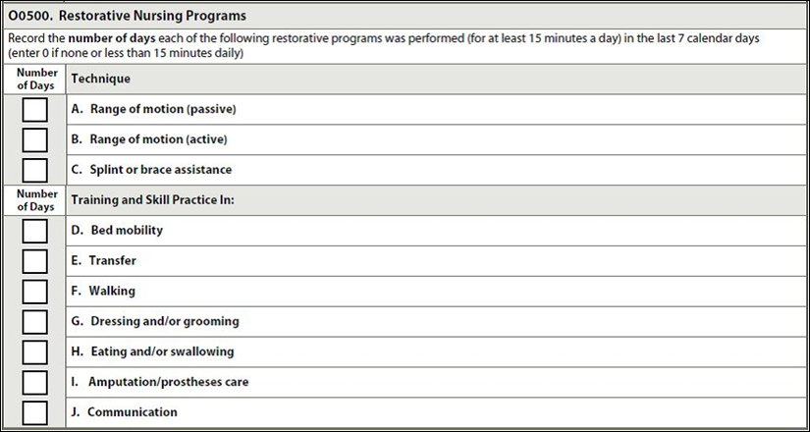
O0500. Restorative Nursing Program
(O-32-37)

Slide 36
O0600: Physician Examinations
Number of days during 14 day look-back period (or since admission, if <14 days ago) physician’s
progress notes reflect physician examined resident
Evaluation – partial or full exam, monitor resident
response to treatment, adjust treatment as result of
exam
Can occur in facility, physician’s office, dialysis, telehealth
Do not include exams during emergency room visit or hospital observation stay, prior to admission/reentry

Slide 37

O0700: Physician Orders
Number of days during 14 day look-back period (or since admission, if <14 days ago) physician (APRN, PA, CNS) changed orders, includes written, telephone, fax, or consultation orders for new or altered treatment
Do not include Orders:
  Standard admission, return admission, renewal or clarifications without changes
  Prior to date of admission/ reentry
  Transfer of care to another physician
  Use of different doses on sliding scales
  Notification PRN activated
  Medicare Certification/Recertification

Slide 38
Care Plan Considerations
Address any special treatments, procedures, and programs with care required, equipment used, complications to monitor for
Specify which therapies are involved and what treatments they are providing
Include Restorative Nursing programs being given
The care plan needs to be updated with each new physician order

Slide 39
Questions?
I’ll take a few minutes to answer any questions you might have.

Slide 40
Thank you!!
Please feel free to contact me at any time
Shirley L. Boltz, RN
RAI/Education Coordinator
785-296-1282
shirley.boltz@kdads.ks.gov

