Slide 1
Section M: Skin Conditions
January 19, 2016 1-3PM
PU Risk, Presence, Stage, Appearance
Skin Ulcers, Wounds, Lesions, Treatments

Slide 2
Objectives
Understands this section documents the risk, presence, appearance, and change of pressure ulcers, other skin ulcers, wounds, lesions, and treatment categories
Understands how to code Section M correctly
Understands what needs to be on the care plan

Slide 3
10-1-2015 Changes
If a resident had a pressure ulcer that healed during the look-back period of the current assessment, but there was no documented pressure ulcer on the prior assessment, code 0. Page M-5
A pressure ulcer with intact skin that is a suspected deep tissue injury (sDTI) should not be coded as a Stage 1 pressure ulcer. It should be coded as unstageable, as illustrated at http://www.npuap.org/wp-content/uploads/2012/03/NPUAP-SuspectDTI.jpg. Page M-6

Slide 4
National Pressure Ulcer Advisory Panel
CMS adopted NPUAP 2007 definition of pressure ulcer as well as categories/staging
Pressure Ulcer
  localized injury to skin and/or underlying tissue usually over bony prominence, as a result of pressure or pressure in combination with shear and/or friction

Slide 5
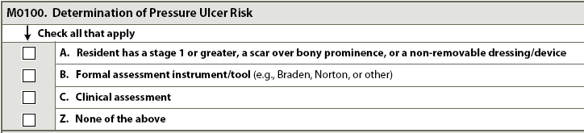
M0100: Determination of
Pressure Ulcer Risk
  A. Stage 1 or greater, scar over boney
  prominence, or a non-removable
  dressing/device
  B. Formal Assessment Instrument or Tool
  C. Clinical Assessment, including physical examination of skin and review of health conditions

Slide 6
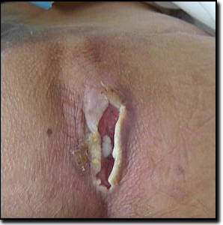
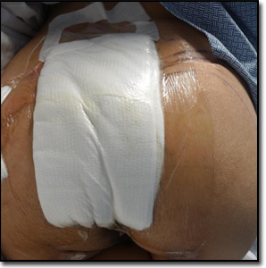
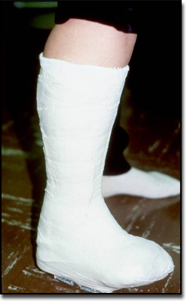
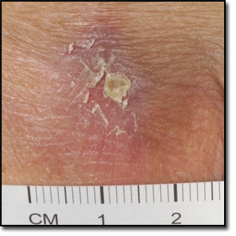
M0100A. PU Stage 1 or greater, scar over boney prominence, non-removable dressing or device
Existing
Pressure
Ulcer
Non - Removable
Dressing
Non – Removable
Device
Healed (Closed)
Pressure Ulcer
Notes:
6

Slide 7
M0100B. Formal Assessment Instrument/Tool
Braden Scale©
Other
M0100C. Clinical Assessment
Head to Toe assessment
Diseases
Medications
Impaired blood flow
Refusal of care/treatment
Cognitive impairment
Incontinence
Poor nutrition/hydration
Healed PUs which are more likely to re-open

Slide 8
M0150: Risk of Pressure Ulcers
Based on M0100 A, B, C -- Is resident at risk of developing pressure ulcers?
  Code 1. Yes. Resident at risk of developing pressure ulcers based on information gathered in M0100

Slide 9
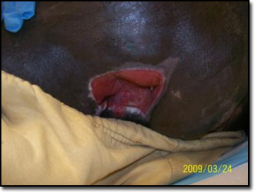
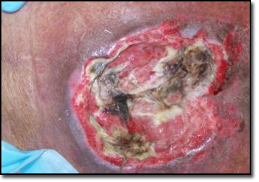
M0210: Unhealed Pressure Ulcers
Stage 1 or higher
Does resident have one or more unhealed PU at Stage 1 or higher? Do not code oral mucosal ulcers here.
  Code 0. No →Skip to M0900. Healed Pressure Ulcers .
Notes:
9
9

Slide 10
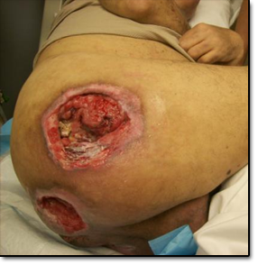
M0300A-G. Key Steps For Completion
Determine:
Deepest anatomical stage of each pressure ulcer, wound bed only partially covered and depth is visualized, numerically stage the ulcer OR
2.Unstageable pressure
ulcer (Visualization of the wound bed is necessary for accurate staging) (DTI is unstageable) (Known PUs covered w/ non-removable drsg/device are unstageable)
3.Pressure ulcer “present
on admission/entry or
reentry”
Notes:
10
10

Slide 11
Step 1.
Deepest Anatomical Stage
Stage 1, 2, 3, 4
Deepest, visible or palpable anatomical level of ulcer base
  depth of tissue layers or palpable bone involved
No reverse or back staging
  If ever classified at deeper stage, classification remains at deeper stage

Slide 12
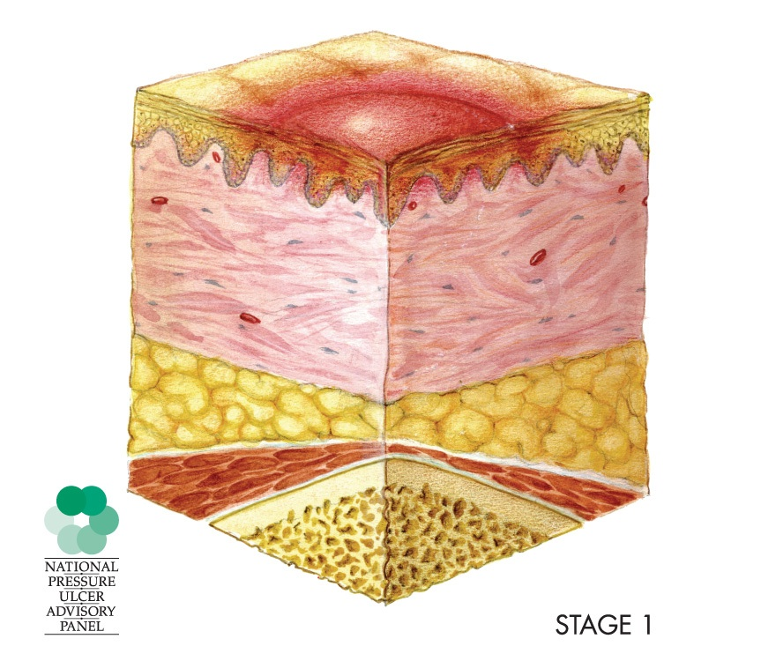
Stage I
Epidermis
Dermis
Adipose Tissue
Muscle
Bone
Epidermis affected

Slide 13
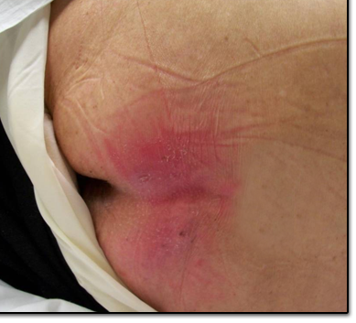
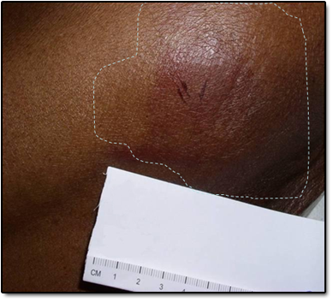
Stage 1
Intact skin with non-blanchable redness of
localized area usually over bony prominence
Darkly pigmented skin may not have visible blanching
  Color & temperature may differ from surrounding area.

Slide 14
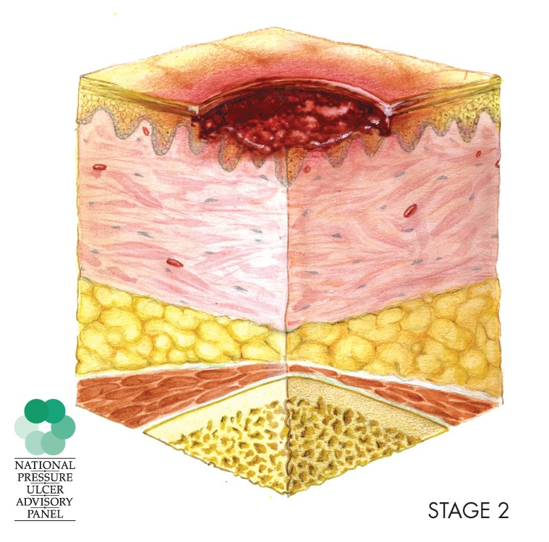
Stage 2
Epidermis
Dermis
Adipose Tissue
Muscle
Bone
Dermis Involved

Slide 15
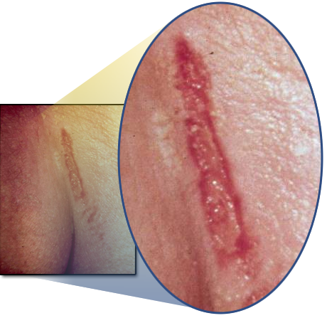
Stage 2
Partial thickness loss of dermis presenting as:
  Shallow open ulcer
  Red or pink
  wound bed
  Without
  slough

Slide 16
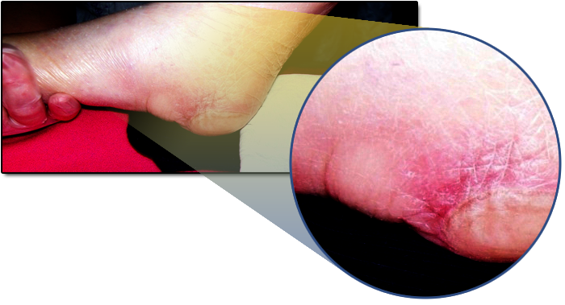
Stage 2
Intact or open/ruptured blister
If tissue adjacent to, or surrounding, blister shows signs of tissue damage, e.g. color change, tenderness, bogginess, firmness, warmth or coolness consider suspected deep tissue injury (sDTI)

Slide 17
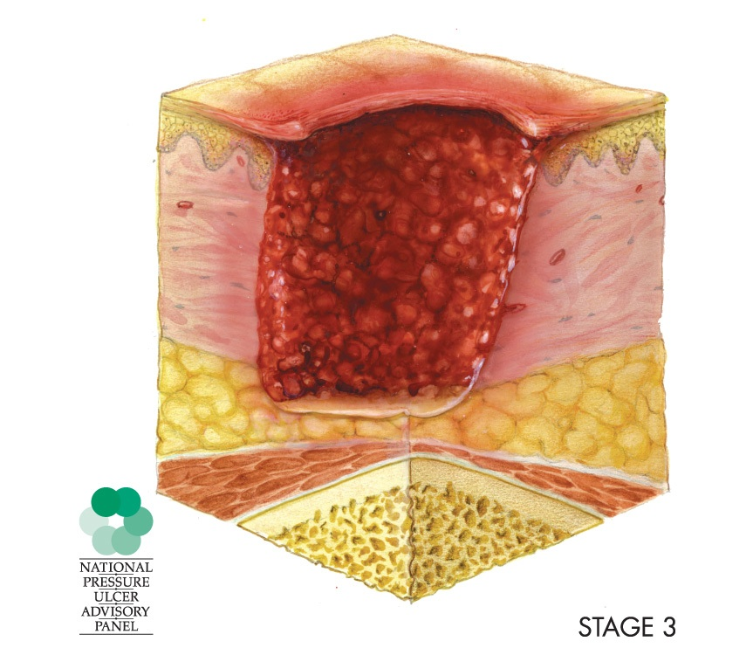
Stage 3
Epidermis
Dermis
Adipose Tissue
Muscle
Bone
Adipose Tissue affected

Slide 18
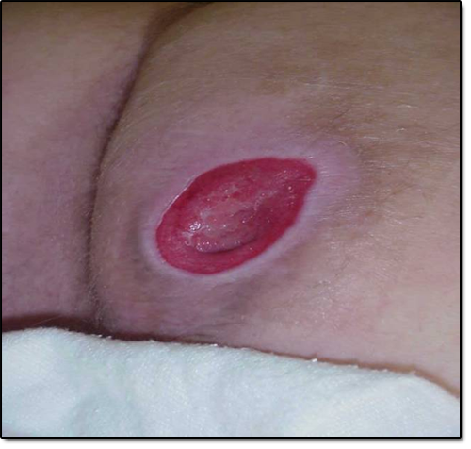
Stage 3
Full thickness tissue loss
Subcutaneous fat may
be visible but bone,
tendon or muscle
not exposed
Slough may be present
but does not obscure
depth of tissue loss
May include undermining and tunneling

Slide 19
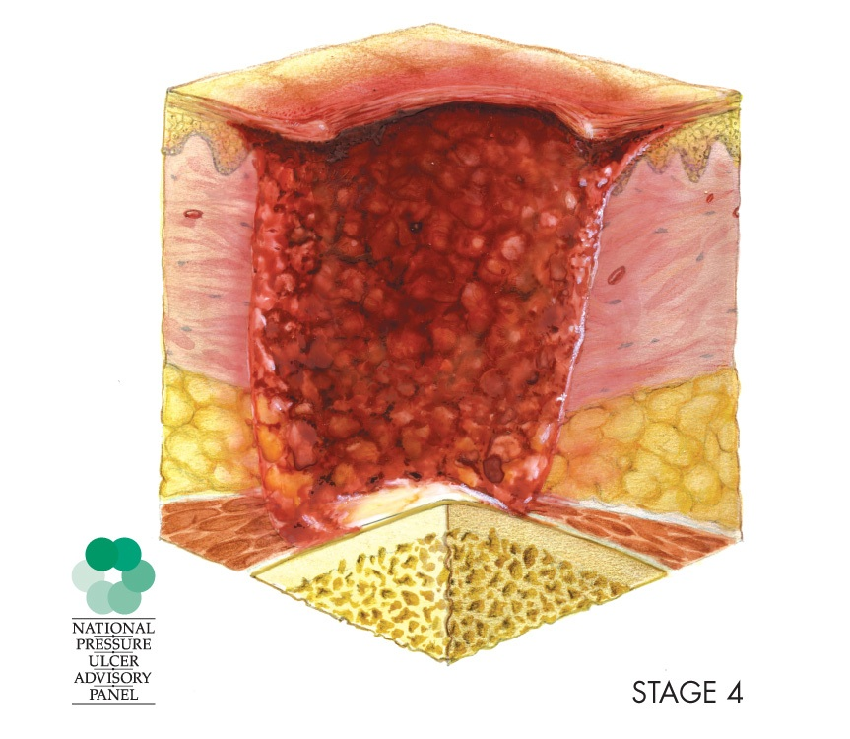
Stage 4
Epidermis
Dermis
Adipose Tissue
Muscle
Bone
Muscle and Bone affected

Slide 20
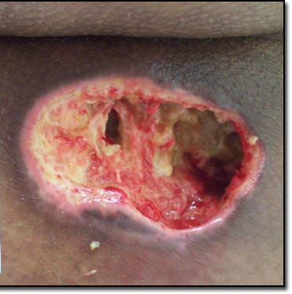
Stage 4
Full thickness tissue loss with exposed bone, cartilage, tendon,
or muscle
Slough or Eschar
may be present on
some parts of wound
bed
Often includes
undermining and
tunneling
Depth varies by anatomical location (bridge of nose, ear, occiput, and malleolus ulcers can be shallow)

Slide 21
Step 2.
Unstageable
Ulcer present but wound bed covered
Non-removable dressings/device
Slough and/or Eschar
Suspected deep tissue injury (sDTI)

Slide 22
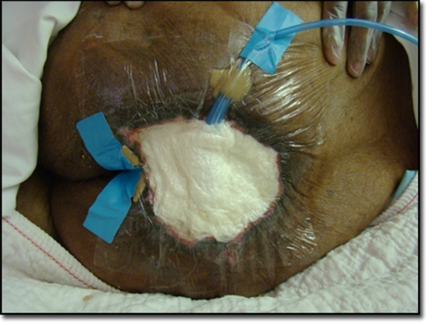
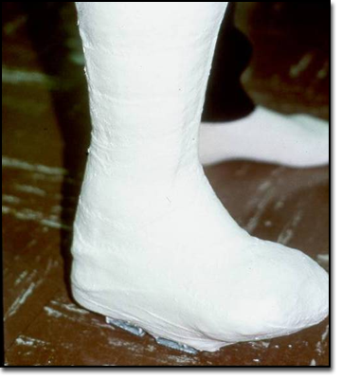
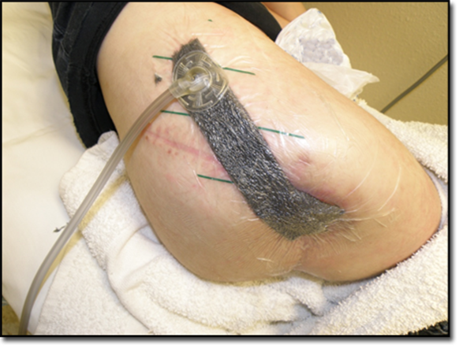
Unstageable
Non-Removable Dressing/Device
Known PU but not stageable due to being covered by a primary surgical dressing that cannot be removed, orthopedic device, or cast.

Slide 23
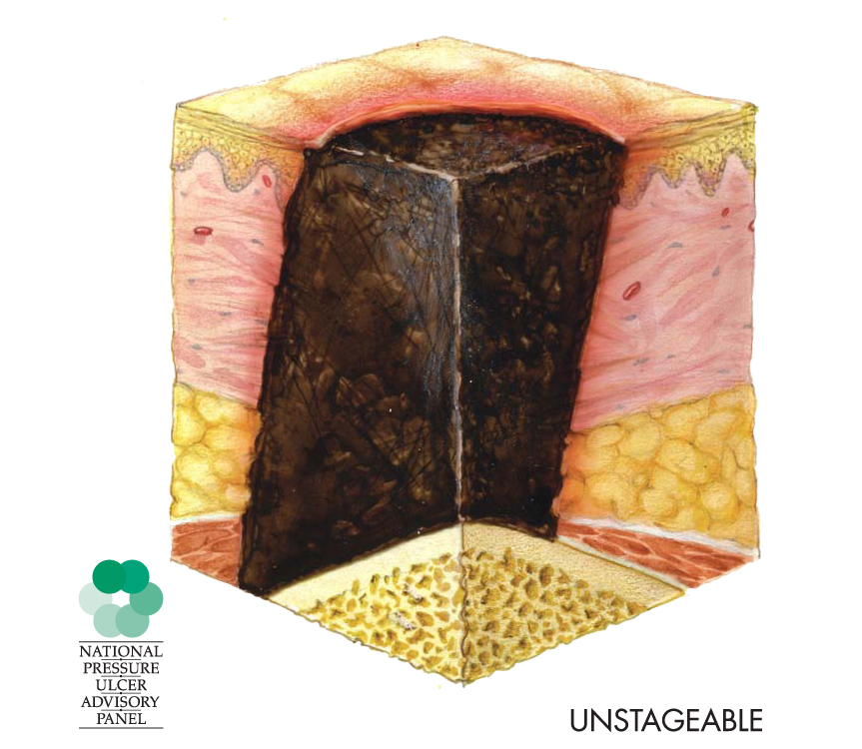
Unstageable
Slough and/or Eschar
Epidermis
Dermis
Adipose Tissue
Muscle
Bone

Slide 24
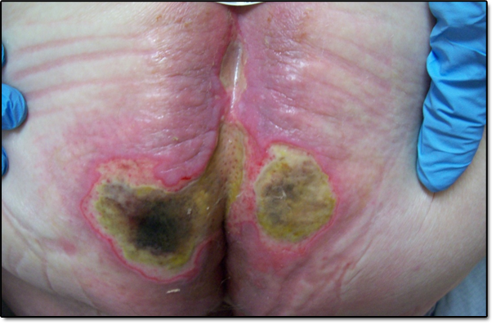
Unstageable
Slough and/or Eschar
Base of ulcer covered
  slough (yellow, tan,
  gray, green or brown)
  and/ or
  Eschar (tan,
  brown or black) in
  wound bed
Notes:
24
24

Slide 25
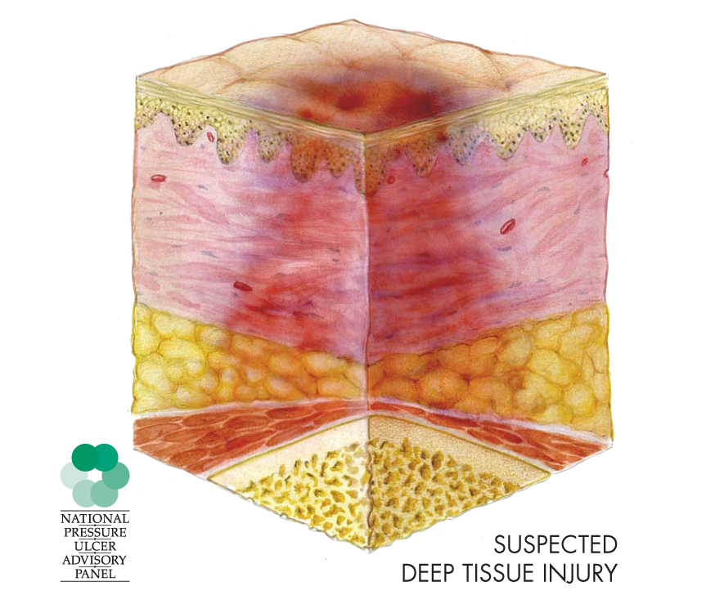
Unstageable
Suspected Deep Tissue Injury
Epidermis
Dermis
Adipose Tissue
Muscle
Bone

Slide 26
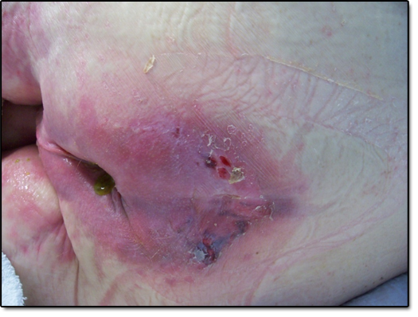
Unstageable
Suspected Deep Tissue Injury
Localized area of discolored (darker than surrounding tissue) intact skin
Related to damage of
underlying soft tissue from
pressure and/ or shear
Area of discoloration may
be preceded by tissue that
is painful, firm, mushy,
boggy, warmer or cooler as
compared to adjacent tissue
May be difficult to detect in individuals with dark skin tones

Slide 27
Step 3.
Present on Admission/Entry or Reentry
Examine resident at admission/entry and
reentry
Review transfer & admission records
Coding determination:
  Setting when PU first occurred
  Setting where stage of PU increased

Slide 28
Pressure Ulcer Examples
PU present upon resident’s admission to facility
Code
Present on Admission/Entry or Reentry
Res. acquired PU in facility
Do NOT code
Present on Admission/Entry or Reentry

Slide 29
Pressure Ulcer Examples
PU present upon resident’s admission/ entry or reentry
PU increases in Numerical Stage in facility
Code PU at that higher stage & Do NOT code “Present on Admission/ Entry or Reentry”
PU unstageable upon resident’s admission/entry or
reentry
PU becomes stageable
Code
“Present on Admission/Entry or Reentry” at first Numerical Stage became stageable
If Numerical Stage later increases, code PU at higher stage & Do NOT code as “Present on Admission/ Entry or Reentry”

Slide 30
Pressure Ulcer Examples
Res. acquired PU in facility
Res. hospitalized & PU Numerical Stage or US remains same
When Res. returns to facility
Do NOT code PU “Present on Admission/Entry or Reentry”
Res. acquired PU in facility
When Res. returns to facility
code PU
“Present on Admission/Entry or Reentry”
Res. Hospitalized & PU Numerical Stage increased

Slide 31
Pressure Ulcer Examples
Res. has PU when admitted to facility
Res. Hospitalized & PU Stage/US remains same
When Res. returns, Do NOT code PU “Present on Admission/ Entry or Reentry”
Res. has PU when admitted to facility
Res. Hospitalized & Numerical PU stage increases
When Res. returns,
code PU “Present on Admission/Entry or Reentry”

Slide 32
M0300A. Number of
Stage 1 Pressure Ulcers
Current Number of Unhealed PU
at Each Stage.

Slide 33
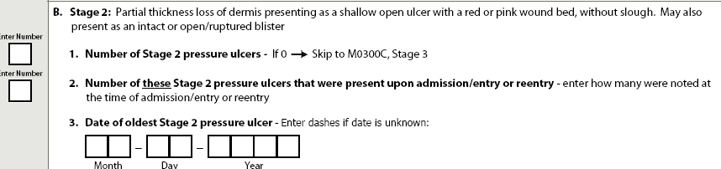
M0300B. Stage 2 Pressure Ulcers
Number
  If 0 → Skip to M0300C. Stage 3
Number of these PU present upon admission/ entry or reentry
  First noted at time of admission/entry or reentry
  Acquired or increased in stage during hospital stay if being readmitted
Date of oldest - If unknown “-” dash

Slide 34
M0300C. Stage 3 Pressure Ulcers
Number
  If 0 → Skip to M0300D. Stage 4
Number of these PU present upon admission/entry or reentry
  First noted at time of admission/entry or reentry
  Acquired or increased in stage during hospital stay if readmitted

Slide 35
M0300D. Stage 4 Pressure Ulcers
Number
  If 0 → Skip to M0300E. Unstageable:
      Non-removable dressing/device
Number of these PU present upon admission/ entry or reentry
  First noted at time of admission/entry or reentry
  Acquired or increased in stage during hospital stay if being readmitted

Slide 36
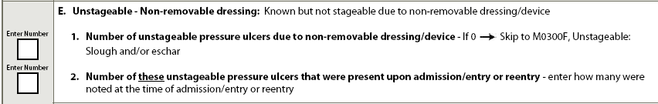
M0300E. Unstageable Pressure Ulcer
Non-Removable Dressing/Device
Number
  If 0 →Skip to M0300F, Unstageable: Slough
  and/or Eschar
Number of these PU present upon admission/ entry or reentry
  First noted at time of admission/entry or
  reentry
  Acquired during hospital stay if being
  readmitted

Slide 37
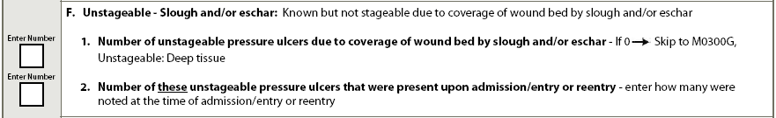
M0300F. Unstageable Pressure Ulcer
Slough and/or Eschar
Number
  If 0 →Skip to M0300G: Deep tissue injury
Number of these PU present upon
admission/ entry or reentry
  First noted at time of admission/entry or reentry
  Acquired during a hospital stay

Slide 38
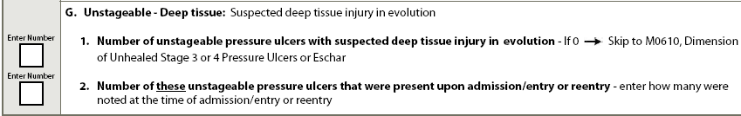
M0300G. Unstageable Pressure Ulcer Suspected Deep Tissue Injury
Number
  If 0 → Skip to M0610, Dimension
Number of these PU present upon admission/entry or reentry
  First noted at time of admission/entry or
  reentry
  Acquired at hospital if readmitted

Slide 39
Example #1
A pressure ulcer described as a
Stage 2 was noted and documented in the resident’s medical record at time of admission.
On a later assessment, the wound is noted to be a full thickness ulcer and is now a Stage 3 pressure ulcer.
How would you code this Pressure Ulcer?
M0300C.1. Number of Stage 3 = 1
M0C00C.2. Number “Present on admission/entry or re-entry” = 0

Slide 40
Example #2
A resident develops a Stage 2 pressure ulcer while at the nursing facility.
The resident is hospitalized due to pneumonia for 8 days.
The resident returns with a Stage 3 pressure ulcer.
How would you code this PU?
M0C00C1. Number of Stage 3 PU = 1
M0C00C2. Number “Present on admission/entry or re-entry” = 1

Slide 41
Example #3
A pressure ulcer on the resident’s sacrum was present
on admission and was 100% covered with black Eschar.
On the admission assessment, it was coded as Unstageable and “present on admission/entry or reentry”.
The pressure ulcer is later debrided using conservative methods, and after 4 weeks, the ulcer has 50% to 75% Eschar present.
The assessor can now see that the damage extends down to the bone.
How would you code the PU?
M0300D.1. Number of Stage 4 = 1
M0300D.2. Number “present on admission/entry or reentry” = 1

Slide 42
Example #4
Miss J. was admitted with one small Stage 2 pressure ulcer.
Despite treatment, it is not improving.
In fact, it now appears deeper than originally observed.
The wound bed is covered with slough.
How would you code?
M0300F.1. Number of Unstageable
due to Slough or Eschar = 1
M0300F.2. Number “Present on admission/entry or reentry” = 0

Slide 43
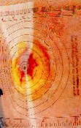
M0610: Dimension of Unhealed PU Stage 3 or 4 or US d/t Slough or Eschar
Measure every PU:
  Stage 3 (non-epithelialized)
  Stage 4 (non-epithelialized)
  Unstageable due to Slough
  Unstageable due to Eschar
Identify one PU with largest surface area

Slide 44
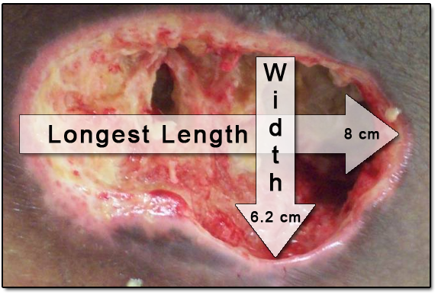
M0610: Dimensions of Unhealed PU
Stage 3, 4, or Unstageable d/t Slough and/or Eschar
A. Length
  Longest length from head to toe
B. Width
  Greatest width, side to side perpendicular (90° angle) to length
HEAD
Notes:
44
44

Slide 45
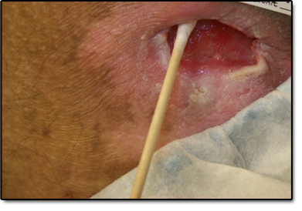
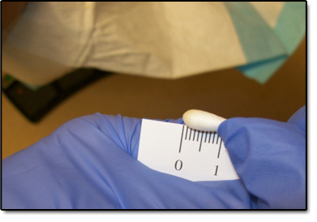
M0610C. Depth
Moisten a sterile, cotton-tipped applicator
with 0.9% sodium chloride (NaCl) solution
Place applicator tip in deepest aspect of
wound and measure distance to the skin level

Slide 46
M0610: Dimensions of Unhealed PU
Stage 3 or 4 or Slough or Eschar
  Dimensions of largest PU in centimeters
    A. Length; B. Width; C. Depth
  “-” when depth unknown d/t slough or Eschar

Slide 47
M0700: Most Severe Tissue Type for Any Pressure Ulcer
Type(s) of most severe tissue in wound bed
Code most severe tissue type if wound bed covered with mix of different types of tissue
Notes:
47
47

Slide 48
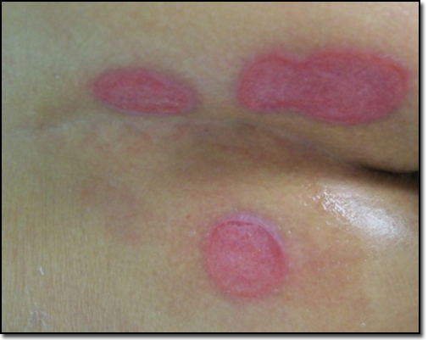
1. Epithelial Tissue
New skin that is light pink and shiny (even in person’s with darkly pigmented skin)
Notes:
48
48

Slide 49
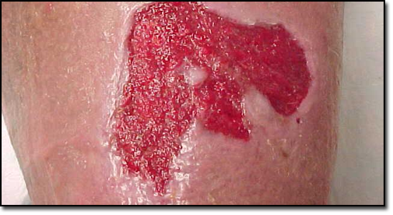
2. Granulation Tissue
GRANULATION TISSUE - Red tissue with “cobblestone” or bumpy appearance, bleeds easily when injured
Notes:
49
49

Slide 50
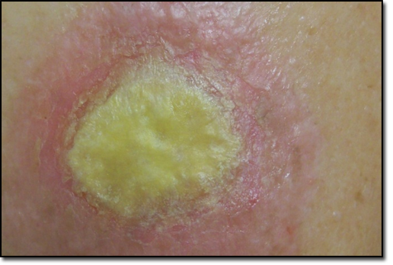
3. Slough
Non-viable yellow, tan, gray, green or brown tissue; usually moist, can be soft, stringy and mucinous in texture. Slough may be adherent to base of wound or present in clumps throughout wound bed
Notes:
50
50

Slide 51
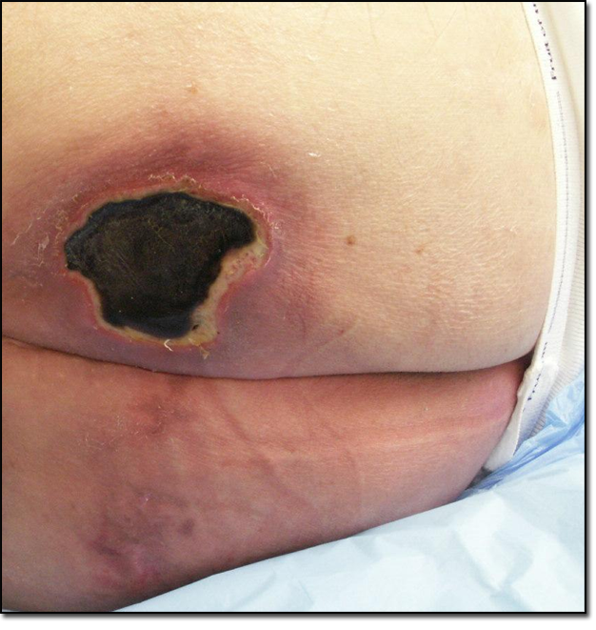
4. Eschar
Dead or devitalized tissue that is hard or soft in texture; usually black, brown, or tan in color and may appear scab-like. Necrotic tissue and Eschar usually firmly adherent to base of wound and often sides/edges of wound
Notes:
51
51

Slide 52
M0700: Most Severe Tissue Type
9. None of the Above
  Wound bed cannot be visualized & therefore cannot be assessed
    Stage 1 PU
    Stage 2 PU with intact blister
    Unstageable PU – non-removable dressing/device
    Unstageable PU – Suspected DTI

Slide 53
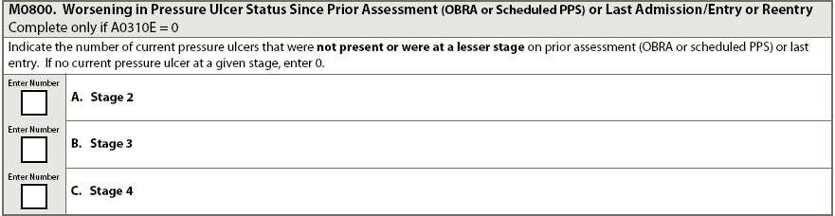
M0800: Worsening PU Status Since Prior Assessment (OBRA or Scheduled PPS) or Last Admission/Entry or Reentry
Look-back period back
  ARD of current assessment to ARD of prior assessment
Number of PU at Stage 2, 3, or 4
  Not present on prior assessment
  Increased in stage at facility since prior assessment
Code “0”, If no new PU or worsened PU
Notes:
53
53

Slide 54
M0800: Worsening PU Status Since Prior Assessment (OBRA or Scheduled PPS) or Last Admission/Entry or Reentry
Do NOT code as worsened/increased in numerical stage:
  PU acquired at hospital (unless later increases in numerical stage in facility)
  PU acquired at facility & increased in numerical stage during hospitalization
  Previously numerically staged PU that no longer can be numerically staged due to slough or Eschar
  Two pressure ulcers that merge, unless there is an increase numerical stage

Slide 55
M0800: Worsening PU Status Since Prior Assessment (OBRA or Scheduled PPS) or Last Admission/Entry or Reentry
Do not Code as worsened/increased in numerical stage
  PU that could not be numerically staged on admission/entry or reentry when it first becomes numerically staged. (If increases later in numerical stage, then code as worsened)
Do Code as worsened/increased in numerical stage
    Previously numerically staged PU could not be numerically staged d/t to slough or Eschar, then is debrided. Compare numerical stage before & after debridement. If numerical stage increased, code as worsened

Slide 56
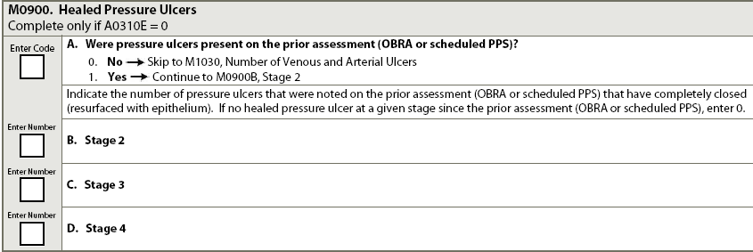
M0900: Healed Pressure Ulcers
Were PU present on prior assessment (OBRA or scheduled PPS)? If no prior assessment, skip this item.
  Look back period – ARD of current assessment to ARD of previous assessment
Number at each stage present on prior assessment and now healed
Do not count PU occurred & healed between assessments
Notes:
56
56

Slide 57
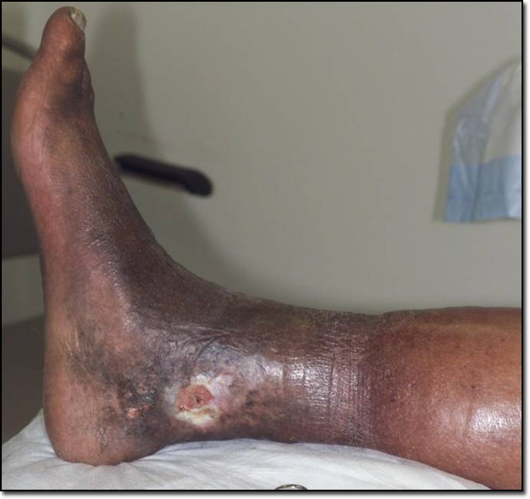
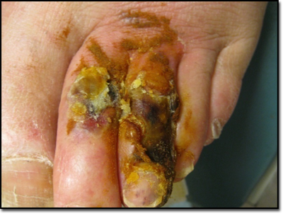

M1030: Number of Venous and Arterial Ulcers
Total number of both types of ulcers
Venous Ulcer
Arterial Ulcer
Notes:
57
57

Slide 58
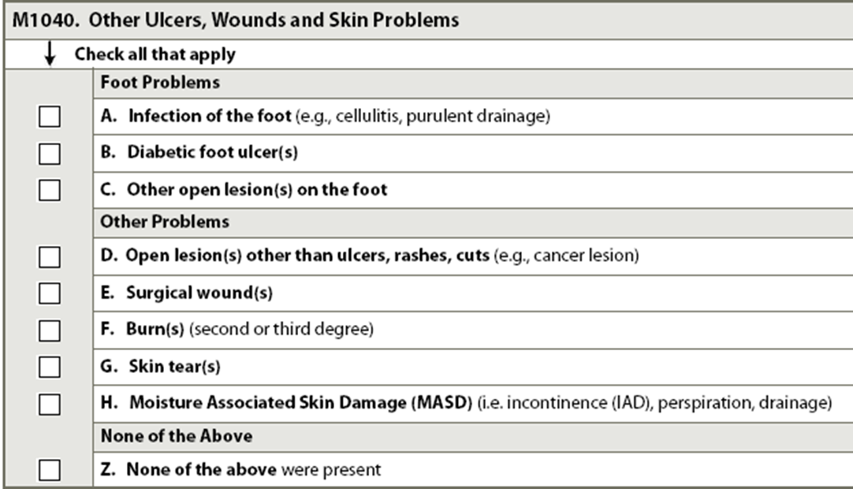
M1040: Other Ulcers, Wounds and
Skin Problems
Check all present in 7 day look back period
Do not code PU coded in M0200-M0900

Slide 59
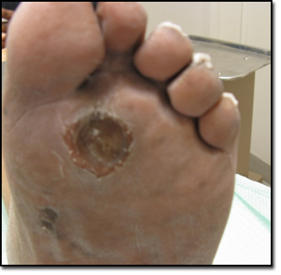
B. Diabetic Foot Ulcers
Ulcers caused by neuropathic and small blood vessel complications of diabetes. Diabetic foot ulcers typically occur over plantar (bottom)
surface of foot on load bearing areas such as ball of foot.
Notes:
59
59

Slide 60
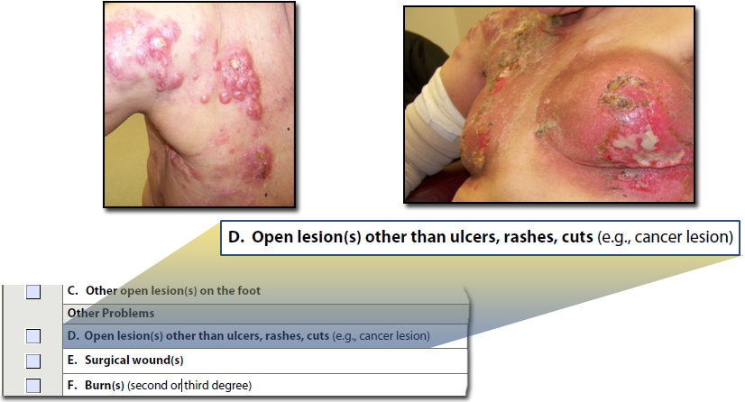
D. Open Lesions Other than Ulcers, Rashes, Cuts
Most typically skin ulcers that develop as result of diseases and conditions such as syphilis and cancer
Notes:
60
60

Slide 61
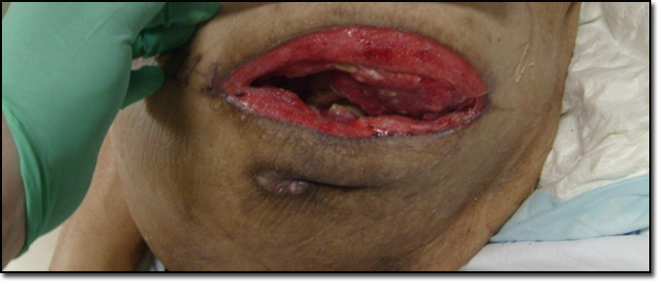
E. Surgical Wounds
Any healing & non-healing, open or closed surgical incisions, skin grafts, or drainage sites.
Failed Flap
Do not include healed surgical sites, healed stomas or lacerations, or debrided PU.
Notes:
61
61

Slide 62
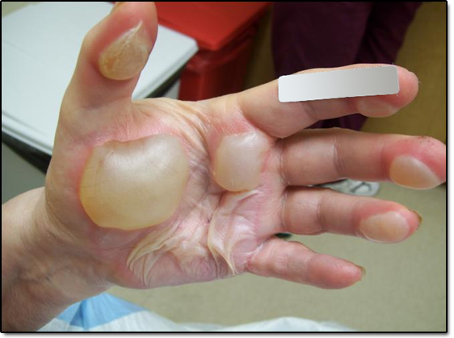
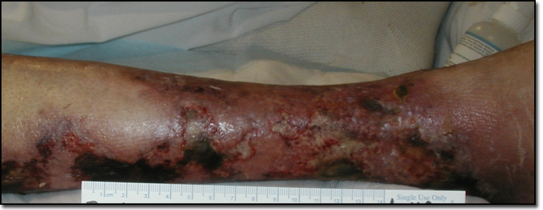
F. Burns
Second or third degree-skin and tissue injury caused by heat or chemicals and may be in any stage of healing
Notes:
62
62

Slide 63
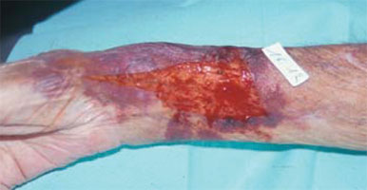
G. Skin Tear(s)
Result of shearing, friction or trauma to skin that causes separation of skin layers.
Partial or full thickness.
Code all skin tears in this item, even if already coded in Item J1900B.

Slide 64
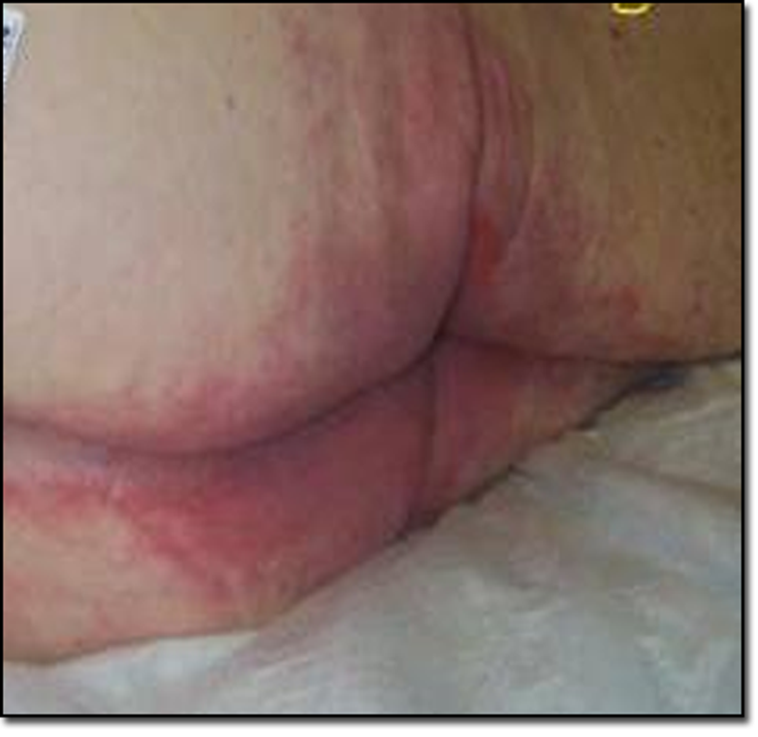
H. Moisture Associated Skin Damage
MASD
Skin Damage cause by sustained moisture rather than pressure, e.g. incontinence, wound exudate, perspiration.
Includes intertriginous dermatitis, periwound & perisotomal moisture-associated dermatitis,

Slide 65
M1200: Skin and Ulcer Treatment
All that apply in 7 day look back period.
Z. None of above provided.
Ankle not part of
foot
Notes:
65
65

Slide 66
M1200: Skin and Ulcer Treatments
Non-Surgical Dressings – do not include bandaids
Pressure-relieving devices do not include:
  Egg crate cushions of any type
  Doughnut or ring devices in chairs
Turning/repositioning program
  Specific approaches for changing resident’s position and realigning body
  Specify intervention and frequency
Nutrition and hydration – Documentation needed
  High calorie diets with added supplementation to prevent skin breakdown
  High protein supplementation for wound healing

Slide 67
Care Plan Considerations
If there is a pressure ulcer, what interventions are to be in place. Interventions range from pressuring relieving devices; mattress, chair cushion, floating the heels. Keep in mind, heel protectors are no longer an acceptable method of relieving pressure. Heels MUST be floated
Include any nutritional interventions
If there are no pressure ulcers present interventions need to be in place to prevent them. Do this on admission – Being proactive is the key

Slide 68
Care Plan Considerations continued
Repositioning an elder every 2 hours is alright if that’s what they need. You will find some that need to be repositioned more frequently to prevent redness. Individualize their repositioning schedule. Do a Tissue Tolerance test to determine their schedule.
Address any other skin issues; cellulitis, surgical wound, skin tears, etc. Define what care is required and interventions in place to help heal and prevent more

Slide 69
Questions?
I’ll take the next few minutes to answer any questions you might have

Slide 70
Thank you!!
Please feel free to contact me
Shirley L. Boltz, RN
RAI/Education Coordinator
785-296-1282
shirley.boltz@kdads.ks.gov

