Slide 1
SECTION L
ORAL/DENTAL STATUS
January 19, 2016 1-3PM
Dental Problems
Notes:
1

Slide 2
Objectives
Understand this section is to record any dental problems during the look-back period
Understand that dental status can identify residents who are at risk for aspiration, malnutrition, pneumonia, endocarditis, and poor control of diabetes
Understand what needs to be on the care plan

Slide 3

L0200: Dental - Assessment
Ask presence of chewing problems, or mouth or facial pain/discomfort
  If unable to report, observe while eating
If has dentures or partials but not wearing, ask reason
Check dentures/partials for fit
Remove dentures/ partials and examine
for chips, cracks, & cleanliness
Use light source - visualize back of mouth & feel lips, gums (inflamed/ bleeding), tongue, palate, mouth floor, check lining, teeth (loose/broken), abnormal masses
Problems or unable to exam – consider referral
Notes:
3

Slide 4
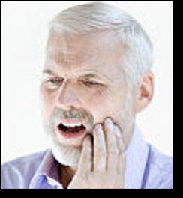
L0200: Dental - Coding
    If F. Mouth or Facial Pain coded code also in Section J: Health Conditions
Notes:
4

Slide 5
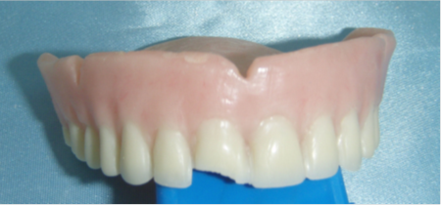
L0200A. Broken or loose fitting full or partial denture (chipped, cracked, unclean able or loose)

Slide 6
L0200B. No natural teeth or tooth fragment(s) (edentulous)
UPPER MANDIBLE
LOWER MANDIBLE
DENTURE IMPLANT

Slide 7
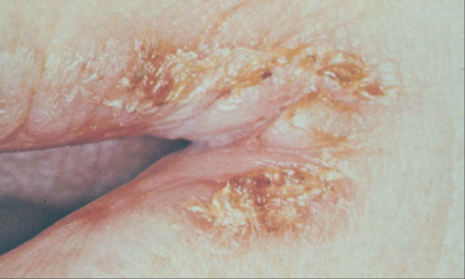
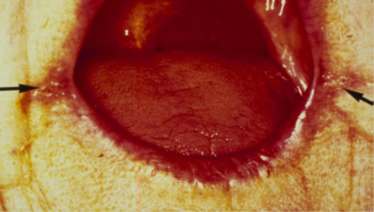
L0200C. Abnormal mouth tissue ulcers, masses, oral lesions on any oral surface
LIPS CRACKED, CRUSTED
CANKER SORE

Slide 8
L0200C. Abnormal mouth tissue ulcers, masses, oral lesions on any oral surface
CANCER

Slide 9
L0200C. Abnormal mouth tissue ulcers, masses, oral lesions on any oral surface, including under denture or partial if one is worn
SORES UNDER DENTURES

Slide 10
L0200C. Abnormal mouth tissue
(ulcers, masses, oral lesions on any oral surface, including under denture or partial if one is worn)
THRUSH ( CANDIDIASIS)

Slide 11
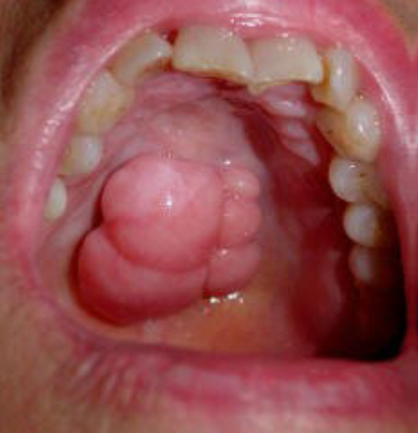
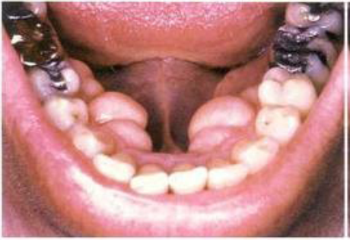
L0200C. Abnormal mouth tissue
(ulcers, masses, oral lesions on any oral surface, including under denture or partial if one is worn)
Torus/Tori
Boney Growths

Slide 12
L0200D. Obvious or likely cavity or broken natural teeth

Slide 13
L200E. Inflamed or bleeding gum or loose natural teeth

Slide 14
Care Plan Consideration
Knowing the oral status is very important since it’s the #1 cause of pain in LTC
Define how oral care needs to be done so it does not cause pain
Include what food consistency is needed so the elder can chew their food without difficulty

Slide 15
Questions?
I’ll take a few minutes to answer any questions you might have.

Slide 16
Thank you!!
Please feel free to contact me at any time.
Shirley L. Boltz, RN
RAI/Education Coordinator
785-296-1282
shirley.boltz@kdads.ks.gov

