Slide 1
SECTION I ACTIVE DIAGNOSES January 14, 2016 1-3PM

Slide 2
Objectives
Understand this section helps generate an updated, accurate picture of the resident’s current health status
Understand how to code Section I correctly
Understand what information from this section needs to be on the care plan and why

Slide 3
10-1-2015 Changes
If an individual is receiving aftercare following a hospitalization, a Z code may be assigned. Z codes cover situations where a patient requires continued care for healing, recovery, or long-term consequences of a disease when initial treatment for that disease has already been performed. When Z codes are used, another diagnosis for the related primary medical condition should be checked in items I0100–I7900 or entered in I8000. ICD-10-CM coding guidance with links to appendices can be found here: http://library.ahima.org/xpedio/groups/public/documents/ahima/bok1_050855.hcsp?dDocName=bok1_050855. Page I-4

Slide 4
Section I: Active Diagnoses
2-Step Process
1. Identify Diagnosis
Physician (or APRN, PA, CNS) documented diagnosis in last 60 Days
2. Determine if Diagnosis Active during 7 day look-back period
Direct relationship to resident’s current :
Functional status
Cognitive status
Mood or behavior status
Medical treatments
Nursing monitoring
Risk of death
Do not include conditions resolved or no longer affect current status or do not drive plan of care.

Slide 5
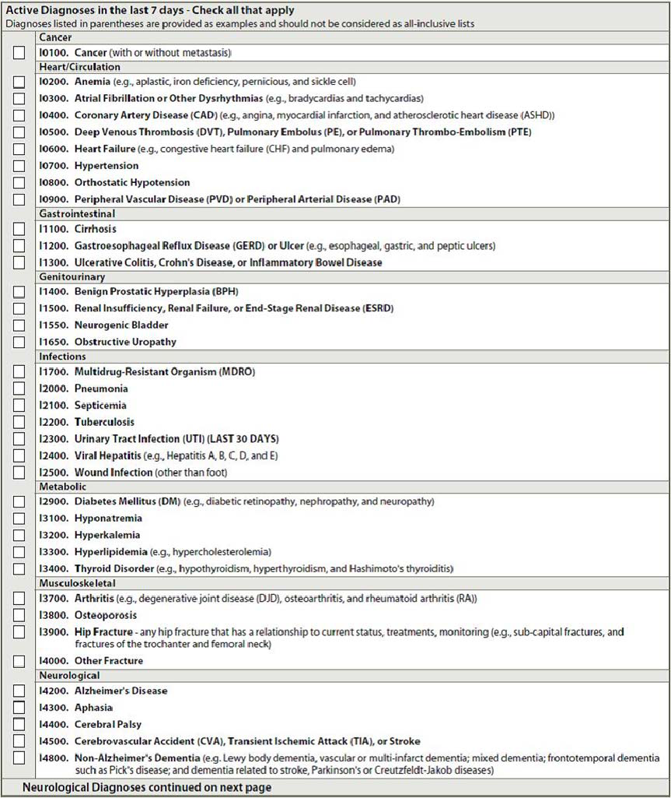
Active Diagnoses
Check all that apply
If disease or condition not specifically listed,
“Other” box (I8000)
ICD code & name of diagnosis

Slide 6
I2300: Urinary Tract Infection
30 day look-back period for active disease
Criteria for Coding UTI (All of these must be met)
Diagnosis in last 30 days
Signs and symptom such as fever, burning, pain
Significant laboratory findings
Medication or treatment in last 30 days

Slide 7
Care Plan Considerations
Make sure the UTI diagnosis fits the criteria for a UTI. UTIs are an acute condition, but still needs to be care planned
Active diagnosis will be used in different care plan problems, i.e. Depression is addressed in Mood and/or Psychosocial, Stroke is addressed in ADL, etc.

Slide 8
Questions?
I’ll take a few minutes to answer any questions you might have.

Slide 9
Thank you!!
Please feel free to contact me at any time
Shirley L. Boltz, RN
RAI/Education Coordinator
785-296-1282
shirley.boltz@kdads.ks.gov

