Slide 1

Section G
Functional status
January 14, 2016 1-3PM
Notes:
1

Slide 2
Objectives
Understand the importance of this section is to provide the necessary assistance and promote independence
Understand how to correctly code Section G
Understand what needs to be on the care plan so all staff provides the same assistance

Slide 3
10-1-2015 Changes
Mrs. J. normally completes all hygiene tasks independently. Three mornings during the 7-day look-back period, however, she was unable to brush and style her hair because of elbow pain, so a staff member did it for her.
Coding: G0110J1 would be coded 3, extensive assistance. G0110J2 would be coded 2, one person physical assist.
Rationale: A staff member had to complete part of the activity of personal hygiene for the resident 3 out of 7 days during the look-back period. The assistance, although non-weight-bearing, is considered full staff performance of the personal hygiene sub-task of brushing and styling her hair. Because this ADL sub-task was completed for the resident 3 times, but not every time during the last 7 days, it qualifies under the second criterion of the extensive assistance definition. Page G-20

Slide 4
G0110
Activities of Daily Living Assistance
Self – Performance
Staff Support
10 ADLs plus Bathing
Notes:
4

Slide 5
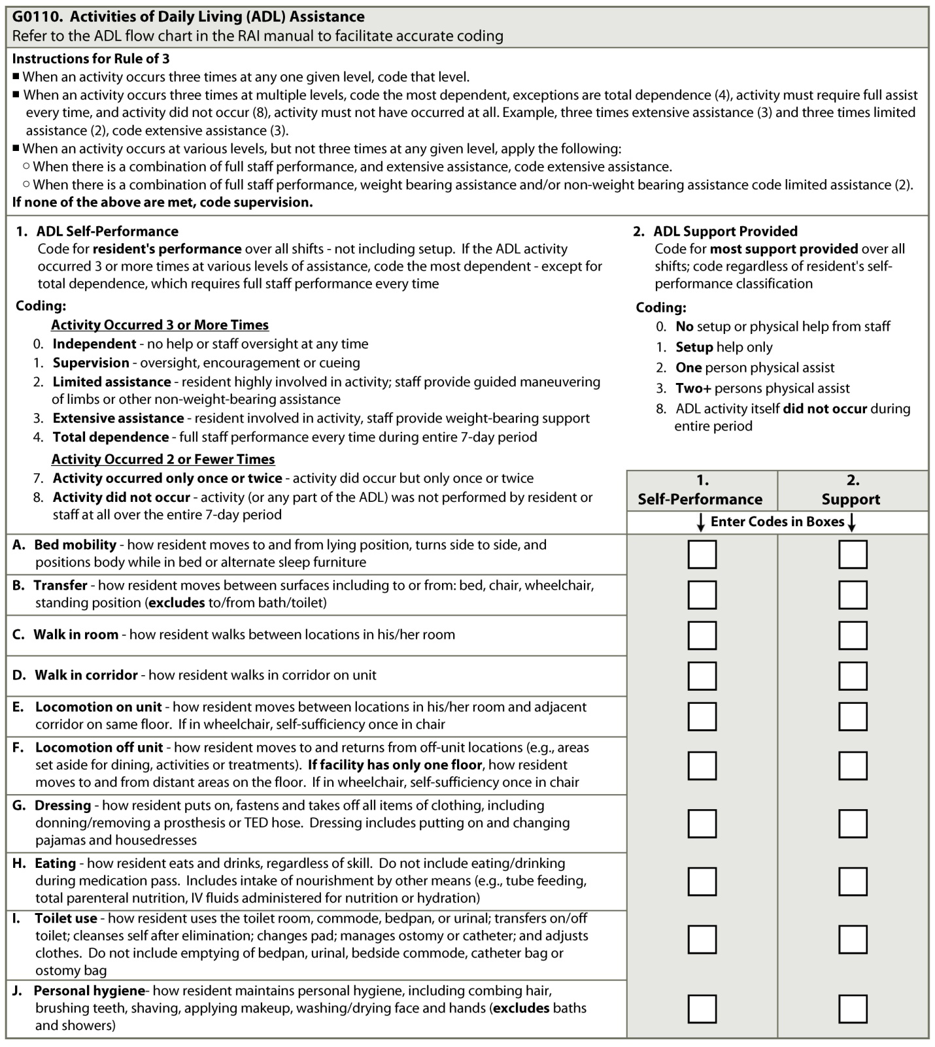
G0110: Activities of Daily Living
Notes:
5

Slide 6
G0110: ADL Assistance
7 day look-back period
Assistance
  Only what took place in nursing home
  Only provided by direct staff and facility contracted staff not outside agencies or students
Assessment Process
  Observe activity
  Review medical record
  Interview staff from each shift:
    Frequency of ADL
    Resident does for self during each ADL
    Type and level of staff assistance
Notes:
6

Slide 7
ADL – A. Bed Mobility
Moves:
  to and from lying position
  to sitting position in bed or to edge of bed
  to head of bed
  turns from side to side
Positions body while in bed or other furniture sleeps on instead of bed
Moving to sitting position before transferring into chair or w/c
Notes:
7

Slide 8
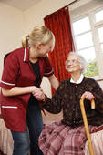
ADL – B. Transfer
Moves between surfaces
  to/from bed, chair, wheelchair,
  standing position
Assumes standing position
Moving from sitting position to standing position before transferring into chair or w/c
When lift used – includes application of sling
Exclude: movement to and from bath or toilet, covered under Toilet Use and Bathing
Notes:
8

Slide 9
ADL – Walking
C. In Room:
  Walks between locations in his/her room (only)
D. In Corridor:
  Walks in corridor on unit (only)
Notes:
9

Slide 10
ADL - Locomotion
E. On Unit:
  Moves between locations in his/her room and adjacent corridor on same floor
  If uses w/c, self-sufficiency once in w/c
F. Off Unit:
  Moves to and returns from off unit locations (areas set aside for dining, activities, treatments)
  If facility only one floor, how moves to and from distant areas on floor
  If uses w/c, self-sufficiency once in w/c
Notes:
10

Slide 11
ADL – G. Dressing
Puts on, fastens, takes off all items of clothing including:
  donning/removing prosthesis or TED hose
  putting on and changing pajamas and house dresses
Notes:
11

Slide 12
ADL – H. Eating
Eats and drinks, regardless of skill
  Includes nourishment by any means:
    orally, tube feeding, TPN, IV fluids administered for hydration/nutrition
Do not include:
  eating/drinking during medication administration
  general supervision in DR
Notes:
12

Slide 13
ADL – I. Toilet Use
Uses toilet room, commode, bedpan, or urinal
Transfers on/off toilet, cleanses self, changes pad, manages ostomy or catheter, and adjusts clothing.
Do not include staff emptying of bedpan, urinal, bedside commode, catheter bag or ostomy bag
Notes:
13

Slide 14
ADL – J. Personal Hygiene
Combs hair, brushes teeth
Shaves, applies makeup
Washes and dries face, hands
Do not include:
  washing and drying of face and hands during bath & shower, covered in
  Bathing ADL
Notes:
14

Slide 15
G0110: Activities of Daily Living
Notes:
15

Slide 16
G0110(1): Self-Performance
Goal to promote highest level of functioning
  Number of times ADL occurred
  Identify what resident actually did for self
  When assistance received
  Type of assistance received & Number of times each type of assistance provided
May use assistive devices
Code actual self-performance, not potential or what is care planned
Notes:
16

Slide 17
G0110(1): Self-Performance
Code 0. Independent
Completed ADL with no help or oversight for every episode
  Bed Mobility
  Mrs. D. can easily turn herself in bed and is able to sit up without any staff assistance at any time in the 7 day look back period. She requires use of a single side rail that staff places in the up position when she is in bed.
Notes:
17

Slide 18

G0110(1): Self-Performance
Code 1. Supervision
Oversight, encouragement, or cueing provided 3 or more times
Bed Mobility
  Mrs. E. favors lying on her right side. Because she has a history of skin breakdown, staff must verbally remind her when she rests in bed to reposition off her right side throughout 7 day look back period.

Slide 19

G0110(1): Self-Performance
Code 2. Limited Assistance
Resident highly involved in activity and receives physical help in guided maneuvering of limb(s) or other non-weight-bearing assistance three or more times during the last 7 days.
Staff not lifting or carrying
Guided maneuvering vs. weight-bearing -- who is supporting weight of resident’s extremity or body
Bed Mobility
  Mr. F. favors lying on his right side. Because he has a history of skin breakdown, staff need to cue him and guide him to place his hands on the side rail and encourage him to change his position daily when in bed throughout 7 day look back period.

Slide 20

G0110(1): Self-Performance
Code 3. Extensive Assistance
Resident performed part of the activity over the last 7 days, help of the following type(s) provided three or more times:
  Weight-bearing support provided three or more times.
  Staff performs all of activity or a component of activity during part but not every time
  Combination of full staff performance and weight-bearing assistance
Notes:
20

Slide 21
G0110(1): Self-Performance
Code 3. Extensive Assistance
Examples:
  Support hand to help resident eat
  Lift arm to allow to resident to brush hair
  Lift foot to assist resident to put on their socks
Bed Mobility
  Mr. Q. slid to the foot of the bed four times during the 7 day look back period. Two staff members had to physically lift and reposition him toward the head of the bed. Mr. Q was able to assist by bending his knees and pushing with his legs when reminded by staff.

Slide 22
G0110(1): Self-Performance
Code 4. Total Dependence
Staff performs entire ADL every time
Resident does not participate in any aspect of ADL
Resident unwilling or unable to perform any part of activity for entire look-back period
Bed Mobility
  Mrs. S. is unable to physically turn, sit up, or lie down in bed. Two staff members must physically turn her without any participation at any time from her during the entire 7 day look back period. She must be physically assisted to a seated position in bed when reading.

Slide 23
G0110(1): Self-Performance
Code 7. Activity occurred only once or twice.
  Activity occurred but less than three times.
  Example:
    Walk in Corridor: Resident ambulated in hallway for weekly bath but otherwise did not leave room
Code 8. Activity did not occur. Activity did not occur or family and/or non-facility staff provided care 100% of time for that activity over entire 7-day period Examples:
    Locomotion – On bed rest & did not get out of bed, & no locomotion via bed
    Toileting – Had no elimination
    Eating – Received no nourishment by any route
Notes:
23

Slide 24
Self Performance - Rule of 3
1. When an activity occurs three times at any one given level of assistance, Code that level.
Limited Assistance
Limited Assistance
Limited Assistance
Limited Assistance

Slide 25
Rule of 3
2. When an activity occurs 3 or more times at multiple levels, code the most dependent level that occurred 3 or more times.
Extensive
Extensive `
Extensive
Limited
Limited
Limited
Extensive
Notes:
25

Slide 26
Rule of 3
3. When an activity occurs 3 or more times and at multiple levels, but not 3 times at any one level apply the following:
  a. Convert episodes of full staff performance to weight bearing assistance, as long as full staff performance did not occur every time.
Extensive
(Weight Bearing Assistance)
Full Staff Performance (Not every time) → Weight Bearing Assistance
Extensive
+
=
Extensive
(Weight Bearing Assistance)
Notes:
READ SLIDE

Slide 27
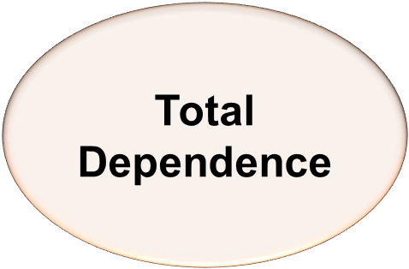
Rule of 3
3. When an activity occurs 3 or more times and at multiple levels, but not 3 times at any one level apply the following:
  b. When there is a combination of full staff performance and weight bearing assistance that total three or more times – code extensive
Total Dependence
(Full Staff Performance)
Extensive
Extensive
+
=
Extensive
(Full Staff Performance)

Slide 28
Rule of 3
3. When an activity occurs three or more times and at multiple levels, but not three times at any one level apply the following:
c. When there is a combination or full staff performance/weight bearing assistance, and/or non-weight bearing assistance that total 3 or more times – code limited assistance (2)
Total
(Full Staff performance)
Limited
(Non-weight bearing assistance)
Extensive
(Weight-bearing assistance)
=
Limited

Slide 29
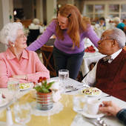
Rule of 3
If none of the above (previous situations) are met
                Code Supervision
Supervision
Limited
Extensive

Slide 30
Self Performance Algorithm
Start at top of algorithm.
  Work down until coding option in algorithm matches level of self performance. Page G-8
Scenario
A resident experiences a severe case of flu during look-back period
Observations indicate resident required following support for transferring:
  1 time of full assistance
  2 times with extensive assistance
  2 times with limited assistance (= Extensive)
Notes:
30

Slide 31
G0110: Activities of Daily Living
Notes:
31

Slide 32
G0110(2): ADL Support Provided
Highest level of staff support provided even if only one time for each ADL over 7 day look-back period
Code separately from ADL Self-Performance assessment
Notes:
32

Slide 33
G0110(2): Support Provided Coding
Code 0. No set up or physical help from staff.
Code 1. Setup help only. Provided materials or devices necessary to perform ADL independently. Include giving or holding out item that resident takes from care giver
  Bed mobility - handing trapeze bar or raising ½ rails
  Transfer - locking brakes on w/c for safe transfer
  Walking - handing walker or cane
  Locomotion - unlocking w/c brakes prior to moving or adjust foot pedals
  Dressing - retrieving clothes from closet, laying clothes on bed, handing shirt
  Eating - opening containers, cutting meat, giving one food item at time
  Personal hygiene - providing washbasin and grooming articles
Notes:
33

Slide 34
G0110(2): ADL Support Provided
Coding
Code 2. One staff physical assist
Code 3. Two or more staff physical assist
Code 8. ADL activity itself did not occur or family and/or non-facility staff provided care 100% of the time for that activity over the entire 7-day period
Notes:
34

Slide 35
G0110(1)(2) - Scenario #1
Mr. J is able to transfer himself from the wheelchair to bed by himself. Once on the bed, however, he is not able to lie down without help from staff. Each afternoon and at bedtime during the 7-day look-back period one nursing staff assistant assists Mr. J by lifting his legs onto the bed. After that, Mr. J is able to turn and reposition himself independently.
How would you code Bed Mobility?
3/2
Extensive Assist, Physical Assist of One Staff
Notes:
35

Slide 36
G0110(1)(2) - Scenario #2
Mrs. R requires extensive assistance with all ADLs and assistance of 2 staff. She spends all of her time in bed with the exception of a weekly outing to a music program in the activity room. During the MDS observation period, two staff transferred the resident from her bed to a wheelchair and then back to bed when the activity was over.
How would you code Transfer?
7/3
Took Place only 2 times
Physical assistance of 2
Notes:
36

Slide 37
G0110(1)(2) - Scenario #3
Mr. K. is reminded by one staff person to toilet frequently during the day. When in BR staff person reminds resident to unzip and zip his pants and to wash his hands when toileting is complete.
The resident required this same process several times daily throughout the entire 7-day look-back period.
How would you code Toilet Use?
1/0
Supervision but not set up or physical help
Notes:
37

Slide 38
G0120: Bathing
Takes full body bath, shower, or sponge bath.
Includes transfer in and out of tub or shower
Does not include washing back or hair
Notes:
38

Slide 39
G0120: Bathing
Coding
Code for most dependent
in self-performance and support
Notes:
39

Slide 40
G0120: Bathing – Coding
Self Performance
Code 0. Independent. Requires no help from staff.
Code 1. Supervision. Oversight help only.
Code 2. Physical Help Limited to Transfer Only.
  Able to perform bathing activity, but required help with transfer only.
Code 3. Physical Help in Part of Bathing Activity. Assistance with some aspect of bathing.
Code 4. Total Dependence. Unable to participate in any of bathing activity.
Code 8. Activity Itself Did Not Occur
If activity did not occur or family and/or non-facility staff
provided care 100% of the time for that activity over
entire 7-day period
Support Provided - Codes same as G0110 (2)
ADL Support Provided
Notes:
40

Slide 41
G0120 - Bathing
Scenario
For one bath, the resident received physical help of one person to position self in bathtub.
However, because of her fluctuating moods, she received total help for her other bath from one staff member.
Clue: Code for maximum amount of assistance
How would you code Bathing?
4/2
Total Dependence, Assisted by 1 Staff
Notes:
41

Slide 42
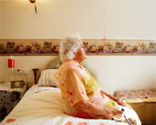
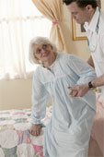
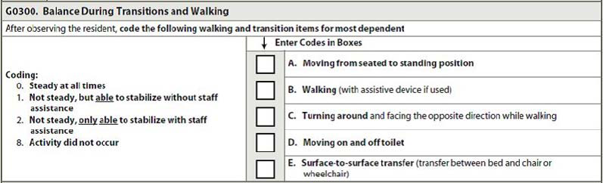
G0300: Balance
During Transition and Walking
Notes:
42

Slide 43
G0300: Balance
During Transition & Walking
Throughout 7 day look-back period, observe and document observations of balance during each transition:
  A. Sitting to Standing
  B. Walking
  C. Turning around
  D. Transferring on and off toilet
  E. Transferring from chair or wheelchair to bed & vice versa
If no systematically documentation of stability in these activities at least once during 7-day look-back period, conduct test for balance

Slide 44
G0300: Balance During Transition & Walking – Test
Start with resident sitting up on edge of bed, in a chair, or in a wheelchair (if generally uses)
Ask resident to:
  Stand up and stand still for 3-5 seconds
    G0300A. Sit to Stand
  Walk approximately 15 feet using assistive device normally uses
    G0300B. Walking
  Turn around
    G0300C. Turning Around
Notes:
44

Slide 45
G0300: Balance, Transition & Walking - Test
Ask resident to:
  Walk or wheel from starting point in room into bathroom
  Prepare for toileting as normal, taking down pants or other clothing (not underclothes)
  Sit on toilet
    G0300D. Move on & off Toilet
Ask resident who is not ambulatory and uses a wheelchair for mobility:
  to transfer from seated position in chair or wheelchair to seated position on bed
    G0300E. Surface to Surface Transfer
Notes:
45

Slide 46
G0300: Balance, Transition & Walking - Coding
For each transition code least steady episode, using assistive device if applicable
Unsteady - unbalanced, move with sway, uncoordinated or jerking movements; abnormally slow gaits with small shuffling steps; wide-based gaits with halting, tentative steps
Notes:
46

Slide 47
G0300 A,B,C,D,E, - Coding
Balance During Transitions & Walking
Code 0. Steady at all times.
  All steady transitions or walking, with or without assistive device
  If normally uses assistive device, plans or integrates its use in transition activity or walking
  May have abnormal gait
  Not Fall Risk
Code 1. Not steady but able to stabilize without staff assistance
  Unsteady transitions or walking but able to stabilize w/o staff assistance
  Increased Fall Risk
Notes:
47

Slide 48
G0300 A,B,C,D,E, - Coding
Balance During Transitions & Walking
Code 2. Not steady, only able to stabilize with staff assistance
  Unsteady transition or walking cannot stabilize w/o staff assistance.
  Had fall during transition or walking during look-back period
  High Fall Risk during transitions or walking
  Mechanical lift used (A,D,E)
Code 8. Activity did not occur
Notes:
48

Slide 49
G0300A - Scenario
Mr. C. locks his wheelchair and uses the arms of his wheelchair to attempt to stand.
On the first attempt, he rises about halfway to a standing position then sits back down.
On the second attempt, he is able to stand steadily.
How should G0300A be coded?
Code 1. Not steady, but able to stabilize without staff assistance.
Even though the second attempt at standing was steady, the first attempt suggests he is unsteady and at risk for falling during this transition.

Slide 50
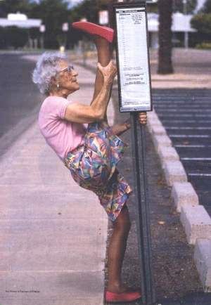
G0400 – Functional Limitation in Range of Motion
Notes:
50

Slide 51
G0400: Functional Limitation in ROM
Limited ability to move joint:
  interferes with daily functioning or
  place at risk of injury
Assess ROM at shoulder, elbow, wrist, hand, hip, knee, ankle, foot and other joints unless contraindicated (both sides of body)
  Ask to move each joint using verbal directions and demonstration.
Notes:
51

Slide 52
G0400: Functional Limitation in ROM - Coding
Code 0. No impairment.
  Full functional ROM on both sides, upper and lower extremities
Code 1. Impairment on one side.
  Upper and/or lower extremity impairment on one side of body that interferes with daily functioning or places resident at risk of injury
Code 2. Impairment on both sides.
  Upper and/or lower extremity impairment on both sides of body that interferes with daily functioning or places resident at risk of injury
Notes:
52

Slide 53
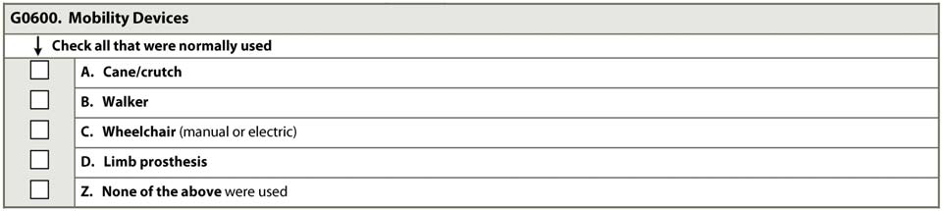

G0600: Mobility Device
Notes:
53

Slide 54
G0600: Mobility Devices – Coding
A. Cane/crutch.
  Including single prong, tripod, quad cane, etc.
B. Walker (or hemi-walker)
  Including enclosed frame-wheeled walker with/without posterior seat & lap cushion
  Pushes wheelchair for support while walking.
C. Wheelchair (manual or electric).
  Sits in wheelchair when moving about. Hand-propelled, motorized, or pushed by another person.
D. Limb Prosthesis.
Z. None of the above.
  Used none of mobility devices listed in G0600 or locomotion did not occur during look-back period.

Slide 55
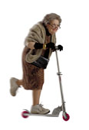
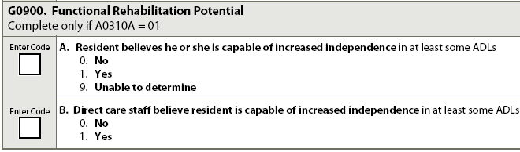
G0900: Functional Rehabilitation Potential
OBRA Admission
Notes:
55

Slide 56
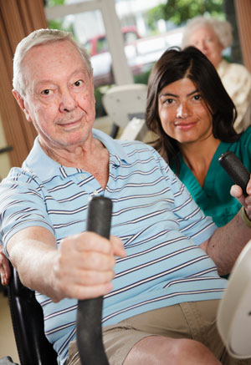
A. Resident Believes Capable of Increased Independence in at Least Some ADLs
Code 0. No.
  Will probably stay same and continue with current needs for assistance.
Code 1. Yes.
  Thinks can improve. Code even if
  expectation appears unrealistic.
Code 9. Unable to Determine.
  Resident cannot indicate any beliefs
  about functional rehabilitation potential.

Slide 57
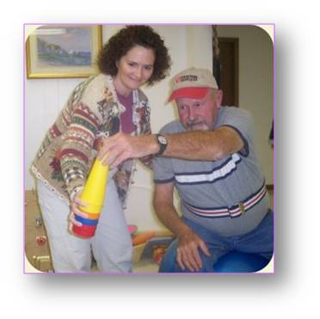
B. Direct Care Staff Believe Resident Is Capable of Increased Independence in at Least Some ADLs
Code 0. No.
  Will probably stay same and continue with current needs for assistance. Likely to experience decrease in capacity for ADL care performance.
Code 1. Yes.
  Can gain greater independence in ADLs. Not sure about potential for improvement.

Slide 58
Care Plan Considerations
This needs to be very detailed. Staff needs to know exactly what help the elder needs for each ADL
This is also where you include the elder’s preferred routine, i.e. when they get up, when they go to bed, when they bathe, how often they bathe, etc.
Include mobile devices they require, i.e. cane, walker, wheelchair, prosthesis. Be specific about when they use the device.
Find out what their routine was prior to coming to the NH

Slide 59
Questions?
I’ll take the next few minutes to answer any questions you might have

Slide 60
Thank you!!
Please feel free to contact me
Shirley L. Boltz, RN
RAI/Education Coordinator
785-296-1282
shirley.boltz@kdads.ks.gov

