Slide 1

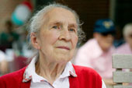
SECTION E
BEHAVIOR
January 14, 2016 1-3PM
Hallucinations
Delusion
Problem Behaviors & Impact

Slide 2
Objectives
Understand that behavioral symptoms may cause distress to the resident, other residents, staff or environment
Understand how to code Section E correctly
Understand that care planning should be focused on minimizing the behaviors

Slide 3
Intent
Identify behavioral symptoms in last 7 days that may:
  cause distress to resident
  be distressing or disruptive to facility residents, staff members, or care environment
Behaviors may:
  place resident at risk for injury, isolation, inactivity
  indicate unrecognized needs, preferences,
  illnesses
  be potentially harmful to resident

Slide 4
Steps for Assessment
Review medical record
Interview staff members and others who have observed the resident in a variety of situations
Observe resident during
    Conversations
    Structured interviews
  Listen for statements indicating hallucinations and delusions

Slide 5
E0100: Potential Indicators of Psychosis
Hallucination
  Perception of presence of something not actually there
  Auditory or visual or involve smells, tastes or touch
Delusion
  Fixed false belief not shared by others that resident holds even in face of evidence to contrary

Slide 6
E0100: Potential Indicators of Psychosis - Coding
Behaviors observed and/or thoughts expressed only in look back period
Not based on Medical Diagnosis
Note: E0100 reads,
“Potential Indicators of Psychosis”

Slide 7
E0100: Psychosis - Example
A resident carries on one sided conversation, mentioning her daughter’s name as if she is addressing her in person.
When asked about this, she reports hearing her daughter’s voice, even though the daughter is not present and no other voices can be heard in the environment.
How would you code E0100?
Code A. Hallucination

Slide 8
E0100: Psychosis - Example
A resident announces he must go to work. In fact, he’s been retired for 15 years. When reminded of this, he continues to insist he must go to work.
How would you code E0100?
Code B. Delusions

Slide 9
E0200: Behavioral Symptom
Presence & Frequency
Problematic behaviors
  Physical, verbal, other
  Directed toward self or others
Identified behavior:
  Frequency of behavior
  Impact of behavior on self and others

Slide 10
E0200 - Categories of Behavioral Symptoms
A. Physical behaviors directed toward others:
Hitting
Kicking
Pushing
Scratching
Grabbing
Abusing others sexually
B. Verbal behaviors directed toward others:
Threatening
Cursing
Screaming
This does not represent all possible behaviors.

Slide 11
E0200 - Categories of Behavioral Symptoms
C. Other behaviors not directed toward others:
Hitting or scratching self
Pacing
Rummaging
Public sexual acts
Disrobing in public
Throwing or smearing food or bodily wastes
Screaming
Disruptive sounds

Slide 12
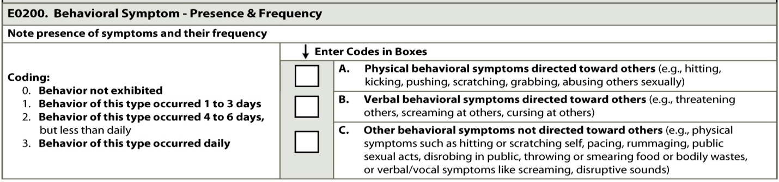
E0200: Behavioral Symptom Presence & Frequency - Coding
Number of days each type of behavior category
Regardless of number or severity of episodes
    Code 0. Behavior not exhibited
    Code 1. Occurred 1-3 days
    Code 2. Occurred 4-6 days
    Code 3. Occurred daily

Slide 13
E0200: Behavioral Symptom
Presence & Frequency – Example
Every morning, a nursing assistant
tries to help a resident who is unable to dress himself.
On the last 4 out of 6 mornings, the resident has hit or scratched the nursing assistant during attempts to dress him.
How would you code E0200?
A. Physical behavior directed toward others with a frequency response of 2. Behavior occurred 4-6 days

Slide 14
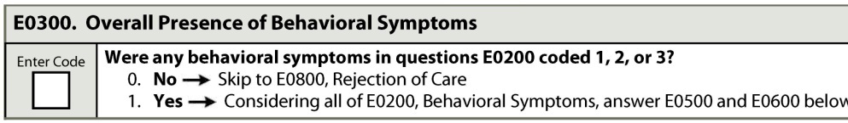
E0300: Overall Presence of Behavioral Symptoms
Were any behavioral symptoms in E0200 coded 1, 2, or 3?
Code 0. No
  All E0200 options Coded 0. No
  →SKIP to E0800 Rejection of Care
Code 1. Yes
  Any E0200 options coded 1, 2, or 3
  Complete E0500 and E0600

Slide 15
E0500: Impact on Resident
E0600: Impact on Others Assessment
Determine significant impact of E0200 behaviors
  E0500: On Resident:
    Risk for physical illness or injury
    Interfere with care
    Interfere with participation in activities or social interactions
  E0600: On Others:
    Risk for physical injury
    Intrude on privacy or activities
    Disrupt care or living environment

Slide 16
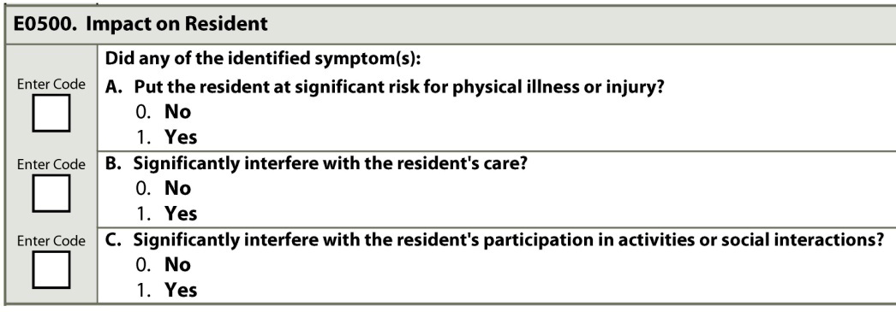
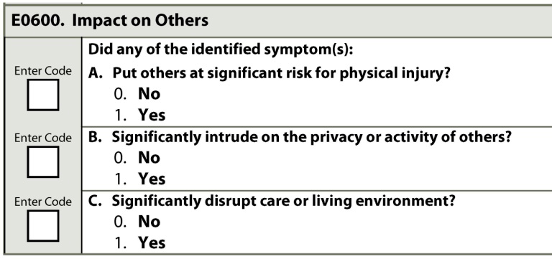
E0500 & E0600
Code 0. No Code 1. Yes

Slide 17
E0500 - Impact on Resident
Example
A resident paces incessantly.
When staff encourage him to sit at the dinner table, he returns to pacing after less than a minute, even after cueing and reminders.
He is so restless that he cannot sit still long enough to feed himself or receive assistance in obtaining adequate nutrition.
How would you code E0500?
A. & B. Code 1. Yes

Slide 18
E0600 - Impact on Others
Example
A resident, when sitting in the hallway outside the community activity room, continually yells, repeating the same phrase.
The yelling can be heard by other residents in hallways, activity and recreational areas but not in their private rooms.
How would you code E0600?
  A. Code 0. No
  B. & C. Code 1. Yes

Slide 19
E0800: Rejection of Care
Goals for Health & Well-Being
Goals reflect resident’s wishes and objectives
for health, function, and life satisfaction
Care preferences reflect desires, wishes, inclinations, or choices for care
Preferences do not have to appear logical or rational to clinician, or
  based on facts or scientific knowledge
  consistent with “good judgment”

Slide 20
E0800: Rejection of Care
Rejection of care – Interrupts or interferes with delivery or receipt of care by:
  Verbally declining or statements of refusal
  Physical behaviors that convey aversion to, result in avoidance of, or interfere with receipt of care

Slide 21
E0800: Rejection of Care
When rejection of care first identified during look back period:
  Investigate & determine resident choice
  Provide education
  If remains resident choice, include in plan of care
  May need to provide alternative care and approaches

Slide 22
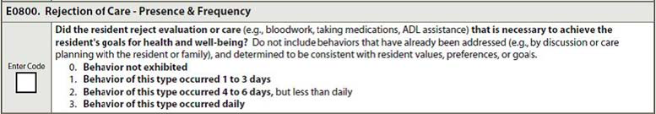
E0800: Rejection of Care
Number of days in look-back period resident exhibited rejection of evaluation or care consistent with resident’s goals.
Code 0. Behavior not exhibited
Code 1. 1-3 days
Code 2. 4-6 days
Code 3. Daily

Slide 23
E0800: Rejection of Care Presence & Frequency – Example
A resident with heart failure who recently returned to
the nursing home after surgical repair of a hip fracture
is offered physical therapy and declines.
She says that she gets too short of breath when she tries to walk even a short distance, making physical therapy intolerable.
She does not expect to walk again and does not want to try.
Her physician has discussed this with her and has indicated that her prognosis for regaining ambulatory function is poor.
How would you code 0800?
Code 0. Behavior not exhibited

Slide 24
E0800: Rejection of Care Presence & Frequency – Example
A resident goes to bed at night without changing out of the clothes he wore during the day.
When a nursing assistant offers to help him get undressed, he declines, stating that he prefers to sleep in his clothes tonight.
The clothes are wet with urine.
This has happened 2 of the past 7 days.
The resident was previously meticulous, recently has expressed embarrassment at being incontinent, and has care goals that include maintaining personal hygiene and skin integrity.
        How would you code E0800?
        Code 1. Behavior of this type occurred 1-3 days

Slide 25
E0900: Wandering
Presence & Frequency
Act of moving from place to place with or without specified course or known direction
May or may not be:
  aimless
  driven by confused thoughts or delusional ideas
May be:
  oblivious to physical or safety needs
  for purpose such as searching but not knowing direction or location
May occur even if resident in locked unit
Pacing/ traveling via planned course not wandering

Slide 26
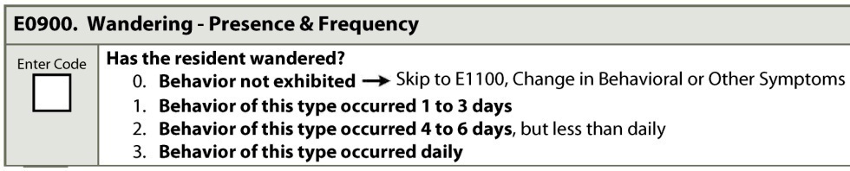
E0900: Wandering
Presence & Frequency
Did wandering occur & if occurred, how frequently
Code 0. Behavior not exhibited
  → SKIP to E1100:Change in Behavioral or Other Symptoms
Code 1. Behavior exhibited 1-3 days
Code 2. Behavior exhibited 4-6 days, but not daily
Code 3. Behavior exhibited daily

Slide 27
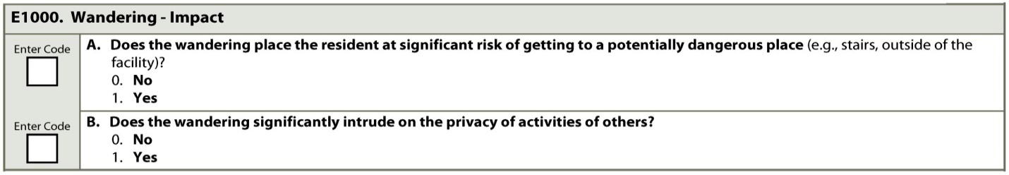
E1000: Wandering – Impact
Does Wandering place resident at significant risk of getting to a potentially dangerous place?
  Code 1. Yes. Includes but not limited to: outside facility
  where heavy traffic or into room of another resident with
  dementia known for physically aggressive toward intruders.
Does Wandering significantly intrude on privacy or activities of others?
  Code 1. Yes. Violates other residents’ privacy or interrupts their performance of ADLs or limits engagement in or enjoyment of social or recreational activities, whether or not other resident complains or communicates displeasure or annoyance.

Slide 28
E1000: Wandering – Impact
Example
A resident wanders away from the nursing home in his pajamas at 3 a.m.
When staff members talk to him, he insists he is looking for his wife.
This elopement behavior had occurred when he was living at home, and on one occasion he became lost and was missing for 3 days, leading his family to choose nursing home admission for his personal safety.
How would you code E1000?
Code 1. Yes

Slide 29
E1100: Change in Behavioral or Other Symptoms
Important indicator
  Change in health status or environmental stimuli
  Positive response to or adverse effects of treatment
Compare to responses to E0100-E1000 on prior MDS with current MDS assessment

Slide 30
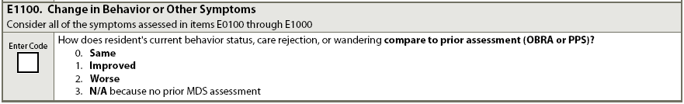
E1100: Change in Behavioral or Other Symptoms
Rate overall behavior
  Code 0. Same. Unchanged
  Code 1. Improved
  Code 2. Worse
  Code 9. N/A. No prior assessment
If multiple behavioral symptoms – same or varying changes, use clinical judgment of overall direction

Slide 31
Care Plan Considerations
When the cause for negative behavior is not reversible the focus needs to minimize the amount of disability and distress
All behaviors happen for a reason and interventions need to be in place to decrease/diminish the bhavior

Slide 32
Questions?
I’ll take a few minutes to answer any questions you might have.

Slide 33
Thank you!!!
Please contact me at any time
Shirley L. Boltz, RN
RAI/Education Coordinator
785-296-1282
shirley.boltz@kdads.ks.gov

