Slide 1




SECTION C
COGNITIVE PATTERNS
January 12, 2016 1-3PM
Attention
Orientation
Register & Recall New Information
Sign & Symptoms of Delirium
Notes:
1

Slide 2
Objectives
Understand how to determine a resident’s attention, orientation and ability to register and recall new information
Understand how to enhance communication and facilitate greater independence
Understand how to correctly code Section C
Understand the importance of these results to be included in the care Plan

Slide 3
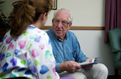



SECTION C
COGNITIVE PATTERNS
BRIEF INTERVIEW FOR
MENTAL STATUS
(BIMS)
C0100 – C0500
Notes:
3

Slide 4


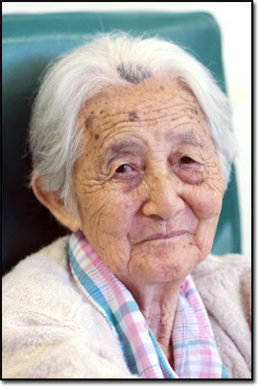

BIMS – Structured Cognitive Test
More accurate & reliable than observation
Decreases incorrect labeling of cognitive ability
Observe for Sign & Symptoms of Delirium

Slide 5
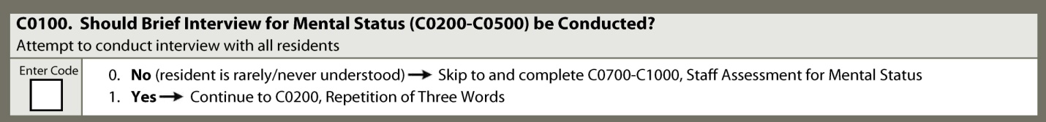
C0100: Should Brief Interview for
Mental Status be Conducted?
Review
  Is resident rarely or never understood? (B0700)
  Does resident want or need interpreter? (A1100)
  Is interpreter available?
Code 0. No. Interview should not be attempted
  If resident rarely/never understood, cannot respond verbally or in writing
  Needs or wants interpreter but one not available
  →SKIP to C0700: Staff Assessment of Mental Status
Code 1. Yes. Interview should be conducted
  If resident at least sometimes understood verbally or in writing, and if interpreter needed or wanted, one is available

Slide 6
Conducting Interview C0200-C0500
Quiet, private setting
  Be sure resident can hear & see you
Introduce interview
  “I would like to ask you some questions. We ask everyone the same questions. This helps us provide you with better care. Some questions may seem very easy, while others may be more difficult.”
Address concerns
Complete interview in one sitting
  C0200-C0400
Ask each question in order as stated
Accept refusals & continue

Slide 7
C0200: Repetition of 3 Words
State sentence as written:
  “I am going to say 3 words for you to remember. Please repeat the words after I have said all three. The words are sock, blue, and bed.”
Immediately prompt resident for response:
  “Now please tell me the three words.”

Slide 8
C0200: Repetition of 3 Words
If after first attempt to repeat words, resident correctly states all three words, reinforce recall by repeating words with category cues
Say:
“That’s right, the words are
sock, something to wear; blue, a color; and bed, a piece of furniture.”
Go to C0300: Temporal Orientation
Notes:
Steps for Assessment

Slide 9
C0200: Repetition of 3 Words
If resident recalls two or fewer words after 1st attempt
Say:
“Let me say the three words again. They are sock, something to wear;
blue, a color; and bed, a piece of furniture. Now tell me the three words.”
If resident does not state all 3 words correctly after second attempt, repeat words and category clues one more time.

Slide 10
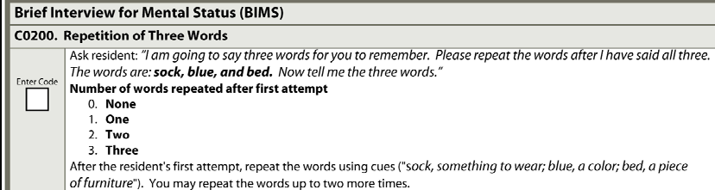
C0200: Repetition of 3 Words
Coding
Record maximum number of words repeated correctly on first attempt only
Count words repeated in any order or
if stated as part of sentence.
Code 0. None. No correct words. Nonsensical Response.

Slide 11
C0300: Temporal Orientation
Correct date in current surroundings
Ask each separately
  A. Current year
  “Please tell me what year it is right now?”
  B. Current month
  “What month are we in right now?”
  C. Day of the week
  “What day of the week is today?”
Allow up to 30 seconds for response.
If asks for clues, respond by saying:
  “I need to know if you can answer this question without any help from me.”

Slide 12
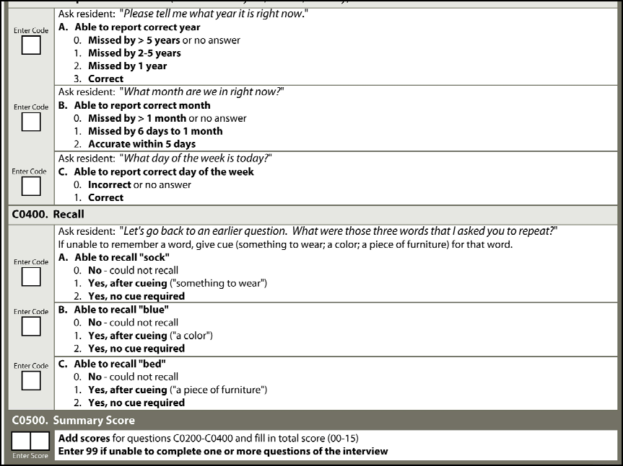
C0300A. Year
Ability to report correct year
Code 0. Answer >5 years, chooses not to answer, gives nonsensical response
Code 1. Answer within 2-5 years from current year
Code 2. Answer within 1 year from current year
Code 3. States correct year

Slide 13
C0300B. Month
Ability to report correct month
Code 0. Answer >1 month, chooses not to answer, gives nonsensical response
Count current day as Day 1 to Code 1 & Code 2
Code 1. Answer within 6 days to 1 month
Code 2. Answer within 5 days

Slide 14
C0300B. Example
Date of interview – October 28
Question
  “What month are we in right now?”
Resident answers
  “November”
Coding: Code 2. Accurate within 5 days
Rationale:
  Day 1 = October 28
  Day 2 = October 29
  Day 3 = October 30
  Day 4 = October 31
  Day 5 = November 1

Slide 15
C0300C. Day
Ability to report correct day of week
Code 0. Answer incorrect, chooses not to answer, or gives nonsensical response
Code 1. Answer correct.

Slide 16

Stop Interview
Stop after completing C0300C. Day of Week
if:
  All responses nonsensical
  No verbal or written response to any question
  No verbal or written response to some questions and nonsensical responses to all other questions

Slide 17
If Interview Stopped after C0300C.
Code a dash “-” - C0400 A, B, and C
Code “99” - C0500: Summary Score
Code 1. Yes. - C0600: Should Staff Assessment
  for Mental Status be Conducted?
Complete Staff Assessment for Mental Status
  (C0700 – C1000)

Slide 18
C0400: Recall
Ask resident: “Let’s go back to an earlier question. What were those three words that I asked you to repeat?”
Allow up to five seconds for spontaneous recall
Provide category cue separately for each word not recalled
  “something to wear”
  “a color”
  “a piece of furniture”
Allow up to five seconds after each category cue for recall of word

Slide 19
C0400: Recall – Coding
Each word coded separately
  C0400A. Sock; C0400B. Blue; C0400C. Bed
Code 2. Yes. No cue required for recall.
  States word spontaneously
  No category cue given
  On first attempt, states desired word(s) along with multiple words in category
Code 1. Yes. After cueing.
  After receiving category cue, states desired word
Code 0. No. Could not recall.
  After receiving category cue, does not state word(s), or states desired word with multiple words in category

Slide 20
C0500: BIMS Summary Score
Add numerical values of answers C0200 – C0400 (BIMS Questions)
  Two digit number between 00-15
  Code 99. Unable to complete interview if:
    4 or more items coded “0” - chose not to answer or gave nonsensical responses OR
    At least 1 item coded with dash “-”
Notes:
20

Slide 21
C0500: BIMS Summary Score
If resident can hear all questions and not delirious
  BIMS correlation to Mini Mental (MMSE)
    13 – 15 = cognitively intact
    8 – 12 = moderately impaired
    0 – 7 = severe impairment
Notes:
21

Slide 22
INTERVIEWING VULNERABLE ELDERS
Here’s the link: http://www.youtube.com/watch?v=Ereawm4_F7k

Slide 23



SECTION C
COGNITIVE PATTERNS
STAFF ASSESSMENT of COGNITION
C0600 - C1000
Notes:
23

Slide 24
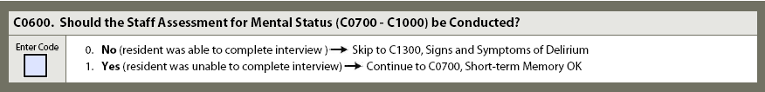
C0600: Should Staff Assessment for Mental Status be Conducted?
Code 0. No.
  BIMS completed
  Summary score (C0500) = 00 – 15
  →SKIP to C1300: Assessment for Delirium
Code 1. Yes.
  BIMS not completed
  Summary score (C0500) = 99
Notes:
24

Slide 25
C0700-C1000
Staff Assessment for Mental Status
7 day look-back period
4 Components
  Short-term Memory
  Long-term Memory
  Memory/Recall Ability
  Cognitive Skills for Daily
  Decision-Making

Slide 26
C0700: Short Term Memory Assessment
Describe event 5 minutes after occurrence or
  Follow through on direction given 5 minutes earlier
Observe cognitive function in various activities
  Note frequency of need for reorientation to activity or instructions
Ask staff, family, significant other
Review medical record
Notes:
26

Slide 27
C0700: Short Term Memory Coding
Code 0. Memory OK.
  Recalls information after 5 minutes
Code 1. Memory problem.
  Most representative level of function shows unable to recall after 5 minutes
Dash “-” Cannot conduct test or staff cannot make determination
Notes:
27

Slide 28
C0800: Long Term Memory Assessment
Engage in conversation about past
Look at memorabilia, observe response
Ask questions that can be validated
Observe response while visiting with family
Ask staff, family, significant other
Review medical record

Slide 29
C0800: Long Term Memory
Coding
Code 0. Memory OK.
  Accurately recalls long past information
Code 1. Memory problem.
  Did not recall long past information or did not recall correctly
Dash “-” Cannot conduct test or staff cannot make determination

Slide 30
C0900: Memory/Recall Ability
Ask questions about:
  Current Season
  Location of Room
  Staff Names and Faces
  Nursing Home
Limited communication skills
  ask staff across all shifts, family or significant other
Review Medical Record

Slide 31
C0900: Memory/Recall Ability
Coding
A. Current Season.
  Identify current season (correctly refers to weather for time of year, legal holidays, religious celebrations, etc.).
B. Location of own Room.
  Locate and recognize own room.
  Able to find way to room.

Slide 32
C900: Memory/Recall Ability
Coding
C. Staff Names and Faces.
  Distinguish staff members from family members, strangers, visitors, and other residents.
  Recognize that person is staff member and not son or daughter
D. Is in a Nursing Home.
  Determine currently living in nursing home.
  Able to refer to nursing home by term such as “home for older people,” “hospital for elderly,” “place where people who need extra help live,” etc.

Slide 33
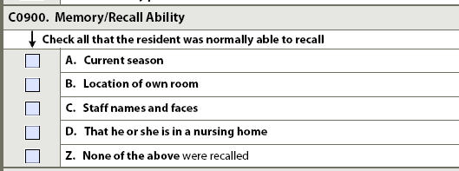
C0900: Memory/Recall
Coding
Check each item recalls
Check Z. None of the above if recalls none of items listed
Notes:
33

Slide 34
C1000: Cognitive Skills for Daily Decision Making
Ability to make daily decisions:
  Choose clothes
  When to go to meals
  Use environmental cues to organize & plan day
  Seek information appropriately from others
  Aware of own strengths & limitations to regulate days events
  Acknowledge need to use appropriate assistive equipment

Slide 35
C1000: Cognitive Skills for Daily Decision Making - Assessment
Performance in actual decision making
Not what staff believes resident might be capable of doing
Impaired performance in decision making characterized by:
  Staff or family taking away responsibility
  Resident chooses not to participate in decision making

Slide 36
C1000 - Coding
Code 0. Independent.
  Decisions in organizing daily routine and making decisions consistent, reasonable and organized reflecting lifestyle, culture, values.
Code 1. Modified Independence.
  Organized daily routine and made safe decisions in familiar situations, but experienced some difficulty in decision making when faced with new tasks or situations.
Code 2. Moderately Impaired.
  Decisions were poor; required reminders, cues, and supervision in planning, organizing, and correcting daily routines.

Slide 37
C1000 - Coding
Code 3. Severely Impaired.
  Decision making severely impaired; never (or rarely) made decisions.
  May give basic verbal, non-verbal, simple gestures, or questions regarding care routines
  May be primarily non-verbal & does not make needs known
Exercising right to decline treatment recommendations by IDT not impaired decision making
Notes:
37

Slide 38
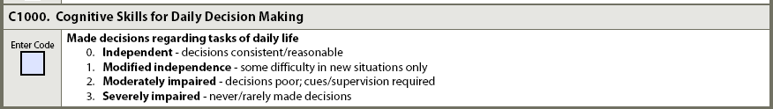
C1000: Cognitive Skills for Daily Decision-Making - Coding
Code actual cognitive skill for daily decision making
Notes:
38

Slide 39
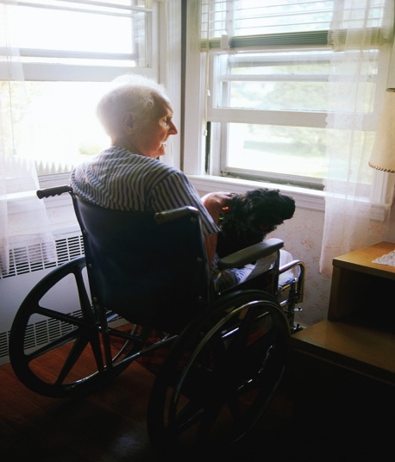
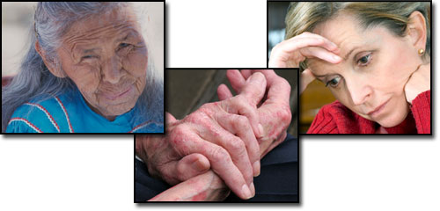
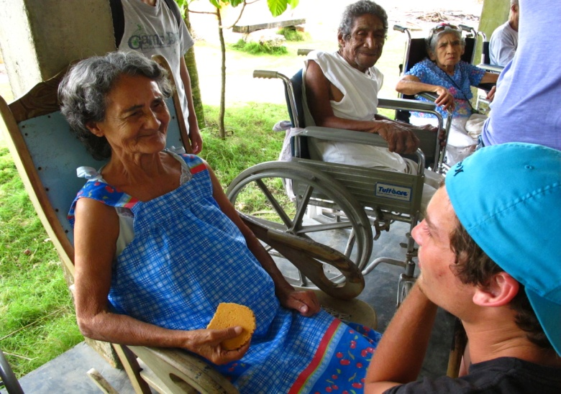
SECTION C
COGNITIVE PATTERNS
DELIRIUM
CONFUSION ASSESSMENT METHOD (CAM) C1300-C1600
Notes:
39

Slide 40
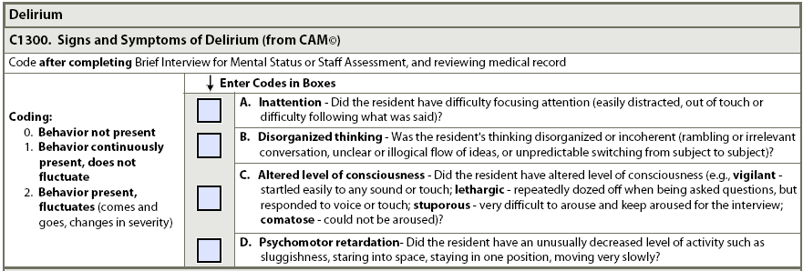
Confusion Assessment Method CAM
©
Standardized instrument developed to facilitate detection of delirium
4 components
  Inattention
  Disorganized thinking
  Altered level of consciousness
  Psychomotor retardation

Slide 41
CAM
Signs & Symptoms of Delirium
©
A. Inattention
  Reduced ability to maintain attention to external stimuli and to appropriately shift attention to new external stimuli.
  Seems unaware or out of touch with environment
  May test by counting backward from 20
B. Disorganized thinking
  Evidenced by rambling, irrelevant, or incoherent speech

Slide 42
CAM
Signs & Symptoms of Delirium
©
C. Altered level of consciousness
  Vigilant – startles easily to any sound or touch
  Lethargic – repeatedly dozes off when asked questions, but responds to voice or touch
  Stupor – very difficult to arouse and keep aroused for interview
  Comatose – cannot be aroused despite shaking & shouting; (A Comatose Diagnosis is not required)
D. Psychomotor retardation
  Greatly reduced or slowed level of physical activity or mental processing

Slide 43
C1300: Signs & Symptoms of Delirium - Assessment
While conducting BIMS:
  Observe for signs and symptoms of delirium
If conducting Staff Assessment for Mental Status
  Ask staff members about observations of signs and symptoms of delirium
Review medical record
  Baseline status - Presence or Absence of S/S
  Fluctuations
  Behaviors not observed during BIMS or reported by staff
Interview staff, family members, significant other

Slide 44
C1300: Signs & Symptoms of Delirium - Coding
Code 0. Behavior not present
Code 1. Behavior continuously present, did not fluctuate
Code 2. Behavior present, fluctuates (comes and goes, increases or decreases in severity
  Information sources disagree

Slide 45

C1600: Is there Evidence of an Acute Change in Mental Status?
7 day look-back period
  Alteration in mental status new or worse usually over hours to days (Appendix A-1)
Code 0. No. No evidence of acute mental status change from baseline
Code 1. Yes. Alteration in mental status observed in past 7 days or in BIMS that represents change from baseline

Slide 46
Care Plan Considerations
Cognition abilities is important to enhance communication and to facilitate greater independence
An observed “difficulty with daily decision making” may indicate possible anxiety or depression
Resident may need more structure, encouragement to participate, or an assessment for underlying medical causes

Slide 47
Questions?
I’ll take a few minutes to answer any questions you might have.

Slide 48
Thank you!!!
Contact me any time
Shirley L. Boltz, RN
RAI/Education Coordinator
785-296-1282
shirley.boltz@kdads.ks.gov

