Slide 1

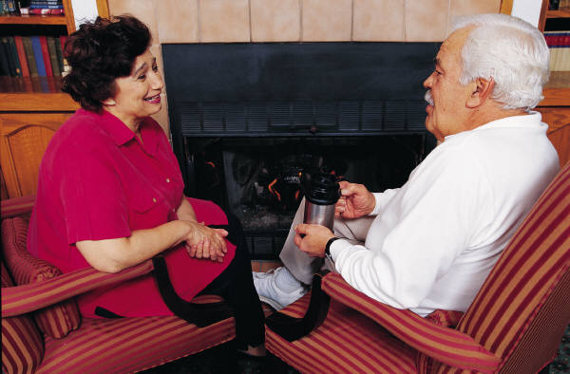
Section B
January 12, 2016 1-3 PM
Hearing, Speech, & Vision
Notes:
1

Slide 2
Objectives
Understand the importance of this information in order to prevent social isolation
Understand the steps for doing the assessment
Understand how to code Section B correctly
Understand what needs to be on the care plan

Slide 3





Section B
Hearing, Speech, Vision
Ability to hear, understand and communicate with others. Speech clarity and visual limitations or difficulties.
Notes:
3

Slide 4

B0100: Comatose
Comatose, Persistent Vegetative State
  Not end-stage Alzheimer’s Disease
Code 1. Yes. Physician documented DX
  →SKIP to Section G. Functional Status
Notes:
4

Slide 5
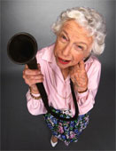
B0200: Hearing
Level of hearing
Always attempt resident interview
  Use hearing aid or appliance as normal
  Ask ability to hear in different situations
Ask family, significant other, staff, specialists
Observe resident who is cognitively impaired in various situations

Slide 6
B0200: Hearing – Coding
Code 0. Adequate.
  No difficulty in normal conversation, social interaction, or listening to TV.
  Hears all normal conversational speech and telephone conversation and announcements in group activities.
Code 1. Minimal Difficulty.
  Difficulty in some environments, e.g., when person speaks softly or noisy setting.
  Hears speech at conversational levels but difficulty hearing when not in quiet listening conditions or when not in one-on-one situations.
  Hearing adequate after environmental adjustments made, i.e. reducing background noise by moving to quiet room or by lowering volume on television or radio.

Slide 7
B0200: Hearing – Coding
Code 2. Moderate Difficulty.
  Speaker has to increase volume and speak distinctly.
  Although hearing-deficient,
    compensates when speaker adjusts tonal quality and speaks distinctly; or
    can hear only when speaker’s face clearly visible.
Code 3. Highly Impaired.
  Absence of useful hearing for conversing.
  Hears only some sounds and frequently fails to respond even when speaker adjusts tonal quality, speaks distinctly, or positioned face-to-face.
  No comprehension of conversational speech, even when speaker makes maximum adjustments.

Slide 8
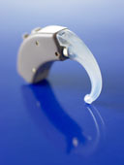
B0300: Hearing Aid
Code 1. Yes. Did use hearing aid (or other hearing appliance) for Hearing Assessment in B0200

Slide 9
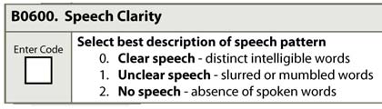
B0600: Speech Clarity
Quality of Speech not content or appropriateness
Listen to resident speak
Ask staff
Review clinical record
Notes:
9

Slide 10




B0700: Makes Self Understood*
B0800: Ability to Understand Others
Ability to express or communicate requests, needs, opinions, and to conduct social conversation in primary language.
Comprehension of direct person to person communication.
Gestures, Verbal,
Written, Sign Language, Braille, Combination

Slide 11
Assessment
Interact with resident
Use preferred language & communication devices
Observe interactions with others, ability to communicate and understand
Interview primary caregivers, family, SLP as appropriate

Slide 12
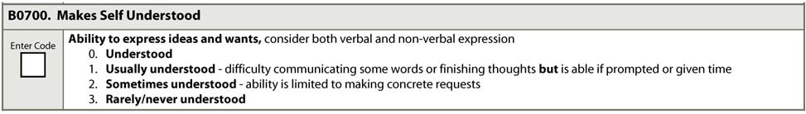
*B0700: Makes Self Understood*
Code 0. Understood. Expresses requests & ideas clearly
Code 1. Usually Understood. Difficulty communicating words or finishing thoughts but able if prompted or given time. May have delayed responses or may require some prompting to make self understood
Code 2. Sometimes Understood. Limited ability, but able to express concrete requests of basic needs: food, drink, sleep, toilet
Code 3. Rarely or Never Understood. Understanding limited to staff interpretation of highly individual, specific sounds or body language (e.g., in pain or need to toilet)
Notes:
12

Slide 13
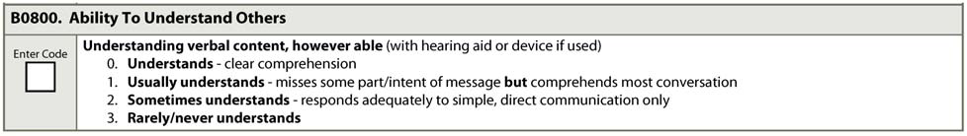
B0800: Ability to Understand Others
Code 0. Understands.
  Clearly comprehends message(s) and demonstrates
  comprehension by words or actions/behaviors.
Code 1. Usually Understands.
  Misses some part or intent of message but comprehends
  most of it. May have periodic difficulties integrating
  information but generally demonstrates comprehension
  by responding in words or actions.
Notes:
13

Slide 14
B0800: Ability to Understand Others
Code 2. Sometimes Understands.
  Demonstrates frequent difficulties integrating information, and responds adequately only to simple and direct questions or instructions.
  When staff rephrase or simplify message(s) and/or use gestures, comprehension enhanced.
Code 3. Rarely/Never Understands.
  Demonstrates very limited ability to understand communication.
  Staff have difficulty determining whether or not comprehends messages, based on verbal and nonverbal responses.
  Hears sounds but does not understand messages.

Slide 15
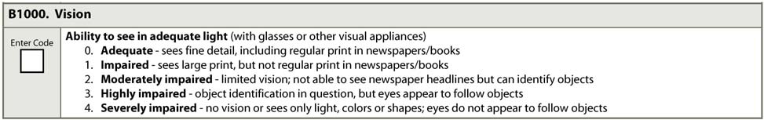
B1000: Vision
Ask staff & resident usual vision pattern
Test close vision with visual appliance in place & adequate lighting
  Have read aloud newspaper, start with headlines & end with smallest print
  If unable to read newspaper print, provide other items with larger print, e.g. flyer, large print book
  Aphasia or illiteracy provide numbers, or pictures that are equivalent in size to regular and large print

Slide 16
B1000: Vision
Code 0. Adequate. Sees fine detail, including regular print in newspapers/books.
Code 1. Impaired. Sees large print, but not regular print in newspapers/books.
Code 2. Moderately Impaired. Limited vision and not able to see newspaper headlines but can identify objects in environment.
Code 3. Highly Impaired. Ability to identify objects in environment in question, but appears to follow objects (especially people walking by).
Code 4. Severely Impaired. No vision, sees only light, colors or shapes, or does not appear to follow objects with eyes.

Slide 17

B1200: Corrective Lenses
Code 1. Yes. Used eyeglasses, corrective lenses, or other visual aids during B1000: Vision assessment
Do not Code 1. Yes. If uses corrective lenses or another visual aid on regular or daily basis but did not use for B1000: Vision assessment
Visual aids do not include surgical lens implants.

Slide 18
Care Plan Considerations
Is the elder Comatose or in a Persistent Vegetative State
Are hearing aides used and if so in which ear and how does the elder take care of them, i.e. take them out at night and store them where, change batteries how often, clean them
If hard-of-hearing and no hearing aides used, which ear can they hear the best with, do they read lips, is it easier to write their communications, does a hearing evaluation need to be scheduled and who do they use
A quiet environment is always necessary or it doesn’t make a difference

Slide 19
Care Plan Considerations continued
Unclear or absent speech can be very frustrating and can result in physical and psychosocial needs not being met resulting in depression and social isolation. Staff must know how to determine what the resident needs
Inability to understand others can severely limit associating with others and inhibit their ability to follow instructions
Moderate, high, or severe vision impairment can contribute to sensory deprivation, social isolation and depressed mood
Do they wear glasses, if so, when. How do they care for them, where do they store them

Slide 20
Questions?
I’ll take the next few minutes to answer any questions you might have

Slide 21
Thank you!!
Please feel free to contact me
Shirley L. Boltz, RN
RAI/Education Coordinator
785-296-1282
shirley.boltz@kdads.ks.gov

