Slide 1
Involuntary Commitment Patient Observation and Transportation Reimbursement
July 27, 2023
Scott Brunner, Deputy Secretary
Department for Aging and Disability Services

Slide 2
2023 Legislature HB 2184
HB 2184 directs KDADS to reimburse healthcare providers, law enforcement, and other county entities for unpaid costs of patient observation and transportation.
(x) During the fiscal year ending June 30, 2024, in addition to the other purposes for which expenditures may be made by the above agency from moneys appropriated from the state general fund or any special revenue fund or funds for fiscal year 2024 as authorized by this or any other appropriation act of the 2023 regular session of the legislature, expenditures shall be made by the above agency from such moneys in an amount not to exceed $5,000,000 for the purpose of reimbursing healthcare providers, law enforcement and other county entities for unpaid costs of patient observation and transportation.
Notes:
There’s a

Slide 3
Key points to the process
KDADS is authorized to healthcare providers, law enforcement, and other county entities. Any organization requesting payment must be registered in SMART (State Accounting System).
HB 2184 directs reimbursement for unpaid costs. The proposed KDADS process collects reimbursement requests from the designated types of providers. The reimbursement is for costs within the State fiscal year – July 1, 2023 through June 30, 2024.
There’s no rate established in the Appropriations bill for observation costs or transportation. $5 million is appropriated to KDADS for this purpose.
Proposing to reimburse for patients waiting for admission to Larned State Hospital, Osawatomie State Hospital, or a State Institution Alternative provider. KDADS can verify reimbursement requests against patients ordered for involuntary commitment under the Care and Treatment Act.

Slide 4
Hospital and Health Care Provider Reimbursement
Health care providers can be reimbursed from the time a patient is screened for state hospital level of care by the Community Mental Health Center or HealthSource screener.
From the time of the completed mental health screening that recommends state hospital admission, hospitals can start the time for reimbursement. The state hospitals will still complete their admissions process which can include requesting lab tests, requesting additional information from hospital staff on patient treatment, and completing the legal requirements for involuntary admission.
If the patient is not found to need the state hospital by referring for outpatient treatment or connection to community resources, that patient is not waiting for admission to a state hospital or State Institution Alternative hospital. Those patients screened but not found to need a state hospital admission are not eligible for reimbursement through this program.

Slide 5
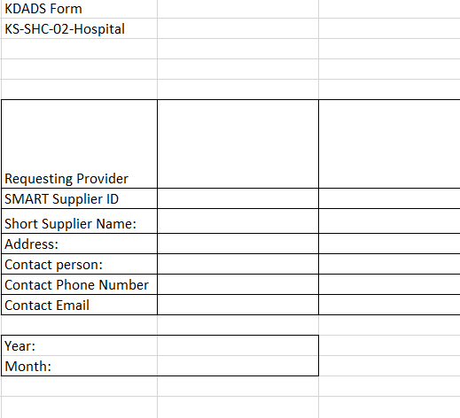
Provider Payment and Contact Information
Hospital and Health Care Providers
Requesting Organization is the name of the health care provider or hospital making the request for payment.
SMART Supplier ID is a 5-digit number assigned by the state Division of Accounts and Reports.
Short supplier name is assigned in SMART. This could help match up a county with Vendor ID if there is a discrepancy.
The Supplier ID and Supplier Name are critical to matching a payment to the right county or provider and processing the payment.

Slide 6
Time Frame for the Reimbursement
The selection should be the timeframe when services were provided, and reimbursement is requested.
The possible years are 2023 and 2024 for the correct state fiscal years.
Notes:
This doesn’t exactly work for reimbursing for the full state fiscal year from July 1, 2022 through June 30, 2023.

Slide 7
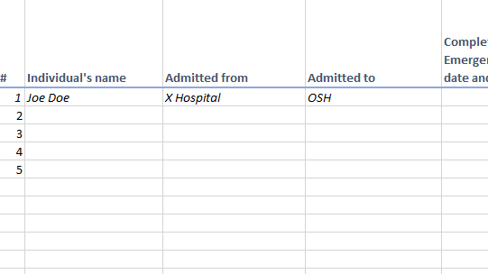
Information about patients
Name should match the patient being assessed for protective custody or for an emergency commitment.
“Admitted from” is the location the patient is being held prior to being admitted to a state hospital. This could be the hospital, a Law Enforcement Organization, or Community Mental Health Center. There should be a connection to the organization requesting reimbursement.
“Admitted to” is a drop down box. Select the appropriate state hospital or SIA.
Notes:
With name should we also ask for other identification information. Date of Birth?

Slide 8
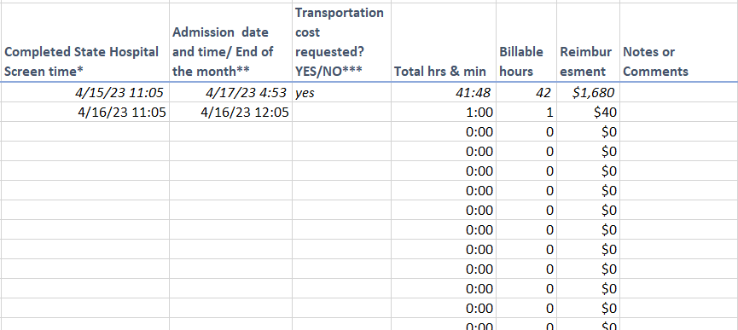
Information about Dates and Payment
“Completed State Hospital Screen Time” is the start time for reimbursement. This should be the date and time a patient has been screened and recommended for state hospital admission.
“Admission date and time…” is when the patient is out of protective custody and is being admitted to the state hospital or SIA facility.
The reimbursement amount is calculated by subtracting the two dates to generate the number of hours.
Reimbursement is $40 per hour to capture the inclusive costs for patient observation.
If transportation costs are being requested, note that as a yes/no and then complete the cost section on the second tab of the workbook.
Notes:
Do we need a better way to communicate when a patient is approved for admission to a state hospital or SIA? Is it clear to hospitals when a patient has been admitted but is waiting for a bed due to space concerns.
If waiting for Medical clearance or legal order, that patient isn’t approved for admission.

Slide 9
Information about Transportation Costs
The second tab in the workbook has a separate spreadsheet to capture transportation costs.
Built to reimburse the round trip mileage at the state rate of $ 0.585 per mile or a lump sum amount.
Providers could send the bill from secure transport service, ambulance, or other provider.
Any costs related to staff observation during the transport would be included in the hourly reimbursement amount.

Slide 10
Reimbursement Process
Submit reimbursement forms to KDADS.reimburse@ks.gov with any supporting documentation.
If a provider is not enrolled in SMART as a vendor, submit the DA-130 form to register and a W-9 (forms will be provided and available on the KDADS website)
Upon submission of a claim form, KDADS will verify the entity submitting the report as a vendor in SMART, verify the patients with patient lists from LSH and OSH.
KDADS will verify the patient has a court ordered Care and Treatment case, the admission status at the state hospital or SIA, and relevant dates of the order and admission.
KDADS will validate the requested payment amount, create an invoice for one payment to the facility for the month, and send to KDADS accounting for payment to the registered vendor. Expect processing to payment within 30 days of submission.

Slide 11
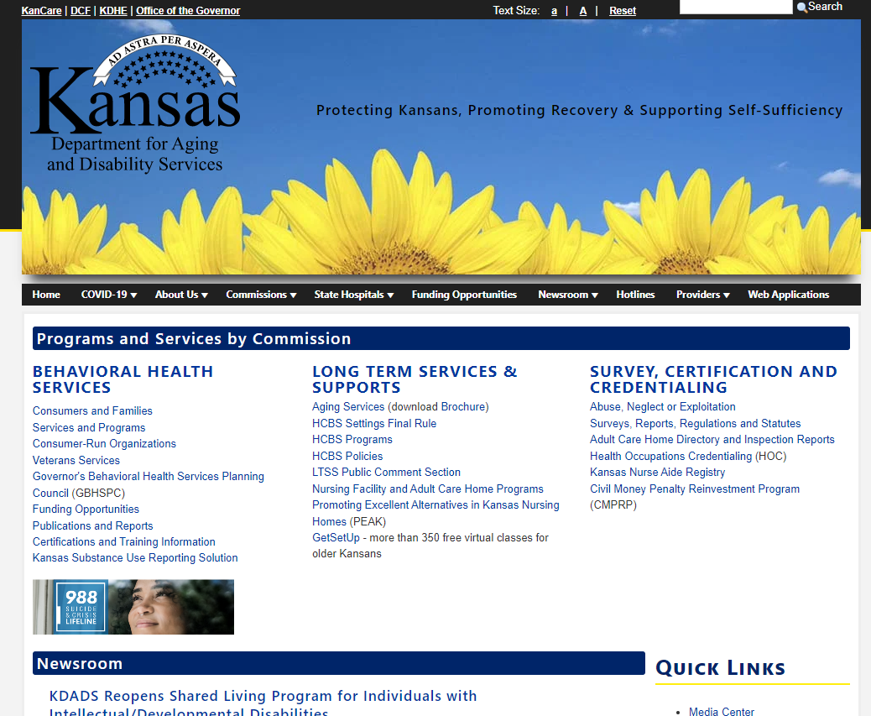
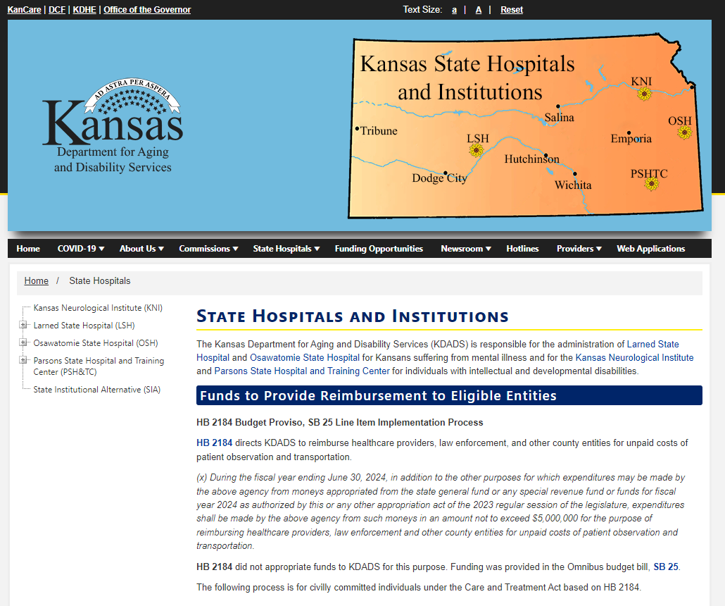
Contact information
KDADS.ks.gov/state-hospitals-and-institutions

Slide 12
Contact Information
KDADS.reimburse@ks.gov
Submission of forms
Additional documentation
Questions about the process or status
Suggestions for improvement
Scott Brunner
Scott Brunner@ks.gov
785-296-0237

