Slide 1
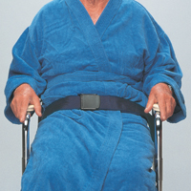
SECTION P
Physical Restraints
January 21, 2016
1-3PM

Slide 2
Objectives
Understand whether or not a device meets the definition of a physical restraint
Understand how to code Section P correctly
Understand what needs to be on the care plan

Slide 3
DEFINITION
Manual method or physical or mechanical device, material, or equipment
Attached or adjacent to resident’s body that individual cannot remove easily
Which restricts freedom of movement or normal access to one’s body

Slide 4
Section P: Physical Restraint
Use not prohibited
Must assess resident before using
Only to treat resident’s medical symptoms
Physician order - type, parameter of use
Not use for discipline or staff convenience
Care plan – process for systematic and gradual restraint reduction

Slide 5
P0100: Physical Restraints
USED IN BED
A. Bed rail
B. Trunk restraint
C. Limb restraint
D. Other
USED IN CHAIR OR OUT OF BED
E. Trunk restraint
F. Limb restraint
G. Chair prevents rising
H. Other

Slide 6
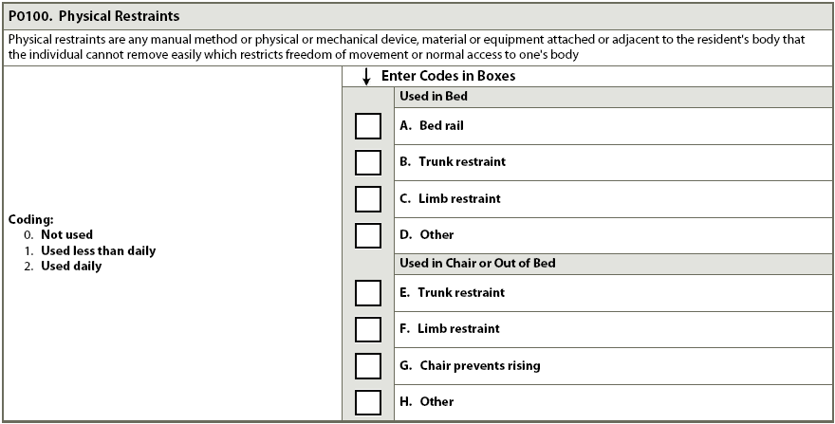
P0100: Physical Restraints
Frequency of use of each type:
Code 0. Not used: During 7 day look-back or used but did not meet definition
Code 1. Used less than daily: Met definition & used < daily
Code 2. Used daily: Met definition& used on daily basis during look-back period

Slide 7
Care Plan Considerations
If a restraint is being used specify what it is, when it should be released, why it’s being used, and how it is going to be discontinued
Best case is not to use any restraints

Slide 8
Questions?
I’ll take a few minutes to answer any questions you might have.

Slide 9
Thank you!!
Please feel free to contact me at any time
Shirley L. Boltz, RN
RAI/Education Coordinator
785-296-1282
shirley.boltz@kdads.ks.gov

