Slide 1

SECTION N
MEDICATIONS
January 19, 2016 1-3PM
Injection – SQ, IM, ID
Insulin Injection and/or
Selected Medications
Notes:
1

Slide 2
Objectives
Understands this records injections and select medications the resident received during the 7 day look-back period
Understands how to code Section N correctly
Understands what needs to be on the care plan

Slide 3
10-1-2015 Changes
Keep in mind that, for clinical purposes, it is important to document a resident’s intake of such herbal and alternative medicine products elsewhere in the medical record and to monitor their potential effects as they can interact with medications the resident is currently taking. For more information consult the FDA website http://www.fda.gov/food/dietarysupplements/usingdietarysupplements/. Page N-8

Slide 4
Look Back Period
7 day look-back period
Since admission/entry or reentry if <7 days
Received as resident --- even if in another health care location, e.g. physician’s office, ER as long as they were not admitted.
Not as inpatient in hospital

Slide 5
N0300: Injections
Number of days medication, antigen, vaccine administered per SQ, IM, Intradermal Injection
Count only day SQ injection given to start pump
One or more injections given on same day=1 day
Notes:
5

Slide 6
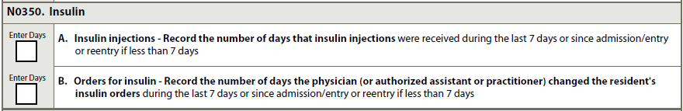
N0350: Insulin
A. Insulin Injections
  Number of days insulin injection(s) received
B. Orders for insulin
  Number of days insulin order(s) received or changed

Slide 7
N0350B. Insulin Order
If Sliding Scale Insulin Order count only Day(s):
  Initial order received
  Revised or changed
  Discontinued
Do not count when different doses administered

Slide 8
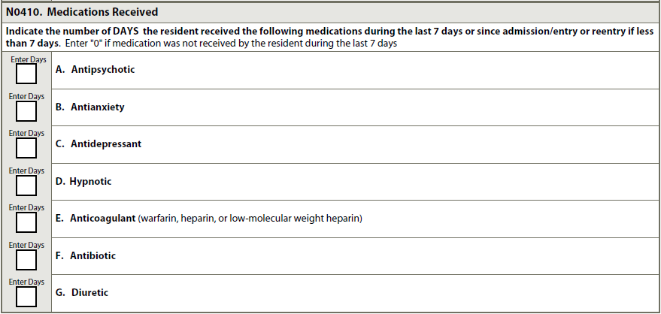
N0410: Medication Received
Number of Days received

Slide 9
N0410: Medication Received
  Code medications:
    According to therapeutic category and/or pharmacological classification, not how used
    Given any route in any setting while resident
    Even if given only once during look-back period
    Long-acting medications given every few weeks or monthly only if given during look-back period
    Combination medications code in all categories that constitute combination.
  Do not code:
    OTC sleeping medications as hypnotics
    Antiplatelet medication as anticoagulant
    Herbal or alternative medicine products
Notes:
.

Slide 10
Unnecessary Medications – F329
Diagnosis
Dose
Monitoring for effectiveness:
  target symptoms, goals
Monitoring for side effects
Monitoring for black box warnings – Care Plan
Behavior monitoring
Gradual Dose Reductions
Partnership to Improve Dementia Care
  http://www.nhqualitycampaign.org

Slide 11
Care Plan Considerations
All Black Box Warnings need to be listed and what staff needs to monitor for. Use terminology that everyone can understand
The meds need to be listed by name and not classification
Specify non-pharmacological interventions – such as walking, reading, music, food, etc.

Slide 12
Questions?
I’ll take the next few minutes to answer any questions you might have

Slide 13
Thank you!!
Please feel free to contact me
Shirley L. Boltz, RN
RAI/Education Coordinator
785-296-1282
shirley.boltz@kdads.ks.gov

