Slide 1


SECTION A Identification Information
January 12, 2016 1-3PM
  Resident
  Facility
  Reasons for Assessment

Slide 2
Objectives
Understand the facility’s provider numbers
Understand how to correctly code Section A
Understand how valuable this information is in order to provide quality care and quality of life
Understand how important it is to have this information included in the care plan

Slide 3
10-1-2015 Changes
Facilities must have a National Provider Identifier (NPI) and a CMS Certification Number (CCN).
Enter the facility provider numbers:
A. National Provider Identifier (NPI)
B. CMS Certification Number (CCN) Page A-3
Date of last day covered as recorded on the effective date from the Notice of Medicare Non-Coverage (NOMNC); or Page A-31
Examples
1. Mrs. G. began receiving services under Medicare Part A on October 14, 2010. Due to her stable condition and ability to manage her medications and dressing changes, the facility determined that she no longer qualified for Part A SNF coverage and issued an Advanced Beneficiary Notice (ABN) and an NOMNC with the last day of coverage as November 23, 2010. Mrs. G. was discharged from the facility on November 24, 2010. Code the following on her Discharge assessment: Page A-32

Slide 4
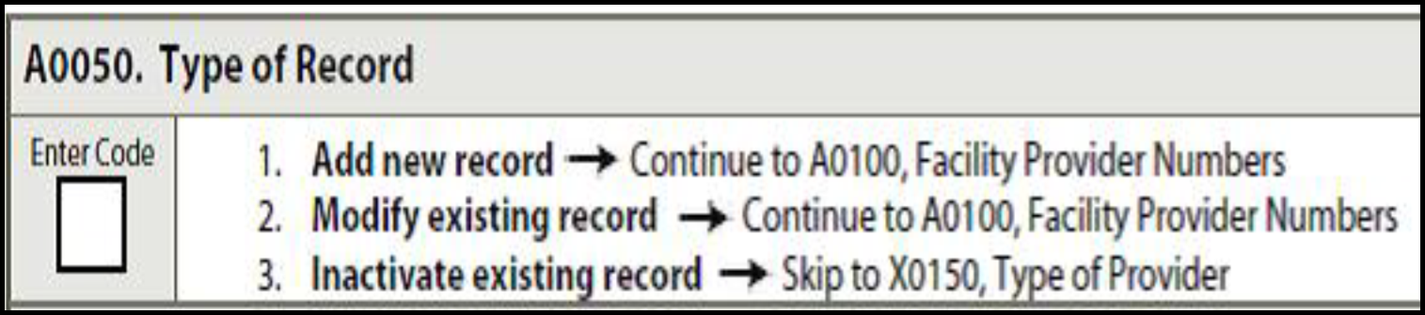
A0050: Type of Record
Code 1. Add new record
  if new record not previously submitted and accepted in QIES ASAP system

Slide 5
A0050: Type of Record
Code 2. Modify existing record
  If request to modify MDS items for record that already has been submitted and accepted in QIES ASAP system.
  If record NOT FOUND, the submitted modification record will be rejected.
Code 3. Inactivate existing record
  If request to inactivate a record already submitted and accepted in QIES ASAP system
  If record NOT FOUND, the inactivation request will be rejected.
  →Skip to X0150. Type of Provider

Slide 6
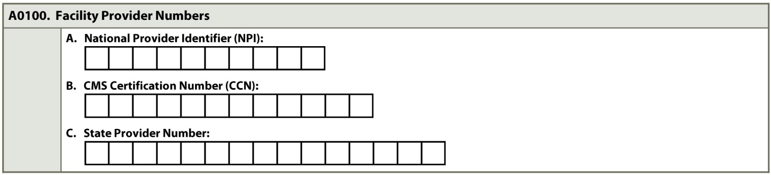
A0100: Facility Provider Numbers
Identification of Facility
A. NPI
  National Provider Identifier
B. CCN
  CMS Certification Number
C. State Provider Number
  State Provider Number

Slide 7
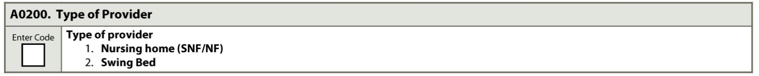
A0200: Type of Provider
Code 1. Nursing Home
  SNF (Medicare)
  NF (Medicaid)
Code 2. Swing Bed
  Rural hospital with <100 beds, CMS approved to provide post hospital SNF care. Beds provide either acute or SNF care

Slide 8
A0310: Type of Assessment
Identifies needed assessment content
One assessment may be completed for more than one Type of Assessment
Combined assessments must meet all requirements for each type of assessment
  Chapter 2
  OBRA
  PPS

Slide 9
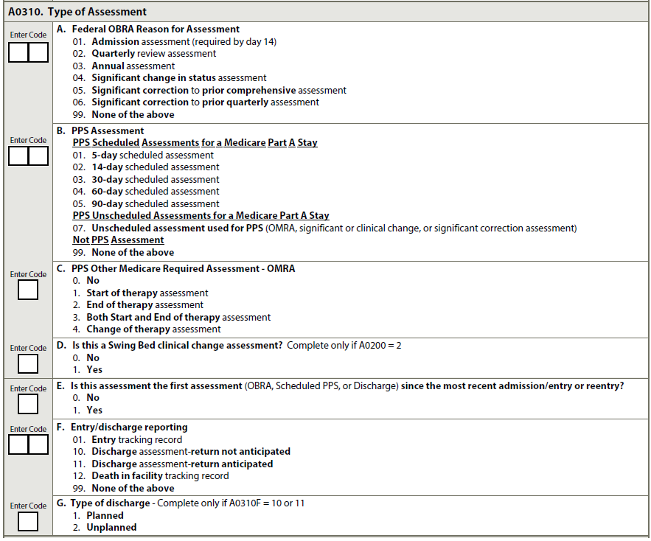
A0310

Slide 10
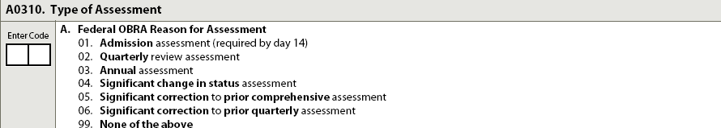
A0310A. Federal OBRA
01. Admission; 02. Quarterly; 03. Annual;
04. SCSA; 05. SCPCA; 06. SCPQA;
99. None of the Above

Slide 11
A0310B. PPS Medicare
Scheduled Assessments:
  01. 5-day
  02. 14-day
  03. 30-day
  04. 60-day
  05. 90-day
Unscheduled assessments
  07. OMRA, Significant Change, Significant Correction
Not PPS Assessment = 99. None of the Above

Slide 12
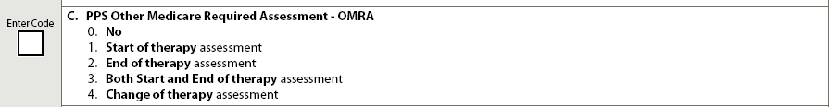
A0310C. PPS OMRA
Assessments related to skilled therapy services
  Code 0. No. Not OMRA assessment
  Code 1. Start of Therapy.
  Code 2. End of Therapy.
  Code 3. Both start and end of therapy. ARD same criteria as Code 1 and 2 (except when short stay assessment – Chapter 6 – page 6-19)
  Code 4. Change of Therapy.

Slide 13
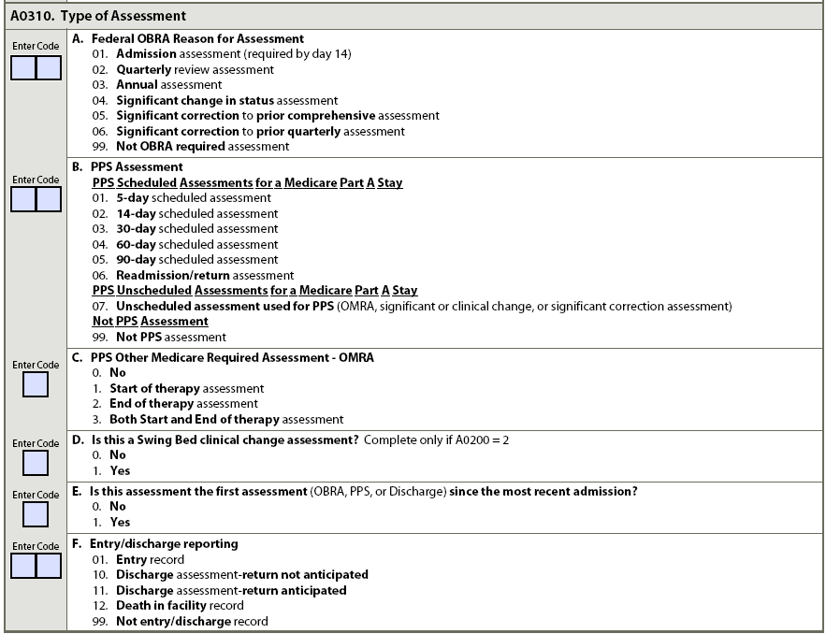
A0310D. Swing Bed
Clinical Change Assessment
Complete only if:
A0200. Type of Provider = 2. SWB

Slide 14
A0310E. First Assessment
Since Most Recent Admission/Entry or Reentry
Is this first OBRA, Scheduled PPS, or Discharge assessment since the most recent Admission/Entry or Reentry?
Code 0. No
Code 1. Yes
Notes:
A0310E, Is This Assessment the First Assessment (OBRA, PPS, or Discharge) since the Most Recent Admission/Entry or Reentry?

Slide 15
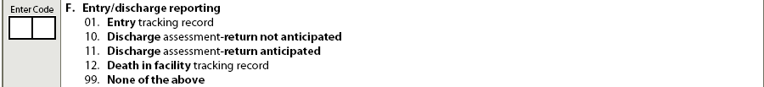
A0310F. Entry/Discharge Reporting
Tracking Record or Discharge Assessment
  01. Entry
  10. DRNA
  11. DRA
  12. Death in Facility
  99. None of the above.

Slide 16
A0310G. Type of Discharge
Complete only if:
  A0310F. is 10. DRA or 11. DRNA
Code 1. Planned discharge
Code 2. Unplanned discharge
*Complete only if:
  A0310F is 10. DRA or 11. DRNA

Slide 17
A0410: Submission Requirement
Submission authority
Do not submit MDS if facility licensed only, or if assessment completed for private insurance company or managed care company.

Slide 18
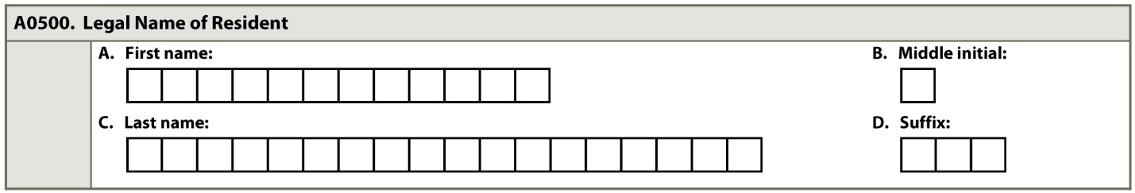
A0500: Legal Name of Resident
Name on Medicare or Medicaid card or other government issued ID
A. First Name
B. Middle Initial – if none, leave blank; if 2 or more use initial of first middle name
C. Last Name
D. Suffix (e.g. Jr/Sr)

Slide 19
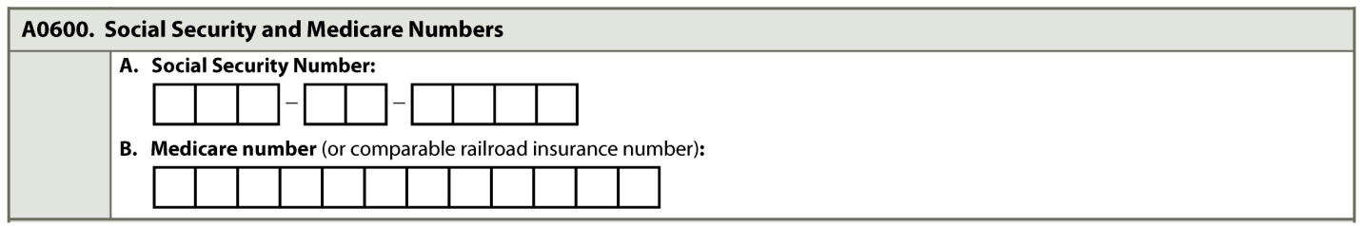
A0600: A. Social Security Number
B. Medicare Number
A. SSN. If none, leave blank
B. Medicare number. (Not HMO)
  If no Medicare number, use RRB (Railroad Retirement Board) number
  If no Medicare or RRB number, leave blank
PPS assessments either SSN or Medicare/RRB number – both cannot be blank

Slide 20
A0700: Medicaid Number
Medicaid recipient
“+” if number pending, add to next
assessment
“N” if not Medicaid recipient

Slide 21
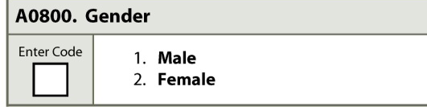
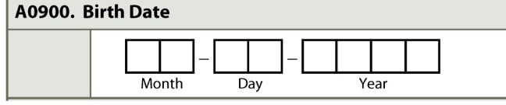
A0800: Gender
Must match data Social Security system
A0900: Birth Date
  If portion of birth date unknown, e.g. month or day, leave coding reference box blank

Slide 22
A1000: Race/Ethnicity
Categories follow common uniform language of Office of Management and Budget. Definitions A-13
Ask resident, family, significant other to select categories most closely correspond

Slide 23
A1100: Language
Interpreter needed or wanted to communicate with doctor or staff:
  Ask resident first. If unable ask family member or significant other
  Review medical record if no other source
Interpreter needed, ask preferred language
Family member or significant other as interpreter:
  Resident comfortable
  Will translate exactly what resident says without providing own interpretation

Slide 24
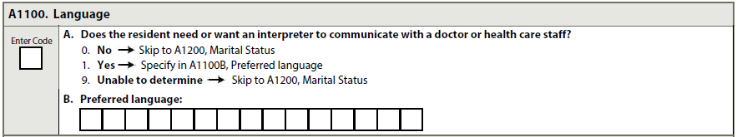
A1100A. Does the resident need or want an interpreter to communicate with doctor or health care staff?
Code 0. No – skip to A1200, Marital Status
Code 1. Yes
  Complete A1100B Preferred Language
Code 9. Unable to determine
  No source can identify. Skip to A1200, Marital Status

Slide 25
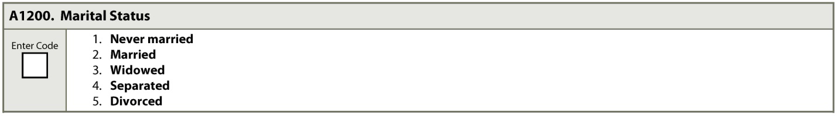
A1200: Marital Status
Best description

Slide 26
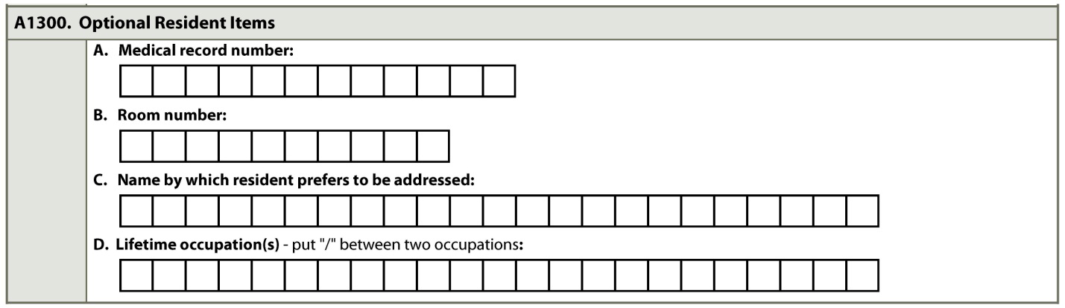
A1300: Optional Resident Items
Facility Use
  A. Medical Record Number
  B. Room Number
  C. Name preferred or most familiar
  D. Life Time Occupations
      Assists activity planning and conversation

Slide 27
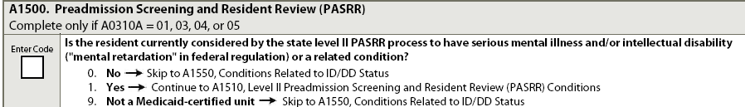
A1500: PASRR
Is resident currently considered by state level II PASRR process to have serious mental illness &/or intellectual disability (“mental retardation” in federal regulation) or related condition?
Complete only on following Assessments:
  A0310A.= 01. Admission; 03. Annual; 04. SCSA; 05. SCPCA
Resident with MI or ID (Intellectual Disability)/DD
PASRR report provided by state

Slide 28
A1500: PASRR - Coding
Code 0. No. If any of the following apply:
  Level I screening did not result in referral
  Level I screening determined resident does not have serious MI/ID/DD or related condition
  PASRR screening not required when:
    Resident admitted from hospital after acute inpatient care AND
    Receiving service for condition received care for in hospital AND
    Attending physician certified before admission likely require <30 days of nursing home care
  →Skip to A1550.
Notes:
Coding Instructions

Slide 29
A1500: PASRR - Coding
Code 1. Yes.
  Level II screening determined resident has serious mental illness/intellectual disability or related condition
Code 9. Not a Medicaid certified unit
  Facility not Medicaid certified
  If facility not totally Medicaid certified, bed not in Medicaid certified part of building
  →Skip to A1550.

Slide 30
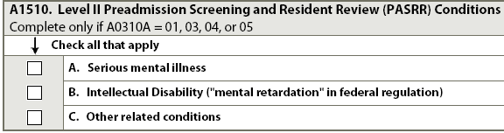
A1510: Level II Preadmission Screening & Resident Review
(PASRR) Conditions
Complete only on following Assessments:
  Admission; Annual; SCSA; SCPCA
Check all that apply
  A. Serious mental illness
  B. ID
  C. Other related conditions

Slide 31
A1550: Conditions
Related to ID/DD Status
Complete on Resident:
  22 years or older on assessment date
    Admission assessment only (A0310A=01)
  21 years or younger on assessment date
    Admission assessment (A0310A = 01)
    Annual assessment (A0310A = 03)
    Significant change in status assessment
    (A0310A =04)
    Significant correction to prior comprehensive assessment (A0310A =05)
Condition Definitions - A-20 & 21

Slide 32
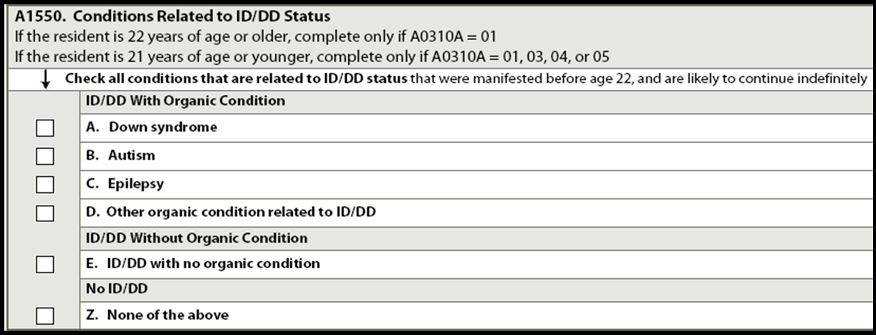
A1550: Conditions related to ID/DD
Check all conditions related to ID/DD and related conditions present before age 22.
When age of onset not specified, assume condition meets this criterion AND likely to continue indefinitely.

Slide 33
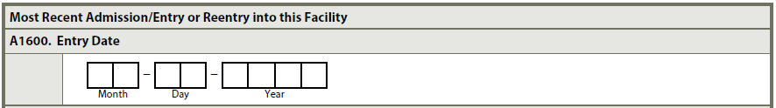
A1600: Entry Date
  Initial date of admission to facility
  Most recent date of admission/entry or reentry into facility

Slide 34

A1700: Type of Entry
Identifies if A1600. Entry Date is
  1. Admission date
  2. Reentry date

Slide 35
A1700: Type of Entry - Coding
Code 1. Admission. One of following occurs:
  Never before admitted to facility; OR
  DRNA; OR
  DRA & did not return within 30 days

Slide 36
A1700: Type of Entry - Coding
Code 2. Reentry. All 3 of following occur prior to this entry
  Admitted to facility AND
  Discharged return anticipated AND
  Returned to facility within 30 days of discharge
    Discharge date not counted in 30 days
    Both Swing Bed facilities and Nursing Homes must apply the above rules.

Slide 37
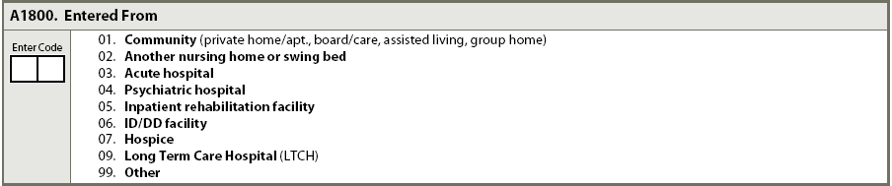
A1800: Entered From
Setting immediately prior to this admission/entry or reentry

Slide 38
A1800: Code 09
Long Term Care Hospital(LTCH)
For the purpose of Medicare payment Long Term Care Hospitals (LTCHs) are defined as having an average inpatient length of stay greater than 25 days

Slide 39

A1900 Admission Date
A1900 Admission Date (Date this episode of care in this facility began)
Document the date this episode began
The admission Date may be the same as the Entry Date for the entire stay
The episode ends when the resident is Discharged Return Not Anticipated OR the resident is Discharged Return Anticipated, but they did not return within 30 days

Slide 40
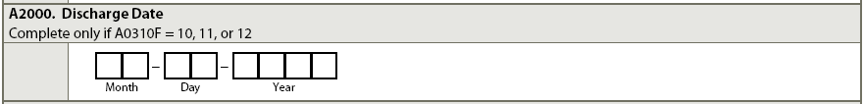
A2000: Discharge Date
Date left facility (DRA or DRNA)
Discharge Date (A2000) and ARD (2300) must be same for discharge assessments
Discharge date may be later than end of Medicare stay (A2400C) if receiving services under SNF Part A PPS

Slide 41
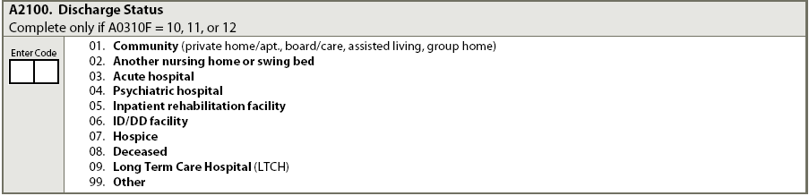
A2100: Discharge Status
Complete only if A0310F. 10. DRA; 11. DRNA; 12. Death in Facility
Review discharge plan and orders
Discharge location
A-24

Slide 42
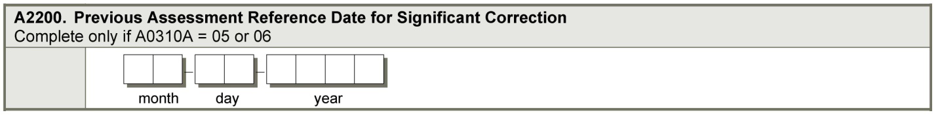
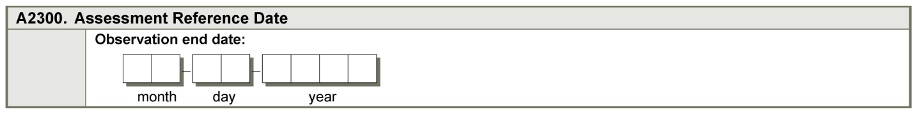
A2200: Previous Assessment Reference Date for Significant Correction
ARD of Corrected Comprehensive or Quarterly Assessment
A2300: Assessment Reference Date (ARD)
End of Look-Back (Observation) Period of Assessment

Slide 43
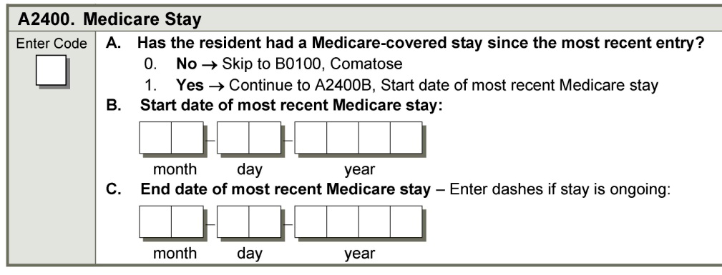
A2400: Medicare Stay
A. Has resident had a Medicare-covered stay
since most recent entry ?
    Code 0. No →Skip to B0100, Comatose
B. Start date of most recent Medicare stay
C. End date of most recent Medicare stay
    “-” Dash - if stay ongoing

Slide 44
A2400 B. & C. Start & End Date Guidelines
Start Date
  Not new Medicare Stay if returned from therapeutic leave of absence or hospital observation stay of < 24 hours
End Date
  Code whichever date occurs first:
    SNF benefits exhausts
    Last day covered as recorded on Notice of Medicare Non-Coverage (NOMNC)
    Payer source changes from Medicare A to another payer
    Discharged from the facility (A2000)

Slide 45
Care Plan Considerations
Important to know their ethnic and racial background in order to provide the care they desire
Need to know if they speak a language other than English and if they need an interpreter
Need to know if spouse will be visiting
Need to know preferred name and lifetime occupation to help staff with conversation

Slide 46
Care Plan Considerations continued
Need to know if resident has MI/DD-ID/RC, and what specific MI/DD-ID/RC they have
All staff must be aware of this type of information so they know who this elder really is. Getting a Life Story is a way of getting all this and putting it in the care plan.
Hint: Lifetime Occupation is NOT “Retired”, I will still be a nurse after I retired!

Slide 47
Questions?
I’ll take a few minutes to answer any questions you might have.

Slide 48
Thank you!!!
Please contact me anytime
Shirley L. Boltz, RN
RAI/Education Coordinator
785-296-1282
shirley.boltz@kdads.ks.gov

