Slide 1
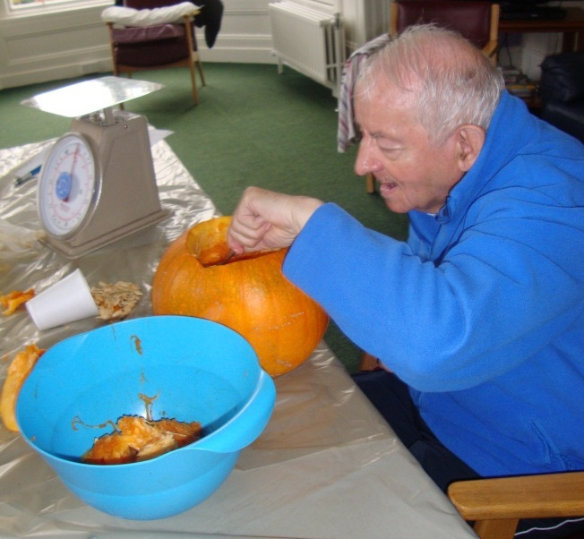
Chapter 2: Assessments Types & Scheduling January 12, 2016 1-3PM

Slide 2
Objectives
Understand Assessment types and definitions
Understand the difference between scheduled and unscheduled assessments
Understand how to schedule assessments
Understand when assessments can be combined and when they cannot be combined

Slide 3
10-1-2015 Changes
The completion and submission of OBRA and/or PPS assessments are a requirement for Medicare and/or Medicaid long-term care facilities. However, even though OBRA does not apply until the provider is certified, facilities are required to conduct and complete resident assessments prior to certification as if the beds were already certified.*
Prior to certification, although the facility is conducting and completing assessments, these assessments are not technically OBRA required, but are required to demonstrate compliance with certification requirements. Since the data on these pre-certification assessments was collected and completed with an ARD/target date prior to the certification date of the facility, CMS does not have the authority to receive this into QIES ASAP. Therefore, these assessments cannot be submitted to the QIES ASAP system.
Assuming a survey is completed where the nursing home has been determined to be in substantial compliance, the facility will be certified effective the last day of the survey and can begin to submit OBRA and PPS required assessments to QIES ASAP
Page 2-4

Slide 4
Continued
For OBRA assessments, the assessment schedule is determined from the resident’s actual date of admission. Please note, if a facility completes an Admission assessment prior to the certification date, there is no need to do another Admission assessment. The facility will simply continue with the next expected assessment according to the OBRA schedule, using the actual admission date as Day 1. Since the first assessment submitted will not be an Entry or OBRA Admission assessment, but a Quarterly, Discharge, etc., the facility may receive a sequencing warning message, but should still submit the required assessment.
o For PPS assessments, please note that Medicare cannot be billed for any care provided prior to the certification date. Therefore, the facility must use the certification date as Day 1 of the covered Part A stay when establishing the Assessment Reference Date (ARD) for the Medicare Part A SNF PPS assessments.
— *NOTE: Even in situations where the facility’s certification date is delayed due to the need for a resurvey, the facility must continue conducting and completing resident assessments according to the original schedule.
Page 2-4

Slide 5
Continued
Staff with QIES user IDs continue to use the same QIES user IDs
Staff who worked for the previous owner cannot use their previous QIES user IDs to submit assessments for the new owner as this is now a new facility. They must register for new user IDs for the new facility. Page 2-5
A SCSA is required to be performed when a terminally ill resident enrolls in a hospice program (Medicare-certified or State-licensed hospice provider) or changes hospice providers and remains a resident at the nursing home. Page 2-21
In cases where the last day of the Medicare Part A benefit (the date used to code A2400C on the MDS) is prior to Day 7 of the COT observation period, then no COT OMRA is required. If the date listed in A2400C is on or after Day 7 of the COT observation period, then a COT OMRA would be required if all other conditions are met.
Finally, in cases where the date used to code A2400C is equal to the date used to code A2000—that is, cases where the discharge from Medicare Part A is the same day as the discharge from the facility—and this date is on or prior to Day 7 of the COT observation period, then no COT OMRA is required. Facilities may choose to combine the COT OMRA with the Discharge assessment under the rules outlined for such combination in this chapter. Page 2-52

Slide 6
Look Back Period & ARD
Observation (Look Back) Period
Time period over which resident’s status captured
Item-specific
Assessment Reference Date (ARD)
Last day of observation (look back) period-11:59 PM
Must set ARD on MDS Item Set or software within required timeframe of assessment being completed
OBRA & Scheduled PPS Assessment scheduling ARD to ARD

Slide 7
Entry
Person enters or re-enters facility
Admission
Reentry

Slide 8
Leave of Absence
Temporary home visit of at least one night
Therapeutic leave of at least one night
Hospital observation stay less than 24 hours and the hospital does not admit the patient.

Slide 9
Discharges
Discharge Return Not Anticipated
Discharge Return Anticipated
DRNA
Discharged & not expected to return within 30 days
DRA
Discharged & expected to return within 30 days
Out of here ---
Not coming back!

Slide 10
Entry and Discharge Reporting Assessments & Tracking Records A0310F, G

Slide 11
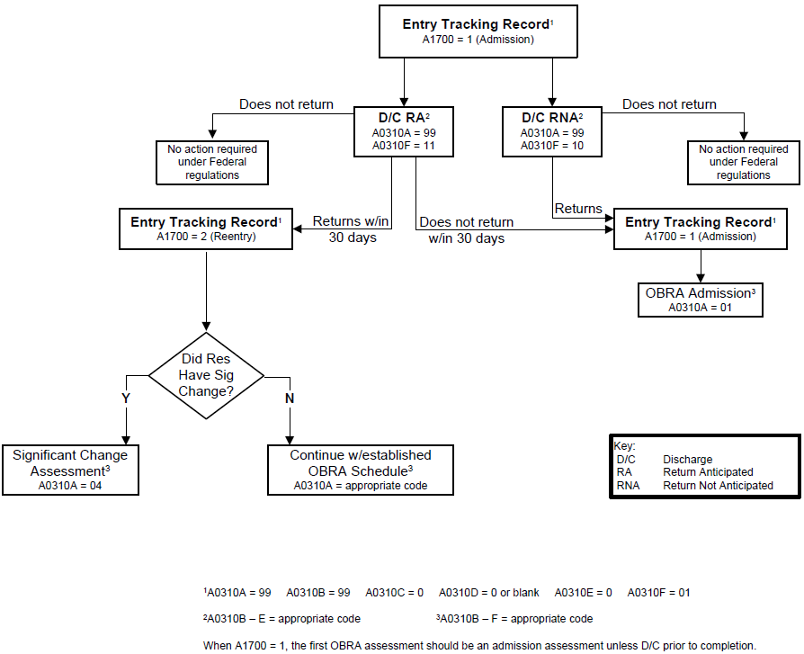
Page 2-38

Slide 12
Tracking Records Discharge Assessments
Complete regardless of payment source or length of stay in Nursing Home or Swing bed
Tracking Records
Entry
Admission
Reentry
Do not complete when return from LOA
Death in the Facility
Do complete even if occurs when on LOA
Discharge Assessments
Return not Anticipated Assessment (DRNA)
Return Anticipated Assessment (DRA)
Do not complete when goes on LOA

Slide 13
Entry Tracking Record (A310F=01) Completion: Entry Date + 7 days Cannot combine with any assessment
Admission (A1700=1)
Reentry (A1700=2)
1. Admitted for first time
2. Readmitted after DRNA
3. Returned after DRA but
(a) OBRA Admission Assessment not completed before discharge or
(b) Did not return within 30 days
Returned after DRA and
OBRA Admission
Assessment
completed before
discharge
and
Returned within 30
days

Slide 14
Entry Tracking Record Admission or Reentry??
Admission
Reentry
Mr. S. was admitted to NH on 2/5/XX following a CVA. He regained most of his function & returned home. He was DRNA.
Eight months later he underwent surgery for a total knee replacement. He returned to NH for rehab on 10/7/XX.
Mr. W. was admitted to NH on 10/1/XX. Three weeks later he become SOB during lunch and developed labored breathing.
He was DRA to hospital on 10/22/XX. On 10/25/XX he returned to NH.

Slide 15
Death in Facility Tracking (A0310F=12)
Dies
in facility
on leave of absence
in ambulance
MDS completion
Discharge (death) date + 7 days
Transmit
Discharge (death) date + 14 days
Can not combine with any assessment

Slide 16
Discharge Assessments
Discharge Return Not Anticipated
Discharge Return Anticipated
DRNA
A0310F=10
Discharged & not expected to return within 30 days
DRA
A0310F=11
Discharged & expected to return within 30 days
ARD: Discharge Date
MDS Completion: Discharge date (ARD) + 14
Days
Transmit: Completion date + 14 Days
Can combine with other assessments if ARD meets requirements of other assessment also.

Slide 17
Discharge (A0310G) 1. Planned or 2. Unplanned
Unplanned discharge
acute-care transfer to hospital or ED to stabilize condition or determine need for acute-care admission
unexpectedly leaving facility against medical advice
unexpectedly deciding to go home or to another setting
Use dash, “-”, when unable to determine response
Kansas Specific - DRA & does not return, do not need to modify assessment

Slide 18
Assessments OBRA – A0310A

Slide 19
OBRA Assessments (A0310A)
Types
01. Admission
02. Quarterly
03. Annual
04. Significant Change in Status
Discharge
05. Significant Correction in Prior Comprehensive Assessment
06. Significant Correction in Prior Quarterly
Assessment
Assessment Summary Table (Pages 2-15 and 2-16)

Slide 20
Comprehensive Assessments Admission (A0310A=01)
Resident:
1. First time in facility
2. Readmitted after DRNA
3. Returned after DRA but
(a) discharged before completion of OBRA admission assessment
OR
(b) did not return within 30 days
of discharge

Slide 21
Comprehensive Assessments Admission Cont.
ARD - No later than 14th day of admission
MDS/CAAs completion - No later than 14th day of admission
(Entry Date +13 calendar days)
Care plan completion
CAAs completion + 7 days
Transmission
Care plan completion + 14 days

Slide 22
Admission Assessment – Scenario
Mr. H. entered the facility on Jan. 3rd (Day 1).
To allow combining the Admission Assessment and a 5 Day Medicare Assessment, the ARD was set for the Jan. 8th (Day 6).
The MDS completion date was Jan. 11th (Day 9).
CAA completion date was Jan. 13th (Day 11).
Care Plan completion was Jan. 19th (Day 17).
The MDS was transmitted on the Jan. 25 (Day 23).
Remember you can always move up the dates for the OBRA assessments. Earlier is OK. Late is not.

Slide 23
Comprehensive Assessments Annual (A0310=03)
ARD - No later than:
ARD of previous comprehensive assessment + 366 days and
ARD of previous quarterly assessment + 92 days
MDS/CAAs completion - ARD + 14 days
Care plan completion
CAAs completion + 7 days
Transmission
Care plan completion + 14 days

Slide 24
Comprehensive Assessments Significant Change in Status Assessment (SCSA) (A0310=04)
Decline or Improvement in resident’s status that:
1. Will not normally resolve itself without intervention by staff or by implementing standard disease-related clinical
interventions ;
2. Impacts more than one area of resident’s health status ; and
3. Requires IDT review &/or revision of care plan.

Slide 25
Comprehensive Assessments SCSA cont.
Hospice Services
Started, revoked or changed Hospice provider
Notify KDADS PASRR (Sue Schuster – 785-368-7323) when SCSA done on resident:
Previously identified by PASRR to have MI, Intellectual Disability (ID) or related condition
New diagnosis of MI, ID, or related condition or new behaviors with symptoms of MI
Exception: if have primary DX of dementia

Slide 26
Comprehensive Assessments SCSA cont.
ARD - No later than 14th day after determination of significant change, hospice starts, is discontinued or hospice provider changes
Resets clock for annual assessment
MDS/CAAs completion
No later than 14th day after determination
Care plan completion
CAAs completion + 7 days
Transmission
Care plan completion + 14 days

Slide 27
Scenario – Significant Change
Mr. Blue had experienced the flu and seemed to be improving. He continued to pick at his food and needed more assistance with dressing and walking. On Wednesday the 4th day of the month, the bath aide found he lost 10 pounds in the last month. The nurse calculated it to be a 5% weight loss in 30 days.
The physician and dietitian were notified. The IDT decided to see if Mr. Blue would improve over the weekend.
On Monday the 9th, he had not lost any more weight but was still needing more assistance with dressing and walking, and had a stage 2 PU on his coccyx.
Due to his initial weight loss, decrease in ADLs, and now a Stage 2 PU the IDT realized a significant change assessment was needed to guide the revision of the care plan.
Although they could wait until the 23rd for the ARD and complete the MDS & CAAs on the 24th (Day 15 after the decision was made a significant change was needed.) It was more feasible to set the ARD for the 18th, MDS completion the 20th & CAA completion on the 23rd and Care Plan completion the 30th.

Slide 28
Non-Comprehensive Assessments Quarterly (A0310=02)
ARD
No later than ARD previous OBRA assessment + 92 days
MDS completion
ARD + 14 days
Transmission
MDS completion + 14 days

Slide 29
OBRA Assessments
Admission
Quarterly
Not >92 Days
Quarterly
Not >92 Days
Annual
Not >92 days
Quarterly
Not >92 Days
Total = Not > 366 Days
Entry Tracking

Slide 30
OBRA Assessments
Admis-sion
Quart-erly
Signif-
icant
Change
Quart-erly
Not >92 Days
Quart-erly
Not >92 Days
Quart-erly
Not >92 Days
Annu-al
Not >92 days
Total = Not > 366 Days
Entry Tracking

Slide 31
Correction of OBRA Assessments
Significant Error
Overall condition not accurately represented on assessment - Incorrect coding of MDS
Significant Correction to Prior Comprehensive Assessment (SCPA), (A0310=05)
Significant Correction to Prior Quarterly Assessment (SCQA), (A0310=06)
Chapter 5 – Submission & Correction of MDS Assessments

Slide 32
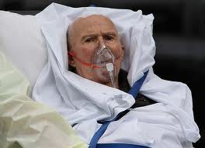
Assessments -PPS Medicare (A0310B, C)
Skilled Therapy
5 days a week
Skilled Nursing
7 days a week

Slide 33
PPS Assessments A0310B Nursing Home/ Swing Beds
Scheduled assessments Medicare Part A Stay
01. 5 day
02. 14 day
03. 30 day
04. 60 day
05. 90 day

Slide 34
PPS Scheduled Assessments Medicare Part A Stay
5 Day
14 Day
30 Day
60 Day
90 Day
Entry Tracking

Slide 35
MEDICARE PPS ASSESSMENTS
Scheduled Assessments
Predetermined time period for setting ARD
Grace Days
Assessment delayed
Unscheduled
Other Medicare Required Assessment (OMRA)
Outside of standard Medicare scheduled assessments
Assessment Summary Table (Pages 2-43, 44, & 45)

Slide 36
PPS Scheduled Assessments
Type | MDS A0310B Code | ARD | ARD Grace Days | Standard Medicare Payment Days
5-day | 01 | 1 – 5 | 6 – 8 | 1 – 14
14-day | 02 | 13 – 14 | 15 – 18 | 15 – 30
30-day | 03 | 27 – 29 | 30 – 33 | 31 – 60
60-day | 04 | 57 – 59 | 60 – 63 | 61 – 90
90-day | 05 | 87 – 89 | 90 – 93 | 91 - 100

Slide 37
PPS Unscheduled Assessments Changes and Corrections A0310B=07, A0310D
Significant Change Status Assessment (SCSA) (OBRA)
Swing Bed Clinical Change Assessment
A0310D
Significant Correction to Prior Assessment (SCPA) (OBRA)

Slide 38
SCSA – Payment Resident on Medicare Part A
SCSA Only - RUG-IV classification & associated payment rate(AP) begins on ARD
SCSA combined with scheduled PPS assessment & ARD not set on Grace Day
RUG-IV classification & AP begins on ARD
SCSA combined with scheduled Medicare-required assessment & ARD set on Grace Day
RUG-IV classification & AP begins on first day of payment period of scheduled PPS assessment standard payment period.

Slide 39
PPS Unscheduled Assessments Therapy A0310B=07, A0310C
All facilities are 7 day per week facilities
Day of therapy = any day received at least 15 minutes of therapy
A310. C. Other Medicare Required Assessment (OMRA)
1. Start of Therapy (SOT)
Optional
2. End of Therapy (EOT)
Required
O0450. End of Therapy Resumption (EOT-R)
Optional
4. Change of Therapy (COT)
Required

Slide 40
Start of Therapy (SOT OMRA) A0310C=1
Completion Optional
Classify into RUG-IV Rehab plus Extensive or Rehab group
ARD - set Day 5, 6,or 7 after start of earliest therapy – SLP, OT, PT
Day 1 = Day of Evaluation
If SOT done as stand alone assessment or combined with Discharge Assessment must set ARD for a date within ARD window but ARD date must be set no more than two days after the window has passed
Payment - Effective the first day of therapy

Slide 41
Start of Therapy OMRA - SOT
Sun | Mon | Tues | Wed | Thurs | Fri | Sat
1 | 2 | 3 | 4 | 5 5 Day | 6 | 7
8 | 9 | 10 | 11 | 12 | 13 | 14 14 Day
15 | 16 OT/PT Eval Day 1 | 17 OT/PT Day 2 | 18 OT/PT Day 3 | 19 OT/PT Day 4 | 20 X OT/PT Day 5 | 21X Day 6
22 X Day 7 | 23 OT/PT | 24 OT/PT
Mr. A. had a ORIF of his hip. Due to an infection, he was not able to start therapy. Since he was receiving skilled nursing services, 5 day & 14 day PPS assessments were completed. On Day 16, he was evaluated & determined to be able to start therapy. ARD for SOT had to be set on Day 5, 6, or 7 after day of evaluation day.

Slide 42
End of Therapy (EOT OMRA) A0310C=2
Completion Required if Resident in:
RUG IV Rehab Plus Extensive or Rehab Therapy Group
1. All Therapy ends completely and
Resident continues on Part A for Skilled
Nursing
Example:
Mr. Jones was receiving OT and PT and Skilled Nursing Services (Part A). He was discharged from OT and PT on Friday and continued on Skilled Nursing Part A.

Slide 43
End of Therapy (EOT OMRA) A0310C=2
Completion Required if Resident in:
RUG IV Rehab Plus Extensive or Rehab Therapy Group
2. No therapy provided for at least 3
consecutive days, regardless of reason
Resident may or may not be on Part A for Skilled Nursing

Slide 44
EOT OMRA – Example 2
Mrs. Brown received OT and PT on Friday. She was not scheduled for therapy Saturday or Sunday and refused therapy on Monday.
Mrs. Brown was not receiving Skilled
Nursing Services (Part A).
Mrs. Green received OT and PT on Friday She was not scheduled for therapy Saturday or Sunday and refused therapy on Monday. Mrs. Green was still receiving Skilled Nursing Services (Part A).

Slide 45
EOT OMRA Info cont.
ARD - must be set on Day 1, 2, or 3 after all therapy discontinued or not provided for 3 consecutive days – planned or unplanned
Day 1 is first day after last day therapy received
Day 1 is date new non-therapy RUG established
Not required if resident discharged:
on or prior to 3rd consecutive day of missed therapy

Slide 46
End of Therapy OMRA - EOT
Sun | Mon | Tues | Wed | Thurs | Fri | Sat
1 OT/PT | 2 OT/PT | 3 OT PT | 4 OT PT | 5 OT PT | 6 OT/PT | 7 No Therapy Day 1 X
8 No Therapy Day 2 X | 9 No Therapy Day 3 X | 10 | 11 | 12 | 13 | 14
15 | 16 | 17 | 18 | 19 | 20 | 21
Mr. Jones was receiving OT and PT and Skilled Nursing Services
(Part A). He was discharged from OT and PT on Friday and
continued on Skilled Nursing Part A.
Day 1 is Saturday. EOT ARD had to be set for Sat., Sun., or Mon.

Slide 47
EOT OMRA Completed D/T 3 Consecutive Missed Days & Therapy Resumed
Completion Option
1. Wait until next scheduled PPS assessment
Will remain in RUG IV Non-Rehab group
2. SOT OMRA
Therapy not provided more than 5
consecutive days since last day of therapy OR
Therapy will not resume at same RUG IV
Rehab group as prior to EOT OMRA
New therapy evaluation required

Slide 48
EOT OMRA Completed D/T 3 Consecutive Missed Days & Therapy resumed EOT-R
Option
3. EOT OMRA with Resumption (EOT-R)
If therapy resumes 5 days or less after last day of therapy AND
therapy will resume at same RUGS IV Rehab
group AND same therapy plan of care as prior to EOT OMRA
EOT-R Transmission
If EOT OMRA not transmitted before EOT–R determined
Code EOT-R (O0450A & B) on assessment & transmit
If EOT OMRA transmitted before EOT–R determined
Modify Assessment. Do not change ARD. Complete EOT- R Item O0450. A & B., Check X0900E & transmit.

Slide 49
End of Therapy OMRA with Resumption - EOT-R
Sun | Mon | Tues | Wed | Thurs | Fri | Sat
1 OT/PT | 2 OT/PT | 3 OT/PT | 4 OT/PT | 5 OT PT | 6 OTPT | 7 No Therapy Day 1
8 No Therapy Day 2 | 9 No Therapy Day 3 | 10 No Therapy Day 4 | 11 EOT-R Therapy must resume by this day at same RUG Day 5 | 12 | 13 | 14
15 | 16 | 17 | 18 | 19 | 20 | 21

Slide 50
Change of Therapy (COT) OMRA A0310C=4
Completion required when
Resident receiving any amount of skilled therapy
Therapy or to extent current RUG no
longer accurate to reflect RUGs
classification or payment.
Change or
Reimbursable therapy minutes (RTM)
Days of therapy
Number of disciplines

Slide 51
Change of Therapy
Observation Period: 7 successive days with 7th day being ARD if COT required
Observation Period Situations
1. Day 1 of Observation Period starts the first day after the ARD of most recent Scheduled or Unscheduled PPS assessment
Ex. 30 day PPS assessment. Observation Period is Day 31 through Day 37. If COT required, ARD must be set for Day 37. Day 38 is first day of next Observation Period.
2. If last assessment was EOT with EOT-R,
Day 1 of Observation Period is the day therapy
resumed (O0450B)
Ex. Therapy resumed Day 40, Observation Period is Day 40-47. If COT required, ARD must be set for Day 47.

Slide 52
COT continued
The COT OMRA may be completed when a resident is not currently classified into a RUG-IV therapy group, but only if both of the following conditions are met:
1. Resident has been classified into a RUG-IV therapy group on a prior assessment during the resident’s current Medicare Part A stay, and
2. No discontinuation of therapy services (planned or unplanned) occurred between Day 1 of COT observation period for the COT that classified them into their current non-therapy RUG-IV group and ARD of the COT that reclassified them into a RUG-IV therapy group.
---- Example: Mr. T classified as a RUA on his 30 day assessment with ARD as Day 30 of his stay. On Day 37, therapy found he did receive the number of therapy minutes to qualify for this RUG, he only received therapy on 4 distinct calendar days, which makes it impossible for him to qualify for RUA and he would not qualify for a therapy RUG group. The COT done on day 37 qualified him for LB1. His rehab regime continued throughout this time period. The COT for day 44 qualified him for RUA.

Slide 53
Change of Therapy (COT)
If Day 7 of COT observation period falls within the ARD window of a scheduled PPS Assessment
SNF may choose
1. to complete scheduled PPS Assessment alone on or prior to Day 7 of COT observation period OR
2. to combine the COT OMRA & scheduled assessment
When combine, COT observation period reset to 7 days following scheduled PPS assessment ARD

Slide 54
Combining Assessments
Can not combine:
2 OBRA scheduled assessments
2 PPS scheduled assessments
May combine assessments if ARD meets requirements for assessments
OBRA and PPS
Scheduled PPS and Unscheduled PPS
Unscheduled PPS
Discharge Assessments with OBRA, Scheduled and Unscheduled PPS
If an unscheduled PPS assessment (OMRA, SCSA, SCPA, SWB CCA) is required in the assessment window (including grace days) of scheduled PPS assessment that has not yet been performed, the assessments must be combined. ARD must be set for ARD of unscheduled assessment.

Slide 55
Combining Assessment Hint
1. Determine allowable dates for ARD Window of Assessment #1
2. Determine allowable dates for ARD Window of Assessment #2
3. Select an overlapping ARD Window date
4. Always determine effect on RUGS Classification and associated payment prior to combining assessments.

Slide 56
Questions?
I’ll take the next few minutes to answer any questions you might have

Slide 57
Thank you!!
Please contact me anytime
Shirley L. Boltz, RN
RAI/Education Coordinator
785-296-1282
shirley.boltz@kdads.ks.gov

