Slide 1
Home and Community Based Services

Slide 2
Home and Community Based Services
INTRODUCTION
WAIVER CHANGE PROPOSALS
IMELINE
QUESTIONS

Slide 3
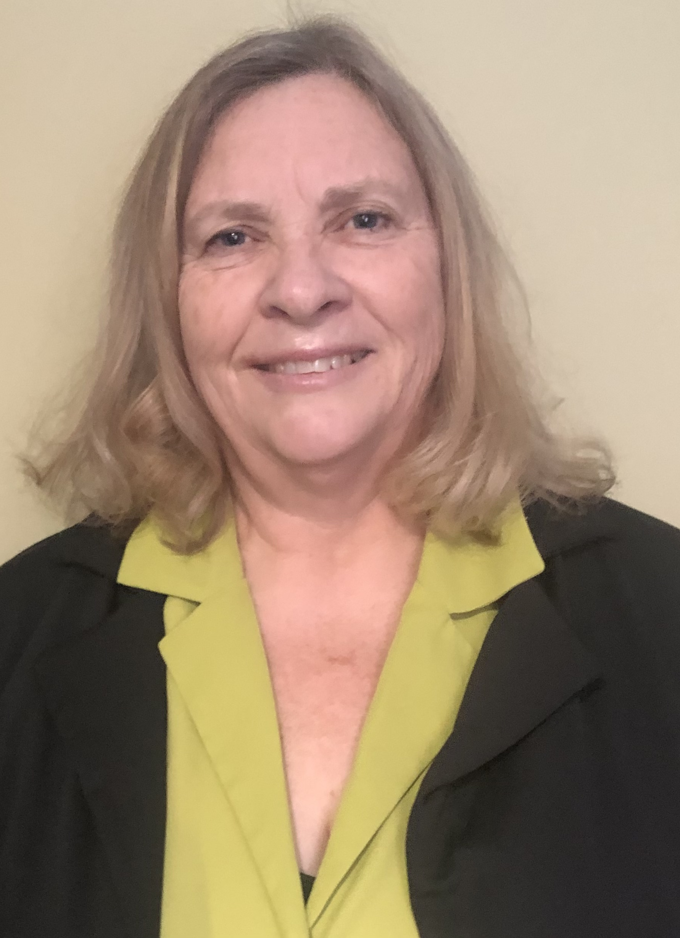
Home and Community Based Services
Leigh smith
Robin lohman
Letha farwell
Jason sheets
LTSS Commissioner
HCBS Director
Assistant I/DD Director
I/DD Program Manager

Slide 4
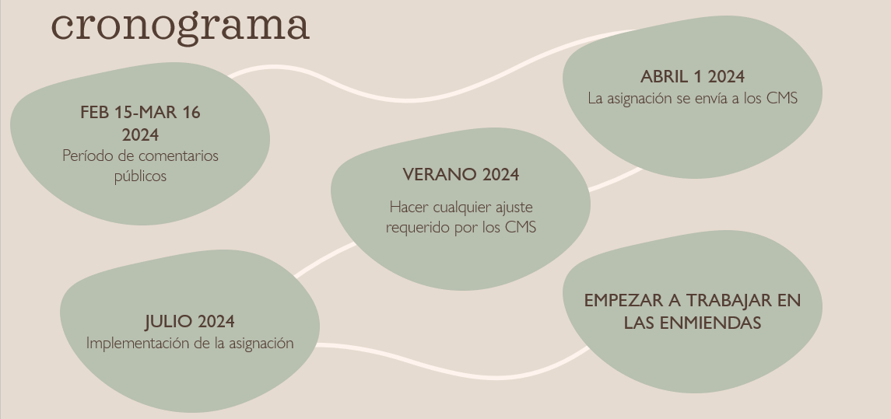
Home and Community Based Services

Slide 5
Home and Community Based Services

Slide 6
Home and Community Based Services

Slide 7
Home and Community Based Services

Slide 8
Home and Community Based Services

Slide 9
Home and Community Based Services

Slide 10
Home and Community Based Services

Slide 11
Home and Community Based Services

Slide 12
Home and Community Based Services

Slide 13
Home and Community Based Services

Slide 14
Home and Community Based Services

Slide 15
Home and Community Based Services

Slide 16
Home and Community Based Services

Slide 17
Home and Community Based Services

