Slide 1
Kansas Department of Aging and Disabilities Services
Employment First Initiative
January 26, 2023
Protecting Kansans, Promoting Recovery & Supporting Self-Sufficiency

Slide 2
Agenda
1. National Expansion of Employment Opportunities Network (NEON) Technical Assistance Award
2. Employment 1st Initiative RFP
3. Recurring E1st Stakeholder Meetings – 4th Thursday of every month
4. Kansas Targeted Employment Act

Slide 3
Stakeholders
How to make Employment First a Reality in Kansas
Currently represented by known subject matter experts throughout the state of Kansas:
Introduce self with name and representative agency in chat box.
To maintain respect for others, please raise hand for questions and comments.
We want to hear from as many individuals as possible, so please be mindful of time when speaking and send additional questions to Christina Ferguson at Christina.Ferguson@ks.gov.

Slide 4
KDADS HCBS Initiatives Team
Mitzie Tyree
Director of HCBS Initiatives
Mitzie.Tyree@ks.gov
Sandy Hestand Puett
HCBS Project Manager
Sandra.Hestandpuett@ks.gov
Megan Shepard
Training and Programming Grant Coordinator
Megan.Shepard@ks.gov
Christina Ferguson
Workforce Employment 1st Specialist
Christina.Ferguson@ks.gov
Jamie Katsbulas
Waitlist/TCM Study Coordinator
Jamie.Katsbulas@ks.gov
Mandy Flower
Interim Commissioner LTSS
Mandy.Flower@ks.gov

Slide 5
National Expansion of Employment Opportunities Network (NEON) Technical Assistance Award
What is NEON?
WHY is this important for KS Employment 1st initiative?
HOW can you help?

Slide 6
Employment 1st Initiative RFP
Update

Slide 7
Recurring Employment 1st Stakeholder Meeting
Held every 4th Thursday of the month
February 23, 2023
March 23, 2023
April 27, 2023
May 25, 2023
June 22, 2023
July 27, 2023
August 24, 2023
September 28, 2023
October 26, 2023
November and December 2023 Meetings are TBD.

Slide 8
Kansas Targeted Employment Act
Presenter: Rachel Neumann, COF Training Services
Rachel Neumann
Chief Operating Officer
COF Training Services
rneumann@cofts.org

Slide 9
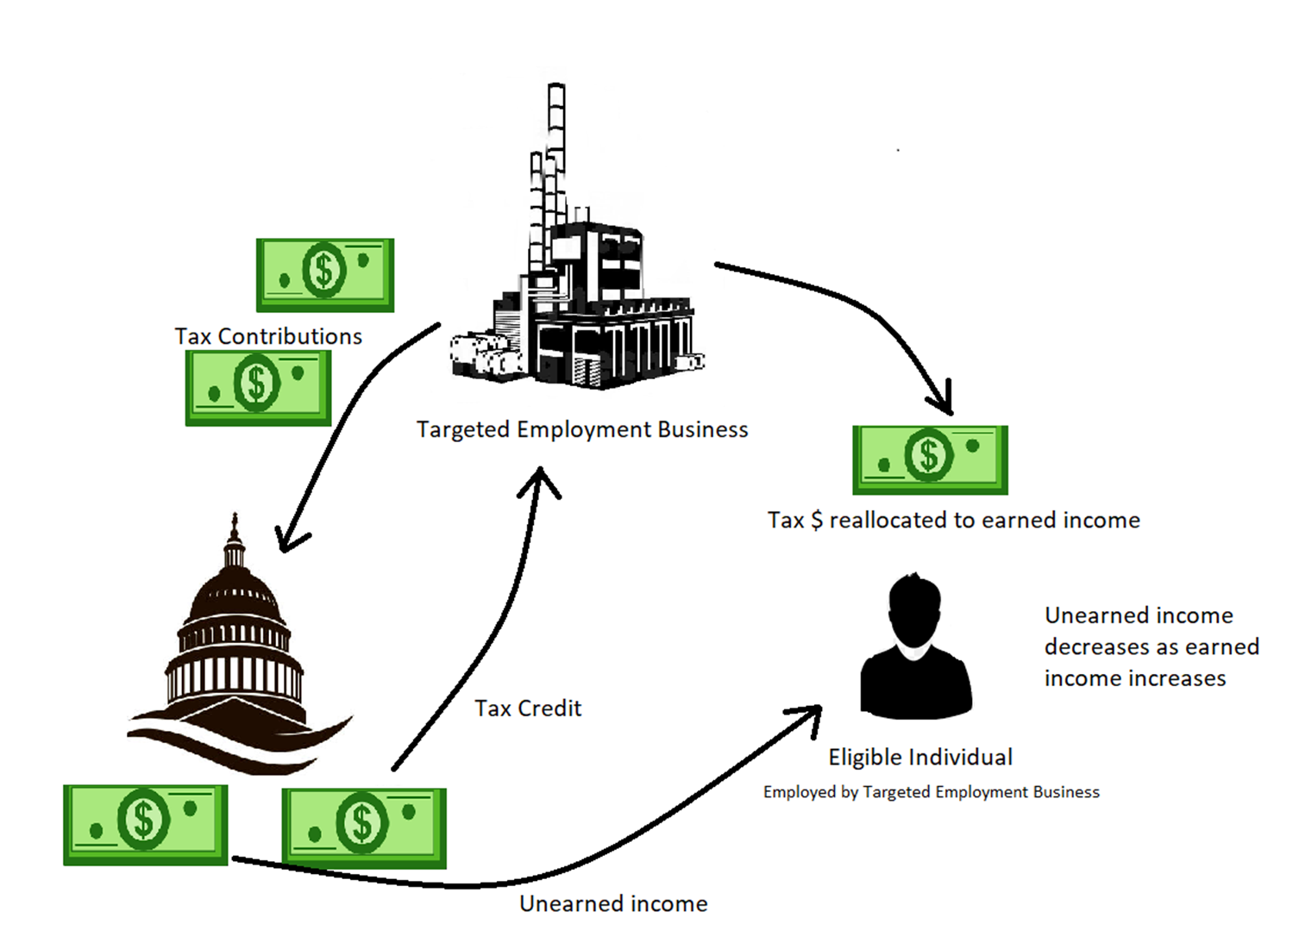
KANSAS TARGETED EMPLOYMENT ACT
HB 2703 Sec 1-6
For tax years 2022-2027

Slide 10
Eligibility
What makes an employer eligible?
Is it really that easy? What about…
Targeted Employment Business
=For profit
=Providing competitive, integrated employment (per WIOA)
=Employs individual with identified intellectual or developmental disability
=Completed single form during tax season to claim the credit
Minimum hours?
There is not a minimum expectation of hours worked by eligible individual
Benefits?
Employers are only required to offer same benefits they offer any other employee that works the same hours/position
Services? What if they need help?
If the individual needs job coaching supports or services, they can receive them during employment and still be considered an eligible employee.

Slide 11
Eligibility
How much of a tax credit is an employer eligible for?
Targeted Employment Businesses are eligible to receive
50% of total wages paid, per hour worked, to each eligible employee.
Up to $15 per hour [$7.50 in credit]
Targeted Employment Businesses can include
Businesses that are outsourcing their work to a non-profit employer that meets the definition of competitive and integrated employer

Slide 12
How to Apply
During tax filing, fill out the
K-69 Form
You can find it here-
https://www.ksrevenue.gov/pdf/k-69.pdf

Slide 13
Additional Information
The bill sunsets
2027 is the final tax season targeted employment businesses will be eligible to receive the tax credit, at this time
In order to extend/codify the bill long term, we need to be able to show it is effective
We do that by displaying utilization and impact of that utilization
Eligible employers/employees will be asked to provide feedback during the first 5 years
Feedback will provide KDADs evidence of the impact of employment on tax subsidy reliance
Information may include:
Amount of tax subsidies received by individual before and during employment
Impact of employment on employee such as: social, emotional, and physical
Impact of employment on targeted employment business

Slide 14
Questions/Discussion
Please use this time to ask questions/give input for these updates.

Slide 15
Contact Information/Questions?
General Questions : Christina.Ferguson@ks.gov
For future projects, please see KDADS website:
Kdads.ks.gov
________________________________________________________

