Slide 1
Governor’s Behavioral Health Services Planning Council
Presentation 2023
Service Members, Veterans and their
Families (SMVF) Subcommittee
2023 Annual Report

Slide 2
Content
01
Mission and Vision
02
Membership
03
Year in Review
04
Recommendations
05
FY2024 Goals
06
Questions

Slide 3
Mission
To ensure that servicemembers, veterans and their families are involved in improving access to behavioral health services which are relevant to military culture in collaboration with key provider organizations and other stakeholders.
Vision
There is an expanded and identifiable network of service providers and community supports to adequately meet the behavioral health care needs of veterans, service members, and their families which includes training provider staff about key elements of military culture and organization as well as ongoing engagement of veterans, service members and family members in eliminating barriers to treatment and in creating flexible treatment and recovery options.

Slide 4
SMVF Subcommittee - Continuous Positions
Charles Bartlett | KDADS
Gary Henault | KDADS
Laura Brake | KDADS
Carolyn Coyne | KDADS
Wes Cole | GBHSPC
Timothy Marler | American Legion
Larry Salmans | Senator (Retired)
Alicia Carey | Community Engagement & Partnership VISN 15 VHA Office of Mental Health and Suicide Prevention
Dr. Christina Menager | Comery-O’Neil Veterans’ Administration Medical Center Dwight D. Eisenhower Department of Veterans Affairs Medical Center
Cassandra Blake | Robert J. Dole VA Medical Center
Maria Granados | Robert J. Dole VA Medical Center

Slide 5
Chair Kathy Shepard | Four County Mental Health
Vice Chair Janell Stang | WSU Community Engagement Institute
Steve Christenberry | Veteran
Shereen Ellis | Aetna Better Health of Kansas
Tony Nutz | NAMI
Lisa Chaney | Greenbush
Lori Bishop | Flint Hills Volunteer Center
Christopher Bowers | Washburn University & VFW Commander (Topeka)
Angela Gabel | Kansas Air Guard
Lisa Galindo | Kansas National Guard
Loran Osborn | Four County Mental Health
Bill Turner | Kansas Commission on Veterans Affairs Office
Jim Crosby | Together With Veterans and Morris County
Tom Reust | Ft Riley Public Affairs Specialist
Stacy Haines | DCCCA
Jessica Wilson | Aetna Better Health of Kansas
Michelle Ferrer | Kansas National Guard
Megan Willis | Central Kansas Mental Health Center
SMVF Subcommittee Membership

Slide 6
FY2023 Year in Review
Part One
SMVF Subcommittee has continued to increase information and resources on Live Connected Website and Facebook page.
Full review of Live Connected Website for needed changes and ongoing updates of resources. This includes creation, distribution and review of a feedback survey.
Creation of a Communication Task Force to promote the website.

Slide 7
FY2023 Year in Review
Part Two
Continued push for completion of PsychArmor training to increase military cultural competency among subcommittee members, CCBHC’S and others.
Creation of a Live Connected Campaign including the Governor’s PSA, which is now in the final editing stage before distribution.
SMVF subcommittee has worked to decrease suicide using lethal means by providing 400 gun locks & gun safety information to Green Zone Training attendees and to gun shop owners for distribution.

Slide 8
Recommendations

Slide 9
The SMVF Subcommittee Recommends
Improved collaboration between state agencies with a focus on improving the lives of the SMVF community in Kansas. The subcommittee recommends an annual meeting with the KDADS, SMVF Subcommittee Leadership, Kansas Commission on Veteran’s Affairs, and other identified Kansas veteran service organizations’ leadership.

Slide 10
The SMVF Subcommittee Recommends
KDADS dedicate funding for a statewide Lethal Means Safety Campaign. The subcommittee recommends prioritizing the SMVF community, especially veterans aged 65 and above based on Kansas specific suicide data.

Slide 11
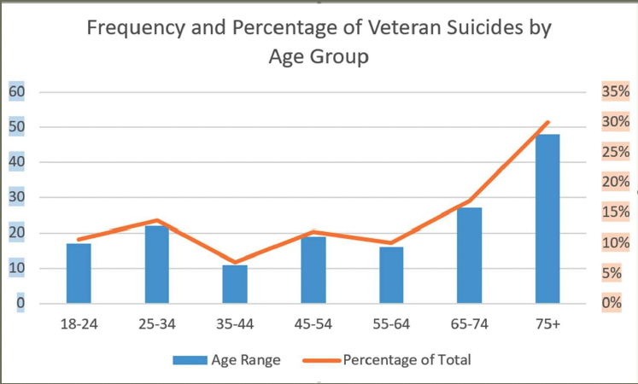
KsVDRS – Veteran Suicides 2019-2020

Slide 12
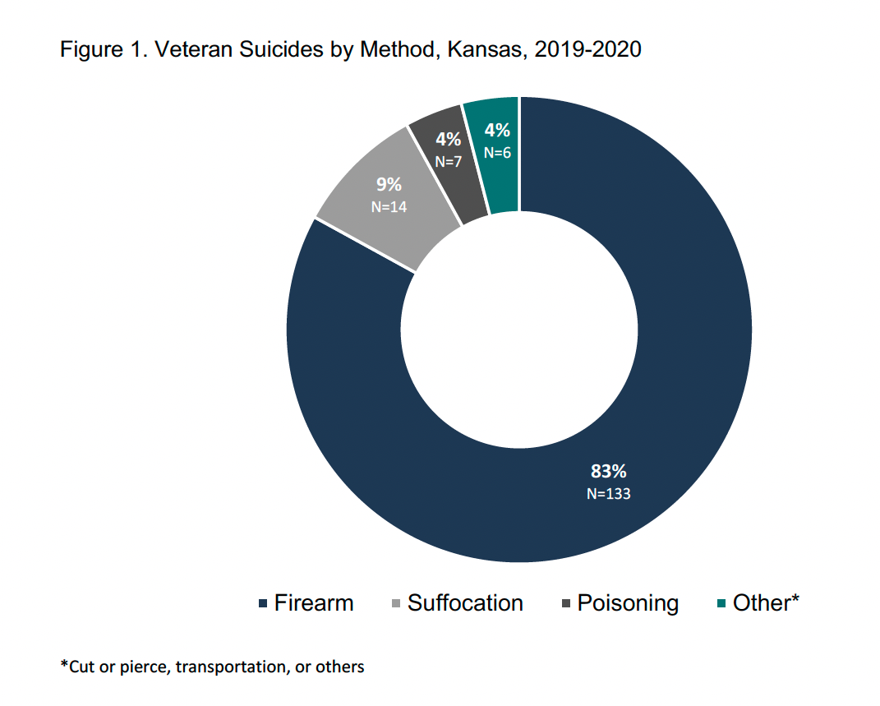
KsVDRS – Veteran Suicides 2019-2020

Slide 13
The SMVF Subcommittee Recommends
KDADS dedicate funding for Mental Health First Aid or other identified suicide prevention training in partnership with local VSOs to provide training for the SMVF community.

Slide 14
Military Family Lifestyle Survey - 2022
Of active duty family respondents, 1 in 5 reported having an adult friend or family member express suicidal thoughts, make an attempt, or die by suicide
Just 25% of active duty family respondents reported feeling very confident in supporting a close friend or loved one experiencing a mental health crisis, suicidal thoughts or attempts
When asked what would best help support a close friend or loved one experiencing a stressful life experience the top three choices were:
Knowledge of how to have a conversation about the issue (60%)
Rapid access to mental health care for a loved one (53%)
Knowledge of when to intervene (51%)

Slide 15
FY2024 Goals

Slide 16
Goal 1
1.1
Create a promotion plan to promote the website within Kansas
Use Live Connected KS to share suicide prevention messages among the SMVF Community in Kansas
1.2
Distribute Governor Kelly’s SMVF Suicide Prevention PSA on the website and social media
1.3
Review and update the plan as needed

Slide 17
Goal 2
2.1
Research programs other states have used to promote lethal means safety among the SMVF Community
Determine the best evidence-based program or strategy to promote lethal means safety
2.2
Determine what is currently being done in Kansas
2.3
Provide recommendation to the GBHSPC and KDADS Secretary

Slide 18
Goal 3
3.1
Request information on peer support services within the VA system
Advocate for KDADS’ Kansas Certified Peer Specialist Training to include additional SMVF peer support curriculum.
3.2
Identify and prioritize subjects that are available to and scalable for the Kansas Certified Peer Specialist Training
3.3
Establish contact with the KS Certified Peer Specialist Training Team and the Peer Support Subcommittee to share priorities, generate feedback, and determine next steps

Slide 19
Goal 4
4.1
Continue building relationships with the Kansas Commission of Veteran’s Affairs (KCVA) through the subcommittee
Strengthen partnerships with SMVF organizations in Kansas
4.2
Determine areas of the state not connected to Live Connected KS and work to fill the gap
4.3
Develop a means to identify and promote SMVF resources, events, and trainings

Slide 20
Questions?
Chair – Kathy Shepard
620-330-6091
kshepard@fourcounty.com
Vice Chair – Janell Stang
316-779-4014
janell.stang@wichita.edu

Slide 21
References
Presentation 2023
HAC Veterans Data Central - informing strategies to help veterans. HAC Veterans Data Central - Informing Strategies to Help Veterans. (n.d.). https://veteransdata.info/
Ringering, S. (2023, May 5). Kansas Violent Death Reporting System- Veteran Suicides.
2022, Military Family Lifestyle Survey 2022 Comprehensive Report Executive Summary.

