Slide 1
GBHSPC Rural & Frontier Subcommittee
FY2023 Annual Report

Slide 2
Leadership
Monica Kurz, LMSW – FY2023 Chair
VP Policy & Prevention
HeadQuarters Kansas
Audra Goldsmith, MS, LMLP – FY2023 Co-Chair
Senior Policy Analyst
Kansas Stepping Up Technical Assistance Center

Slide 3
Annual Report Overview
Vision, Mission, and History
FY2022 Objectives and Progress
FY2023 Goals and Plans

Slide 4
Vision
Behavioral Health Equity
for All Kansas
All residents of rural and frontier communities of Kansas will have access to essential, high quality, behavioral health services
May 2023, Rural/Frontier Charter

Slide 5
Mission
We are dedicated to utilizing data-driven and needs assessment approaches to address the unique behavioral health challenges and requirements of rural and frontier counties to assure the accessibility, availability, and acceptability of behavioral health services for all Kansans.

Slide 6
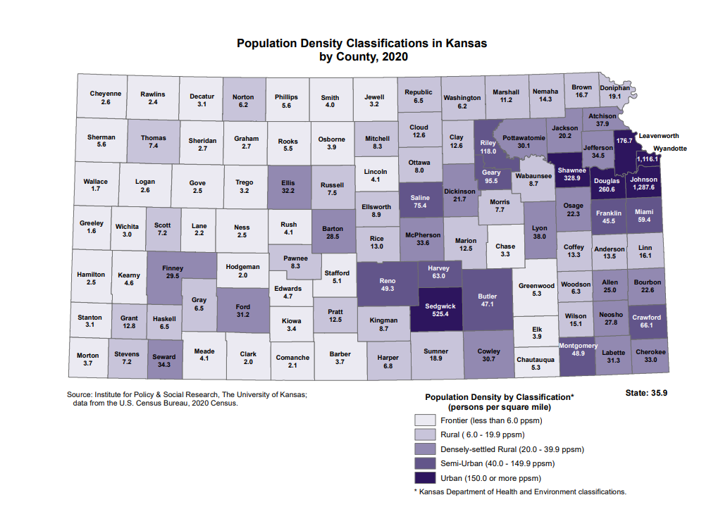
Notes:
37 Frontier
33 Rural
19 Densley-settled
10 Semi-Urban
6 Urban

Slide 7
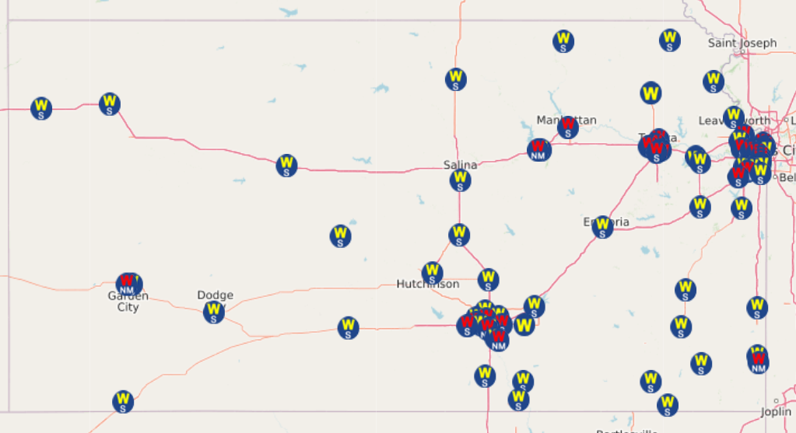
74 Walmart Stores in Kansas

Slide 8
Kansas Mental Health Professional Shortage Areas 2022

Slide 9
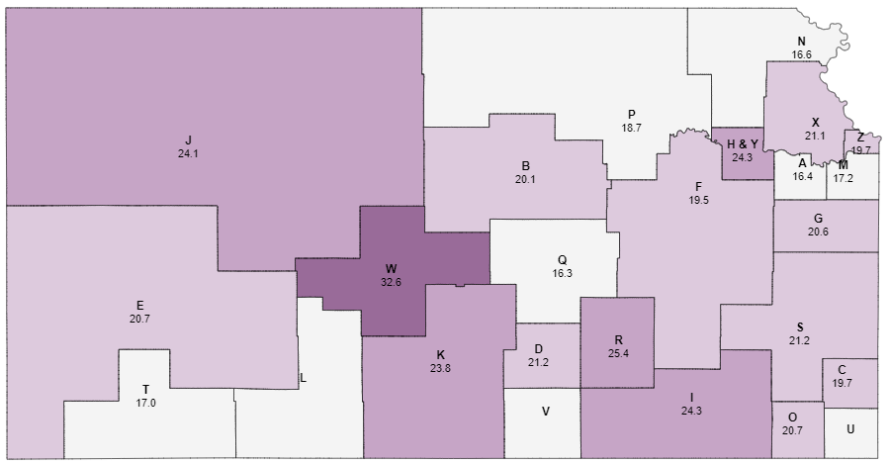
CMHC Catchment Areas
ED Visits for Suicide Attempts, 2016-2021
Suicide Death Rates, 2011-2021

Slide 10
Opioid Overdose Vulnerability by County, Kansas, 2022
Notes:
Core indicators:
Age adjusted rate of opioid fatalities (2011-2020)
Rate of non-fatal opioid overdose ED visits (per 100,000)
Rate of drug related crimes (per 10,000)
Average annual MME of opioid prescriptions per capita HCV rate in people age 10-54 (per 100,000)
Median income (USD)

Slide 11
FY2023 Goals and Progress
Crisis Response in Rural and Frontier Communities
01
Suicide Prevention and Postvention
02
Service Accessibility and Workforce Shortages
03

Slide 12
Crisis Response in Rural and Frontier Communities
Cost of staffing and delivering services– cost for staffing are not adequately covered by the income from services; alternative staffing e.g. using law enforcement officers can pass along budget concerns
Staffing models– any model needs to account for potentially low volume of calls
Staff recruitment – workforce shortages coupled with specialization required of staff
Staff training– safety, collaboration with law enforcement, effective use of telehealth
Community trust– need to connect to communities in a way that is meaningful.

Slide 13
Potential Training Resources
FarmResponse® is an On-Demand 3.5-hour continuing education course developed by national experts from the AgriStress Response® Network. AgriSafe’s FarmResponse course provides the full range of competencies necessary to provide appropriate mental healthcare for agricultural producers and their families. https://www.agrisafe.org/courses/farm-response/
Down on the Farm: Supporting Farmers in Stressful Times is a 3-hour workshop that teaches people who live and work in agricultural communities how to recognize and respond when they suspect a farmer or farm family member might need help. It can be offered in-person or online. Down on the Farm was developed by Minnesota Department of Agriculture and the AgCentric Northern Center of Agricultural Excellence at Central Lakes College.
Tools consistent with the Zero Suicide model currently supported by SAMHSA’s award to KDHE e.g. CSSRS, CALM and Stanley-Brown safety plan training.

Slide 14
Suicide Prevention and Postvention
Advocacy for rural/frontier representation on the Kansas Suicide Prevention Coalition
Grew membership from two sub-committee members to additional executive committee who live and work in R-F communities
The intentional inclusion of rural/frontier members is important because behavioral health policy and decision-making generally occurs in the state’s urban centers; however, more than 80% of the State is classified as rural or frontier.
Cultural Competency training for the Agricultural Sector delivered to 988 crisis counselors (Land Logic)
Rural and Frontier communities and agricultural sector are identified as priorities in the Kansas Suicide prevention Coalition’s work on the state plan goal to deliver culturally competent suicide prevention programs

Slide 15
Service Accessibility and Workforce Shortages
Challenges
Western CCBHCs are noting the difficulty of replacing staff who are retiring
Competition with other settings like schools that offering employment with benefits like offering summers off
Integration of law enforcement into the delivery of crisis response has potential to increase their financial demands such as overtime budget increases when officers are “holding the iPad”
Lack of parity in reimbursement between in-person and telehealth services (HB 2337)

Slide 16
Noteworthy Efforts FY2023
Hosted an in-person Legislative Luncheon in November 2022
Intentional learning from providers across the state as well as other states
Increased membership outreach to multiple R-F regions

Slide 17
FY2023 Leadership
Chair: Audra Goldsmith
Co-Chair: Ian Cizerle-Brown
Secretary: Amanda Benaway

Slide 18
FY2024 Areas of Interest
Competency Evaluation and Restoration access in R-F counties
Juvenile Crisis Intervention Centers
Learning from State Evaluations
Crossover with Justice System
Regional SIMS Summits
Suicide Prevention Coalition
Understanding R&F System Needs
Funding gaps
Service gaps

Slide 19
Recommendations
Expand Medicaid to increase reimbursement for all mental health substance use treatment services.
Work with the Office of the Governor to propose a comprehensive funding proposal targeted at mental health including line items for technology, training, and workforce expansion.
Rural and frontier behavioral healthcare providers would benefit from clear direction about funds being directed to meet the unique needs of these areas of the state and guidance on how to apply for funds from the relevant agency.
Engage in education to policy makers, that expanding Medicaid is essential for the delivery of high-quality crisis behavioral health services as Medicaid is one of the only payor sources for these services outside of direct allocation of other funds.
The Sub-Committee encourages KDADS to tailor crisis funding to address the inherent challenges associated with delivering mobile crisis services in low-population density areas.
Additional funds ($2M) to support rural & frontier providers mobile crisis response technology and staffing.

Slide 20
Recommendations
Utilize a portion of monies appropriated by the legislature for Substance Use Disorder treatment for the uninsured to expand access to assessment and treatment (residential and outpatient) in rural/frontier areas especially in the western parts of the state.
Request additional funding for SUD treatment for uninsured to be targeted to rural/frontier areas in the amount of $3M.
Provide leadership in supporting novel strategies for expanding a qualified mental health workforce.
Identification of processes and policies from the BSRB to expedite the implementation of new license types.
Establish a grant or scholarship program which helps to support behavioral health employers (e.g. CCBHCs, FQHCs, inpatient and residential providers, etc.) in expanding clinical workforce by making educational opportunities available to their existing employees ($400,000).

Slide 21
Recommendations
Fund training initiatives that support the delivery of crisis mental health services.
Telehealth training to providers of crisis mental health services. Consider the ECHO model to create a community of learning. ($100,000)
Expansion of training available to address cultural differences between law enforcement and mental health. ($100,000)
Pilot training for auxiliary personnel who may be available to respond to mental health crisis e.g. paramedics, clergy, other volunteers. ($70,000)
Expansion of access to trainings which focus on cultural competence for those working in the agricultural industry. (see recommendations under Goal 1).

Slide 22
Questions
For more information contact:
Audra Goldsmith, Co-Chair
agoldsmith@cgs.org
Ian Cizerle-Brown
ibrown@fourcounty.com

