Slide 1
Governor’s Behavioral Health Services Planning Council
Problem Gambling/Gaming Sub-Committee
September 20, 2023

Slide 2
Problem Gambling Sub-Committee Charter
The Purpose
To evaluate data and other research to guide policy directed toward reducing problem gambling/gaming and the impact on individual and community health.

Slide 3
The Guiding Principles of the
Problem Gambling/Gaming Sub-Committee
Vision: All Kansans will be free from the impact of problem gambling.
Mission: The public health of Kansans will be supported through a comprehensive system of services to address problem gambling and the co-occurrence with other addictions.

Slide 4
The Values
Adhere to the legislative intent of the PGOAF to ensure problem gambling programs receive adequate allocations to address prevention, treatment, research and evaluation.
Create a system of care that is customer/community centered, outcome driven and comprised of a highly competent workforce focused on best practices.
Develop and implement research-based prevention and treatment strategies that address problem gambling and the co-occurrence with other addictions.
Reduce the impact of problem gambling by providing resources that uphold prevention, treatment and service efficacy.
Infuse problem gambling language into all behavioral health programs and services.

Slide 5
The Vision for Problem Gambling/ Gaming Services in Kansas
Prevention
Public Awareness
Workforce Development
Treatment
Crisis Intervention and Helpline Services
Research and Evaluation

Slide 6
Problem gambling is a preventable and treatable public health issue.
Problem gambling is a persistent and recurrent problematic gambling behavior leading to clinically significant impairment or distress, as indicated by the individual exhibiting four or more of the following in a 12-month period referencing the DSM 5 Diagnostic Criteria for Gambling Disorder:
Needs to gamble with increasing amounts of money in order to achieve the desired effect.
Is restless or irritable when attempting to cut down or stop gambling.
Has made repeated unsuccessful efforts to control gambling.
Is often preoccupied with gambling.
Often gambles when feeling distressed.
After losing money, returns another day to get even (chasing losses).
Lies to conceal the extent of involvement with gambling.
Has jeopardized or lost a significant relationship, job or educational or career opportunity.
Relies on others to provide money to mitigate financial situations caused by gambling.
Notes:
DSM-5 Diagnostic Criteria

Slide 7
Legalized Gambling in Kansas
1987 – Kansas Lottery was launched
Late 1990’s – 4 Tribal Casinos opened in NE Kansas
2007 – Kansas Expanded Lottery Act (KELA)
2008 – Tribal Casino opened in KC
2009-2017 – 4 State-owned destination casinos opened
2020 – Tribal Casino opened in Park City
2022 – Kansas became the 36th state to legalize Sports Betting*
2023 – Historical Horse Racing Machines were legalized in KS
*(in the 4 state-owned casinos)
Notes:
Tribal casinos must negotiate with the Governor to amend their existing gaming compacts in order to offer sports betting.
Kansas Tribal Casinos:
1996 Golden Eagle Casino, Horton (Kickapoo Tribe of Indians of the Kickapoo)
1998 Prairie Band Casino (Harrah’s Casino), Mayetta (Prairie Band of Potawatomi Nation)
1998 Sac and Fox, Powhattan (Sac and Fox Nation of Kansas and Nebraska)
1998 Casino White Cloud, White Cloud (Iowa Tribe of Kansas and Nebraska)
2008 7th Street Casino, Kansas City (Wyandotte Nation of Oklahoma)
2020 Crosswinds Casino, Park City (Wyandotte Nation of Oklahoma)

Slide 8
Prevalence Rates in Kansas*
63,873 problem gamblers (2.9% of the adult population are at high risk of developing a gambling disorder)
27,425 pathological gamblers (1.17% of the adult population)
* (2017 Kansas Gambling Survey, Greenbush/Learning Tree Institute. Rate based on2022census adjustment.)

Slide 9
Historical Perspective
Kansas Expanded Lottery Act (KELA)
Problem Gambling and Other Addictions Fund (PGOAF)
K.S.A. 79-4805
2% of Lottery Gaming Facility net revenues is to be paid to the PGOAF
Notes:
KELA allowed for legalized gambling in the state of Kansas (4 state-owned casinos; one in each of the 4 designated gaming zones – SW, SC, SE, and NE).
The PGOAF is defined in (Kansas Statutes Annotated) K.S.A. 79-4805. 2% of the Lottery Gaming Facility (state-owned casinos) net revenue is to be credited to the PGOAF. Our program receives less than 10% of that.

Slide 10
Legal Sports Betting in Kansas
Sports Betting is legal in 36 states and Washington D. C.
Kansas signed sports betting legislation May 2022, to become legal July 1, 2022 (SB 84)
Since the launch on September 1, 7.9% (a 31% increase over 2021) of Kansas adults have signed up for a sportsbook app username (approx. 183,400 Kansans)
About 1 in 5 Americans (19%) say they have bet on sports in the last year

Slide 11
Sports Betting Legislation – Revenue Distribution
Sports Wagering Receipts Fund
Any revenue generated from sports wagering less any voided wagers, federal excise tax, promotional credits, and amounts paid as prizes. This fund is separate from the casino games revenue.
From this fund, revenue will be distributed accordingly starting July 1, 2023:
White Collar Crime Fund (for investigations and prosecuting)
On or after July 1 each year, the first $750,000 will be credited to this fund
Attracting Professional Sports to Kansas Fund
On or after July 1 each year, 80% of the remaining revenue will be credited to this fund
Problem Gambling and Addictions Grant Fund
On or after July 1 each year, 2% of the remaining revenue will be credited to this fund
To fund a helpline with text messaging and chat capabilities
For the treatment, research, education, or prevention of pathological gambling; and
Treatment for alcoholism, drug abuse, and other addictive or co-occurring behavioral health disorders
This legislation requires funds in this PGAF to be used for the purposes specified above
before being used to treat alcoholism, drug abuse and other addictive behaviors, and other
co-occurring BH disorders.
Notes:
In 2023, the Lottery estimates sports betting revenue at $1.8 million. Using this estimate:
White Collar Crime Fund receives - $750,000
Attracting Professional Sports to Kansas Fund receives - $840,000
PGAF receives - $4200
State receives - $205,800
So, unless we get a significant increase from the funding we receive from casino games revenue, or there is significantly more revenue generated from sports betting in 2023, this will not allow for any additional PG services (to make this relative - $4200 would pay about ¾ of a residential treatment stay for one person or outpatient counseling for 3 individuals). It would not pay for a prevalence study which we desperately need (last one 2017 and before Kansas Crossing was open).
Revenue estimates in 2025 are $10 million. Using this revenue estimate:
White Collar Crime Fund receives - $750,000
Attracting Professional Sports to Kansas Fund receives - $7,400,000
PGAF receives - $37,000
State receives - $1,813,000

Slide 12
The National View of Legal Sports Betting
Sports Betting is legal in 36 states plus Washington D.C.
61.1 million American adults will wager on the 2023 NFL season
30.2 million will place a bet online this season (up 31% from 2022)
10.6 million will place a bet in person (up 2% from 2021)
Bookie usage is 50% higher in states without legal sports betting
Super Bowl LVIII will be set in Nevada – the second Super Bowl to be played in a legal sports betting jurisdiction
(American Gaming Association, 2022)

Slide 13
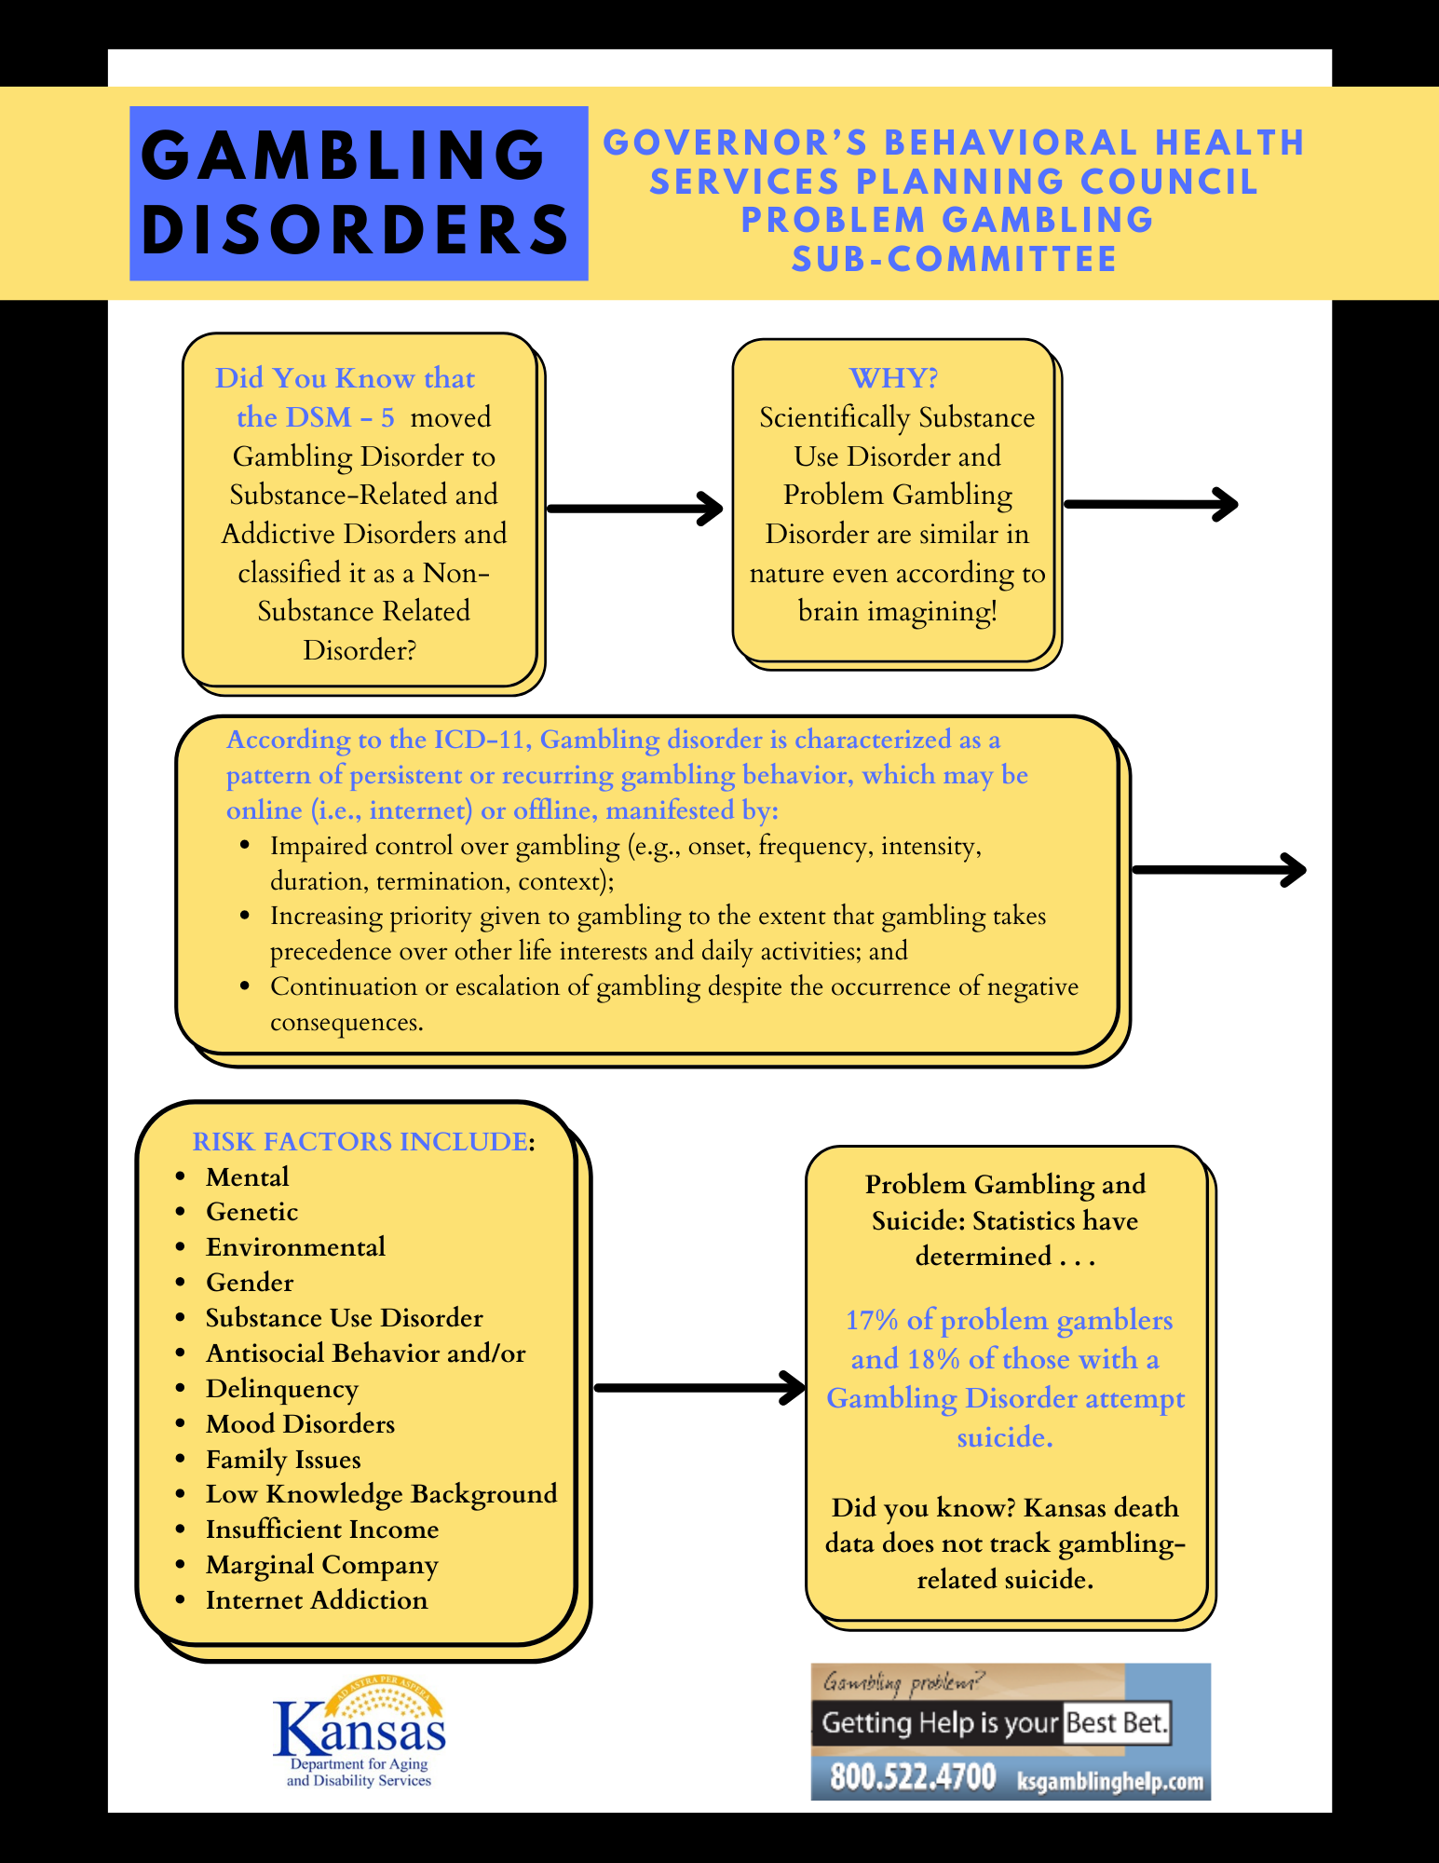

Slide 15
Take A Break Campaign
Set limits on how long you play
Engage in other activities
Connect with others
Notes:
school district in SC Kansas (South Central Problem Gambling Task Force) that will kick off this fall
SCPGTF supplied the school district with rubber wrist bands embossed with “Take A Break” and will be mailing out educational materials to all families.

Slide 16
Problem Gambling and the Military
Why?
Problem gambling among service members is twice that of the civilian population in the U.S.
POCs with the Army and Airforce
Raise Awareness, Educate, Provide Resources
Collaborate and Encourage KCGC Training
Notes:
The Problem Gambling (PG) subcommittee has begun, this year, to initiate efforts in attempting to contact points of contact (POC) with the Army and Air Force (ADAPT) Alcohol and Drug Abuse Prevention and Treatment programs located on each of the active-duty military instillations located in Kansas.
The PG subcommittee has a two-fold vision in developing a relationship with the ADAPT programs. First is to raise awareness and educate the military service members, who serve our nation while based in Kansas, about the resources available to them to help them gamble responsibly and to seek help when gambling starts to become a problem. Second, is to collaborate with ADAPT counseling staff to encourage interest in having some of them trained as Kansas Certified Gambling Counselors (KCGC) to help provide the necessary supports and services to their own community. As one of the old sayings in the Army goes, “We take care of our own.”. It is the intention of the PG subcommittee to support our service members, here in Kansas, by offering the important knowledge and resources about gambling so that the dire consequences of problem gambling or addiction doesn’t impact the mission readiness of our fighting force.
There are some important facts to understand about how gambling sometimes uniquely impacts our service members in a negative way. Statistics, from year to year, put problem gambling with service members at double the rate of civilians (2 to 4% of the population), per the National Council on Problem Gambling. With gambling problems, service members can face difficulties such as; issues with obtaining security clearances, suicidal thinking, co-occurring substance abuse and mental health issues, domestic violence, bankruptcy. One of the biggest vulnerabilities, that leads service members to making poor choices and sometimes risk national security, is financial issues. 34.2% of all active component service members respondents, according to the 2018 Health Related Behaviors Survey, suggested that seeking help damages one’s military career. In light of these facts, the PG subcommittee has deemed it imperative to continue these efforts as one of its ongoing projects.
“On the battlefield, the military pledges to leave no soldier behind. As a nation, let it be our pledge that when they return home, we leave no veteran behind.” – Dan Lipinski

Slide 17
Need Help? Have Questions?
1-800-GAMBLER
Notes:
1-800-522-4700 is our existing helpline number (on all print material and marketing) WHICH WILL SOON BE CHANGING
1-800-GAMBLER is new through the National Council on Problem Gambling Helpline harmonization project.
How these work – a call to either number goes to the National Helpline Call Center and is automatically routed to a state call center by area code.
If you live in Kansas but do not have a phone number with a Kansas area code, your call with go to the state matching your area code. You will need to ask the call center to route you to the Kansas call center. They can do this quickly (all call centers have a link to the master list of call centers across the country).
WE WILL BE KICKING OFF A STATEWIDE MEDIA CAMPAIGN STREAMLINING THE HELPLINE NUMBER AND REMINDERS TO PLAY IT SAFE WHEN SPORT BETTING.

