Slide 1

Governor’s Behavioral Health Services Planning Council
Prevention Subcommittee 2023 Annual Report

Slide 2

VISION:
To ensure that key representatives and stakeholders are involved in the process of reflection, feedback,
and guidance relating to initiatives within Kansas Behavioral Health Prevention Initiatives to ensure
enhanced collaboration, effectiveness, and impact on State and local level prevention and behavioral
health outcomes.

Slide 3
MISSION:
To provide engagement, feedback, guidance, and advocacy at the State level for related behavioral
health prevention outcomes and identification of systems changes to address challenges, barriers,
issues, and needs at the State, regional, or community level.

Slide 4

2023 Highlights
  Created a new Diversity, Equity, and Inclusion Workgroup
  Adopted SAMHSA Health Equity statement
  Developed internal systems to improve collaboration and streamline work processes
  Supported and advocated for key Behavioral Health Prevention programs and policies

Slide 5

Behavioral Health Priorities
1) Alcohol
2) DUI
3) Marijuana
4) Illicit drug use (youth, young adults, adults)
5) Suicide
6) Depression

Slide 6
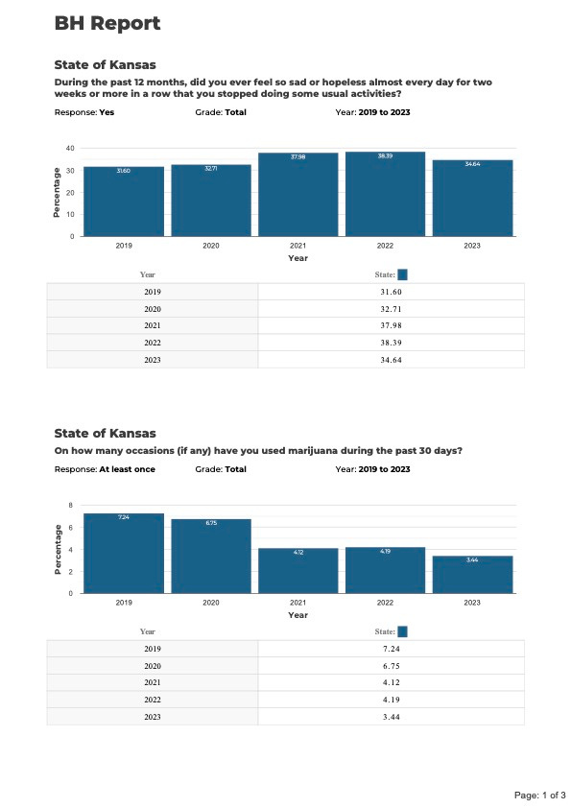
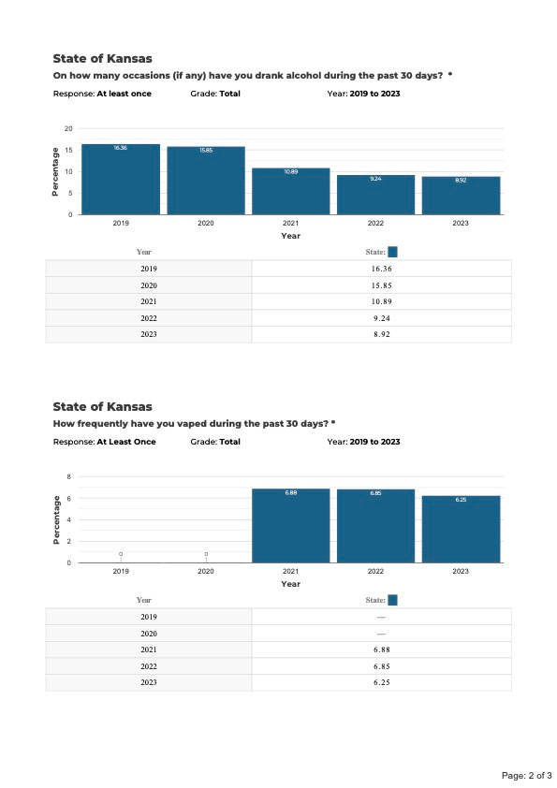
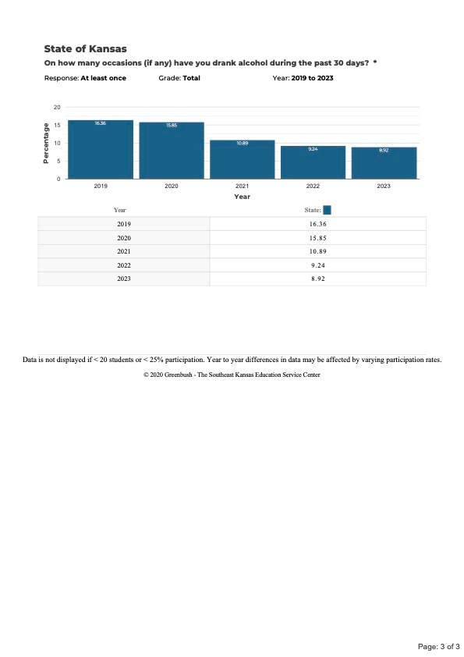

Trends in Behavioral Health Prioririties

Slide 7

Goals
  Support shared access to data resource.
  Empower state entities to provide synergy for local partners at all points on the prevention continuum.
  Allocate resources to data-driven priorities.
  Update the subcommittee prevention plan annually.
  Advocate for equity across the continuum if care with services available to people of diverse populations reflective of their identity and community specific to their needs.

Slide 8
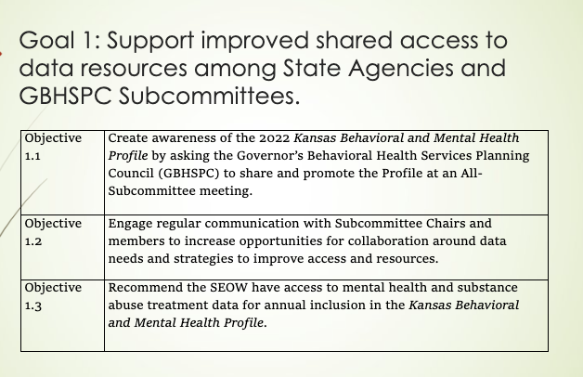
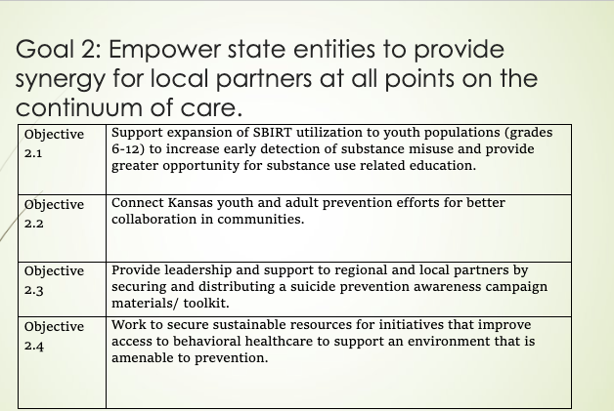

Slide 9
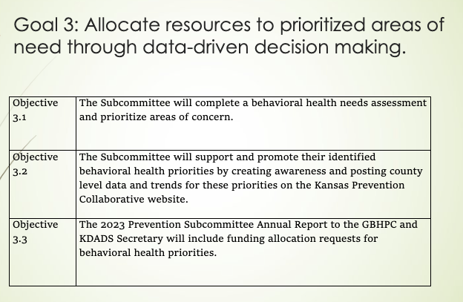
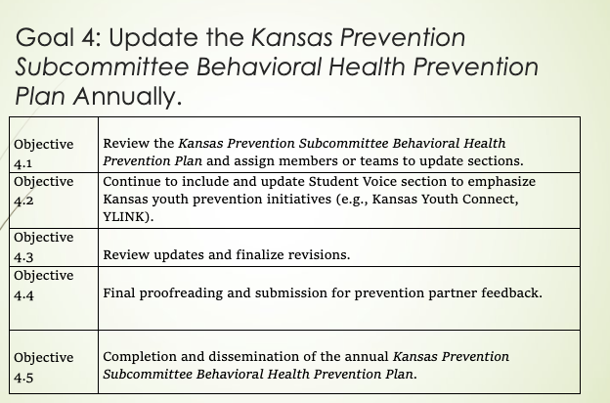
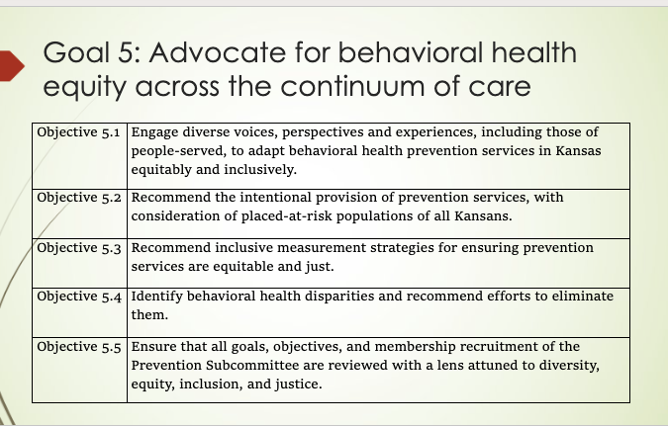

Slide 10

Data-sharing and Access ​
Support improved data-sharing among State Agencies and Subcommittees.​
Share and promote the Kansas Behavioral & Mental Health Profile at an all-subcommittee meeting. ​
​
Transitions ​
Expand approved providers for SBIRT by changing the language to include community health workers and other health education providers. ​
Consider sustainable resources for initiatives that improve access to behavioral healthcare to support an environment that is amenable to prevention. ​
​
Collaboration​
Hold quarterly GBHSPC Subcommittee Chairs’ meetings for increased awareness and opportunities for collaboration. ​
Hold annual all-subcommittee meetings to identify opportunities for coordination of goal development and alignment.
Recommendations for the future

Slide 11

Resource & Funding Request
Support broader evidence-based universal prevention strategies for community and statewide implementation around Prevention Subcommittee behavioral health priorities (suicide, depression, youth alcohol, marijuana, vaping, family attachment) at $500,000.
Hire and employ a centralized Epidemiologist to gather, compile, and compare behavioral health needs assessment data from all State Departments and Subcommittees and to support and maintain a Behavioral Health Data Source Inventory at a rate of $80,000 or higher in consideration of fair market rate.

Slide 12


Current
SEPTEMBER 2023
Membership
Liason
Stephanie Rhinehart - Kansas Department for Aging & Disability Services
Chair
Callie Dyer - LiveWell Finney County
Vice Chair
Aonya Barnett - Safe Streets Wichita
Secretary
The Center for Counseling & Consultation
Secretaty
Liz Hamor - Center of Daring
Prevention Subcommittee
Bailey Balir - KSPC
Georgina LaFoe - WSU CEI
Monica Kurz - HQ
Chrissy Mayer - DCCCA
Jerry Schultz - University of Kansas Center for Community Health and Development
Gary Henault- Kansas Department for Aging & disability Services

Slide 13
Thank you for your dedication to improving behavioral health in our community!

