Slide 1
Evidence-Based Practice Sub-Committee 2022-2023 Annual Report
Kansas Governor’s Behavioral Health Services Planning Council

Slide 2
MISSION
A robust network of support for communities implementing EBPs that best meet the needs of their population. This network will include making connections between individuals served, providers, trauma responsive communities, and information to implement needed EBPs in the community. This process will utilize best practices in implementation science and will centralize feedback from individuals receiving care, practitioners, agency collaboration, and research-based outcomes.
Notes:
We updated our Mission and Vision this year to promote our efforts in being more Trauma Informed in our activities. READ SLIDE

Slide 3
MISSION
These principles of trauma-informed care guide the work of this sub-committee.
Safety.
Trustworthiness & transparency.
Peer support.
Collaboration & mutuality.
Empowerment & choice.
Cultural, historical & gender issues.
Notes:
READ SLIDE

Slide 4
VISION
Creating connections, community, and resource models for implementation, evaluation, and sustainability of EBPs in Kansas. We will hold ourselves and each other accountable to the principles of Trauma Informed Care in all we do, following the principles outlined in the Mission.
Notes:
READ SLIDE

Slide 5
2022-2023 Leadership
Chair: Ruby Johnson, OneCare Kansas Program Lead, Aetna Better Health of Kansas
Vice Chair: Lori Libel, Director of Quality Management, Valeo Behavioral Health Care
Past Chair: Rachel Erpelding, Executive Director Kim Wilson Housing, Inc., Wyandot Behavioral Health Network
Secretary: Elizabeth Worth, Director of Adult Services, Johnson County Mental Health Center
KDADS Liaison: Tara Jo Latham, Quality Assurance Manager, KDADS
5
Notes:
This year’s Sub-Committee consists of: READ SLIDE

Slide 6
Accomplishments
EXPLORATION OF STATE-WIDE TRAUMA INFORMED COMMUNITIES
What’s being done in Kansas (OSH)
What’s being done in other States (OK)
Exploration of the Sanctuary Model
Notes:
We chose this model because: The Sanctuary® Model is a blueprint for clinical and organizational change which, at its core, promotes safety and recovery from adversity through the active creation of a trauma-informed community. A recognition that trauma is pervasive in the experience of human beings forms the basis for the Sanctuary Model’s focus not only on the people who seek treatment, but equally on the people and systems who provide that treatment.

Slide 7
Recommendations
Trauma Informed Care
Continue to promote TIC work through current KDADS contacts and grants.
Implementation Costs– both CCBHC and others
Baseline TIC standards for all KDADS contracts
Funds for TIC training
Notes:
The work of creating and sustaining a trauma-informed system must take place at all levels to be successful. We recommend the Council and KDADS actively seek and identify funding to implement the full recommendations of this report. This includes but is not limited to
READ SLIDE

Slide 8
Recommendations
Trauma Informed Care
Contract with Agency to provide TIC Training who can provide:
an existing and proven model of cultural, system, and agency-level intervention.
follow up and support for a significant period to support implementation and sustainability.
and a train-the-trainer approach to equip our system stakeholders to sustain this important work going forward.
Notes:
The work of creating and sustaining a trauma-informed system must take place at all levels to be successful. We recommend the Council and KDADS actively seek and identify funding to implement the full recommendations of this report. This includes but is not limited to
A recommendation that appropriates costs for TIC Implementation be included in the CCBHC cost reports and for additional funds for all EBP service providers in Kansas outside of the CCBHC clinics.
Continuation of the current practice of including trauma-informed care work in grants and projects applied for by KDADS and sub-awarded by KDADS.
Identify baseline standards for trauma-informed care to be included in state contracts as appropriate – including all contracts in which TIC is mentioned related to deliverables.
$60k built into the state budget to support stakeholder attendance at any identified training germane to creating a trauma-informed, trauma-transformed system.
We recommend the state pursue a contract with an agency that can provide legwork, training, and facilitation to support the creation of a trauma-informed, trauma-transformed system. We recommend that any such contractor be able to
provide an existing and proven model of cultural, system, and agency-level intervention.
follow up and support for a significant period of time to support implementation and sustainability.
and a train-the-trainer approach to equip our system stakeholders to sustain this important work going forward.

Slide 9
Recommendations
Data Dashboard
Exploration & Planning Stage of Implementation still needed.
EBP Subcommittee asks for support from KDADS in the establishment of work group that includes multiple state agencies, community EBP providers, individuals served, and other stakeholders. This committee would assist in the creation of common data standards, including both information and quality measures.
Notes:
This recordation continues from last year:
A Data Dashboard would increase data-driven decision-making and ensure standardization of data collection across the state. Specifically, data evaluated by a common set of quality measures from implementation and ongoing services provided by all EBP providers. The data that would be available through this data dashboard can demonstrate outcomes, validate current practices, and support recommendations for future practices. Further, maintaining a data dashboard will allow for a historical record of practices and outcomes provided throughout the state.
A Data Dashboard has been both a current and a past recommendation from several sub-committees of this council. The Evidence-Based Practice Sub-Committee, in line with the stages of implementation science, recognizes that groundwork of establishing a data dashboard need to be fully explored to ensure the necessity and intentional use of data outcomes from evidence-based practices across the state. The EBP Sub-Committee commits to leading the effort of exploration of a data dashboard through assessing needs, fit, and capacity with stakeholders throughout the state. The hope of this sub-committee is to provide a comprehensive recommendation in 2024 report regarding a pilot for a data dashboard that has been fully researched and planned for the most effective and intentional use by stakeholders at all levels.
Recommendations will include the following:
Level of analytical intensity of data: static versus an interactive dashboard with drill down capabilities.
User level (regulatory, agency administrator, clinician, person receiving services)
Evidence-based practices to include in a data dashboard pilot program. Examples include ACT, IPS, MAT, SOAR, Seeking Safety, Housing First, AOT, Zero Suicide, TIC, PMTO, MRSS-MCR
Determine the domains to be included in measurements for each domain (clinical outcomes, quality of life, social determinants of health, etc.)
Assist in developing a data collection plan.
Determine cost indicators based on pilot program.
Potential vendor/contractor for data dashboard pilot program with experience in data blending from multiple data sources. (Ex. Qualtrics, Practical Data Solutions, Domo, Tableau, Icentrix)

Slide 10
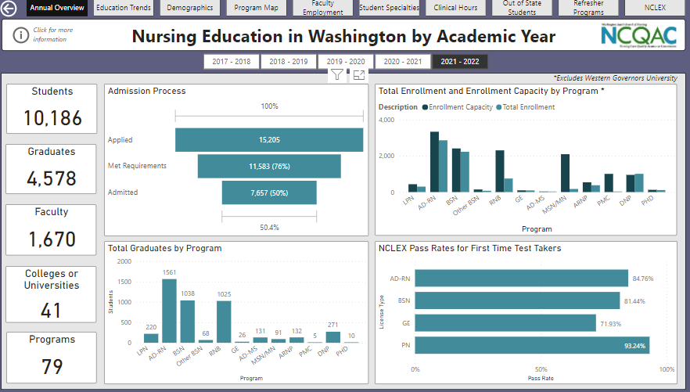
example
Notes:
This is an example of a data dashboard we found from Washington regarding nursing education. We would like to collect data that relates to a multitude of EBPs used in KS, breaking them down by number of individuals served, service locations, individual demographics, etc. Some EBP examples include but are not limited to:
ACT
IPS/Employment First
MAT
SOR
Seeking Safety
Housing First
AOT
Zero Suicide
TIC-EBPs
PMTO
MRSS-/MCR

Slide 11
State Snapshot Dashboard
https://datatools.ahrq.gov/nhqdr/?_gl=1%2All90fu%2A_ga%2AMTEzMTQ4NTIzNC4xNjk2Njk1NTY3%2A_ga_1NPT56LE7J%2AMTY5NjY5NTU2Ny4xLjAuMTY5NjY5NTU3MS41Ni4wLjA.

Slide 12
2024 Goals
Ongoing Framework
For learning from other Council Sub-committee representatives, state stakeholders, providers, consumers, and family members for which EBPs or other measurement-based modes of care are creating positive outcomes for individuals served.
For sustainable technical assistance to providers so they can deliver the best practices (evidence-based practices with fidelity) chosen by the individual served in collaboration with the provider.
To equip providers to deliver efficient, effective, person-centered, value-based care.
For providers in measuring the value of care provision from the standpoint of structure, process, cost-effectiveness, and impact of care provision; and Managed Care Organizations (MCO) support of training and quality review that leads to fidelity for their provider network as required by their contracts.

Slide 13
2024 Goals
New Initiatives
Partner with KDADS to develop a work group that includes stakeholders across the state to assess the need and use of a data dashboard. The EBP Sub-committee will lead a work group to explore the need through surveys, focus groups, convening other sub-committees around this goal, etc. and explore potential vendors and cost to develop an initial implementation plan of a data dashboard pilot for 2024.
Partner with KDADS to utilize ongoing Technical Assistance (TA) around common practices or themes that flow throughout all the EBPs as provided by the MHTTC with consideration of access to EBP’s for a broad population. An example may include Diversity, Equity, and Inclusion (DE&I) practices.
Create a toolbox that can be used for all providers
This kit would focus on the implementation of any EBP across Kansas, looking into what is best for the community served, resources available and needed, where to start, and who are the available partners.
Define fidelity with quality as the indicator with specific consideration to modifications as appropriate for agency environment/circumstances (e.g., Rural and Frontier, workforce capacity, etc.).
Continually monitor and review previous work based on data collected and feedback from providers and individuals served to inform decision making.
Partner with KDADS to sustain future implementation of EBP’s across Kansas.

Slide 14
Thank you ?Questions?

