Slide 1
Children’s Subcommittee
2022-23 Annual Report

Slide 2
Highlights of Progress
Kansas was the first state to legislate a requirement to implement Certified Community Behavioral Health Clinics (CCBHCs) statewide and has certified/provisionally certified 20 of the 26 during this report period and by January 2024 all 26 will be certified.
Kansas implemented Youth Mobile Crisis Response in Oct 1, 2021 that provides immediate crisis line support to parents and caregivers and in-person crisis response coordinated at the local level via CMHCs when needed. Data is being collected to review the efficacy of the program.
Adult Mobile Crisis Response was implemented along with the CCBHCs.
Mandatory training of mental health first aid for all juvenile KDOC supervision officers.
Kansas implemented the 988 National Suicide Prevention Hotline on July 16, 2022.
KDADS implemented Parent Peer Support with 136 individuals registered to complete Level 1 training. Sixty (60) individuals have completed the Level I online training and there are 9 certified Parent Peer Support Specialists in training that can bill up to 20 hours a week. Level 2 In Person Training is scheduled for the fall.
The PRTF process document was reviewed and approved by the committee. These processes help to define the roles and responsibilities across the stakeholders involved in assessing, supporting, admitting and discharging from a PRTF.
KSKidsMAP’s overall enrollment goal is at least 200 PCPs by June 30, 2023.
We lost several members of the committee throughout the year and were able to replace them quickly. Many of our new members are parents with lived experience.
Notes:
Erick

Slide 3
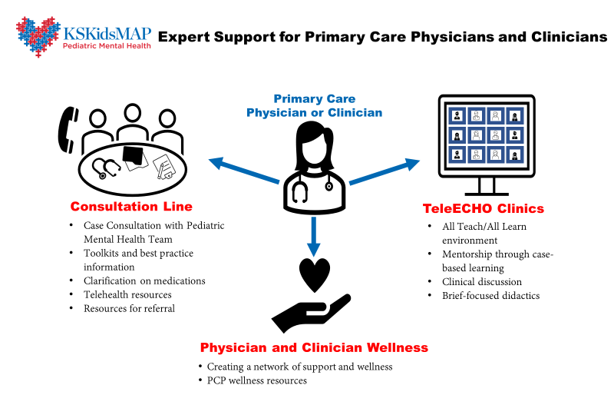
Notes:
Kelsee

Slide 4
KSKidsMAP
Continue to serve as the advisory council for KDHE’s KSKidsMAP pediatric mental health grant.
Make progress on the recommendation to sustain the program by continuing to research and identifying opportunities or actions for the committee or others to take to sustain the project.
Goal 1: KSKidsMAP
Recommendations:
Make pediatric primary care workforce development opportunities (e.g., training, technical assistance) widely available to clinicians working in primary care and other health centers as well as in professionals working in settings for birth-age 21 school settings. These efforts will ensure gap-filling treatment services in mental health professional shortage areas are high-quality and follow best practice guidelines.
    Recommendation was set forth by the U.S. Surgeon General’s Advisory on Protecting Youth Mental Health (What Federal, State, Local, and Tribal Governments Can Do). Update to reflect most recent recommendations. The American Psychological Association 2022 Trends Report recommends mental health needs be addressed in schools, training teachers on how to address trauma, build resilience in children through protective factors and positive childhood experiences.
Fully fund a statewide psychiatry access program (e.g., KSKidsMAP) to lead these activities. Current funding ends June 2023.
    Consider adding a line item to the state budget that supports the KMHM recommendation as was set forth by the 2022 Special Legislative Committee on Kansas Mental Health Modernization and Reform (5.3: Frontline Capacity) and to align with the Governor’s priorities on improving access to early childhood mental health.
    Consider adding a line item to the state budget to fund initiatives that enhance the number of highly trained professional practicing in Kansas, including child and adolescent psychiatrists and child psychologists. Recommend expanding the child psychiatry fellowships to strength the access to care.
Notes:
Erick

Slide 5
Review the system of care to identify current resources and needs, ensure parents know what services are available and how to access them.
Professionals are educated to refer parents/caregivers to services/support)
Goal 2: Parent Engagement
Recommendations:
Develop family Navigators to assist families in identifying current resources and accessing them. Explore the Pathways HUB model through the Pathways Community HUB Institute. (Community Based Care Coordination | Pathways Community HUB Institute (pchi-hub.org). Invest in Community Health Workers that are focused on families and their unique needs.
When NFF training is ready, partner with them to support the Parent Support. CMHCs should be encouraged to employ the Parent Support Specialists who have lived experience.
Continue to expand the offering of Mental Health First Aid Training to youth, parents, youth workers, law enforcement, school, and court officials.
Notes:
Erick

Slide 6
Review the system of care to identify current resources and needs, ensure parents know what services are available and how to access them.
Professionals are educated to refer parents/caregivers to services/support)
Goal 2: Parent Engagement (cont’d)
Recommendations:
Develop a collaboration between committee, KSDE, KS MTSS, KPIRC, Project STAY, Former TPS SpEd Director, Topeka Public Schools to address:
    ACES impact child/adolescent development and student performance
    Define toxic stress and explain the implications for teachers and school communities.
    List the key components of trauma-informed schools and classrooms that facilitate resilience that is standardized, and practice based on the following definition:
      A trauma-informed child and family service system is one in which all parties involved recognize and respond to the impact of traumatic stress on those who have contact with the system including children, caregivers, and service providers. Programs and organizations within such a system infuse and sustain trauma awareness, knowledge, and skills into their organizational culture, practices, and policies. They act in collaboration with all those who are involved with the [client] and support their ability to thrive.
    Identify strategies to remain emotionally grounded, build emotional intelligence, and create change through self-care
    Expand the Family Resource Centers, working across the communities to develop this resource
Notes:
Erick

Slide 7
Focus on unserved and underserved populations with a focus on race, ethnicity, gender identity, language, and culture.
Goal 3: Diversity, Equity, and Inclusion
Recommendations:
  Professionals with a level of cultural humility and curiosity that would include populations of LGBTQIA+.
  Add workforce piece that represents the population they serve, matching and attracting a more diverse workforce
  Different licensing boards to require cultural competency training as part of their licensure/certifications for those working with children and families. All states with CCBHCs under SAMSHA will be required to show cultural competence.
  Consistency and direction (best practices) for serving diverse populations
  Agencies demonstrating culturally responsiveness to the diverse populations across Kansas which would include LGBTQIA+
  Culturally and Linguistically Appropriate Services
  https://thinkculturalhealth.hhs.gov/clas
Notes:
Kelsee

Slide 8
Other Recommendations
Throughout the year we received updates and had many discussions which resulted sometimes in follow-up and/or sharing of information. As a result, we identified other recommendations that do not fall within our identified goals for the year. These recommendations are summarized here.
Statewide data systems and dashboards. The need for consistent, summarized and even analyzed data to inform our work and other people’s work, including decision making of state agencies, is a consistent need we see, and other committees identify. This points to the need for better data systems. We see this in substance use disorder, mental health, and child welfare systems. We recommend that state agencies work together on a plan to identify system and data dashboard needs and a plan to consistently fund and maintain such systems.
We decided we did not have resources or capacity to move this forward as a Subcommittee. However, we did discuss some details and a recommendation related to this idea for the governor and secretaries to consider. We recommendation that a state agency (KDADS or KDHE) be identified to develop a campaign to target awareness around the negative effects of isolation and the benefits of connections.
Notes:
Kelsee

Slide 9
2023-2024 Goals
KSKidsMAP: Continue to serve as the advisory council and support the sustainability of the KSKidsMAP program.
Support initiatives for Transitional Age Youth, with a particular emphasis on the IDD population and supporting the families.
Early Childhood MH services, focusing on prevention, positive childhood experiences and healthy pregnancy/postpartum impact on development and what resources would be needed through the development in the early years.
Notes:
Kelsee

Slide 10
Additional topics
Lack of support for adoptive parents.
Early Childhood mental health services and funding
Substance Use – other groups and systems are looking at this
Improve cross-system care” or “improve services for children/youth receiving multi-system services
Workforce KDADS strategic plan, CW case managers for DCF/CMPs
Healthy pregnancy/postpartum impact on early development
Prevention and focus on positive childhood experiences to avoid the ACES impact
Transitional age youth – CCBHCs coordination to other resources and supporting them through SDOH, connection in the community, employment, VocRehab, employers who will support this (homelessness for aging out of CW) STEPS

Slide 11
Feedback and Questions

