Slide 1
KDADS Webinar
Forensic Competency Wait Time Reimbursement
July 21, 2023 / July 28, 2023
Scott Brunner, Deputy Secretary
Department for Aging and Disability Services

Slide 2
2023 Legislature SB 228
Directs KDADS to reimburse counties for costs related to holding a person in custody while awaiting examination, evaluation, or treatment to restore competency to stand trial.
The rate is $100 per day. KDADS is directed to develop a process to pay on a quarterly basis.
Counties can be compensated for each day a person is in custody and confined.
For defendants waiting for examination or evaluation, compensation is for days from the date the request for examination or evaluation is made until the date the person is taken from confinement in the county jail for such examination or evaluation or the examination or evaluation is completed at the county jail.
For defendants awaiting competency restoration treatment, compensation is for days from the date of return to confinement in the county jail from examination or evaluation or the examination or evaluation is completed at the county jail until the date the person is taken from confinement in the county jail for such treatment or treatment is completed at the county jail.

Slide 3
Key points to the process
KDADS is paying counties. Counties must be registered in SMART (State Accounting System).
The only types of competency examination, evaluation or treatment eligible for reimbursement are under K.S.A.:
22-3219
22-3302
22-3303
22-3429
22-3428
22-3430
Reimbursements are based on requests from counties for defendants they are responsible for based on criminal charges or court orders.
Should not claim for defendants that are out on bond or not in custody in jail.
KDADS can verify against information maintained at Larned State Hospital (LSH) State Security Program about defendants ordered for evaluation or treatment.
If we can get information from counties that is like what’s requested on the Reimbursement Form, we will try not to duplicate efforts.

Slide 4
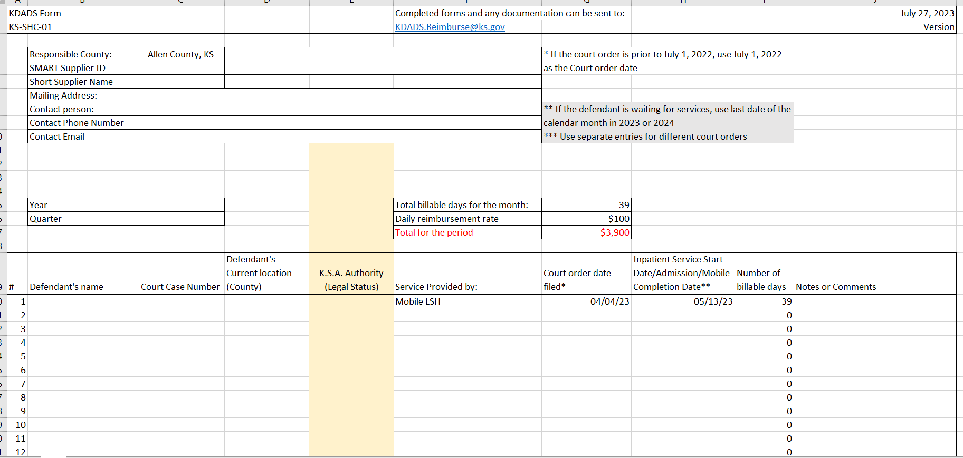
Notes:
This form is built in Excel.
There are several fields with drop down boxes with the allowable options for entry.

Slide 5
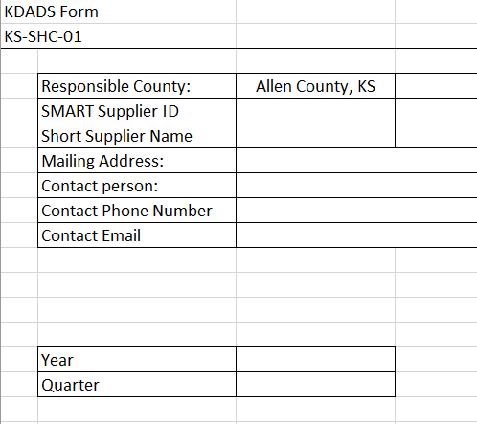
County Payment and Contact Information
Responsible County is a drop down with all county names.
SMART Supplier ID is a 5-digit number assigned by the state Division of Accounts and Reports. There is a drop down with Supplier IDs we found in SMART.
Short supplier name is also a drop-down selection of names we found in SMART. This could help match up a county with Vendor ID if there is a discrepancy.
If the drop-down options are not correct, enter your preferred values. The Supplier ID and Supplier Name are critical to matching a payment to the right county and processing the payment.

Slide 6
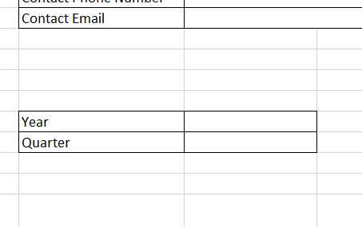
Time Frame for the Reimbursement
The form was built to meet the requirement for a quarterly payment.
The selection should be the timeframe when services were provided, and reimbursement is requested.
The possible years are 2022, 2023, and 2024 for the correct state fiscal years.
Quarters are:
January-March
April-June
July-September
October-December
Notes:
This doesn’t exactly work for reimbursing for the full state fiscal year from July 1, 2022 through June 30, 2023.

Slide 7
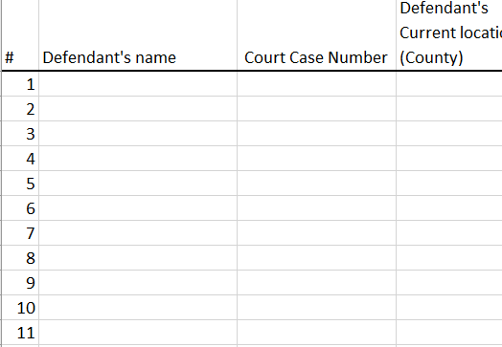
Information about the Defendants
Name and Case Number should match the person on the waiting list.
Defendant’s Current Location is the county housing the defendant. If another jail is housing a defendant on behalf of the responsible county, this can help KDADS and Larned State Hospital verify the defendant on the wait list.
The reimbursement should go to the County where the criminal charges were filed.
A single defendant could appear multiple times if there are additional charges or if the defendant moves between competency evaluation and restoration.

Slide 8
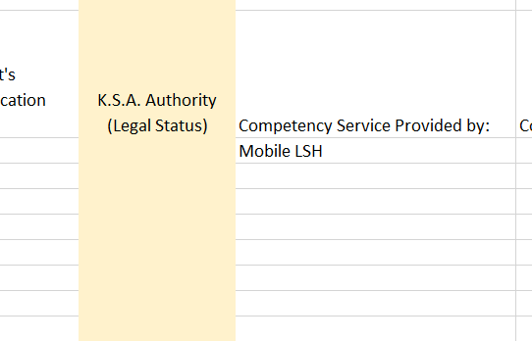
Information about the Service
K.S.A. Authority is a drop-down field to select the legal order from the court for a defendant.
Options are:
22-3219 22-3428
22-3302 22-3429
22-3303 22-3430
22-3302/22-3219
Service provided by:
LSH Inpatient
OSH Inpatient
Mobile LSH – This would be through a contractor or LSH staff member
Waiting for services
CMHC – Future option where a CMHC is conducting competency as ordered by District Court

Slide 9
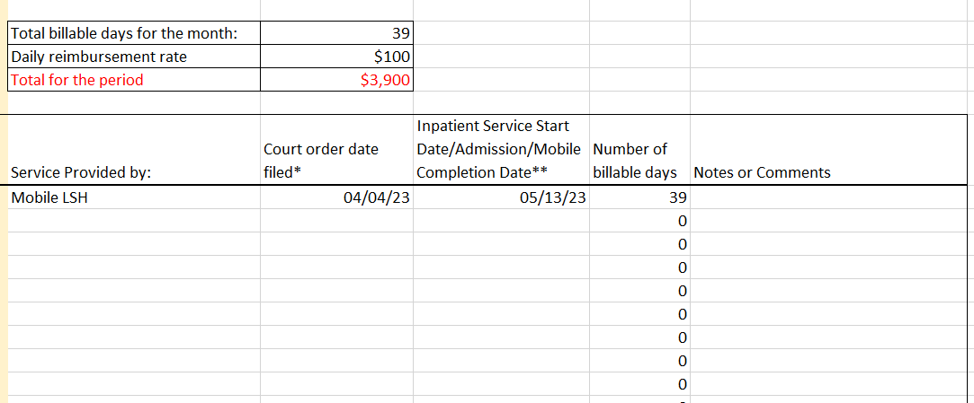
Information about Dates and Payment
Court order date is the date stamped on the order.
July 1, 2022 should be entered for any orders for a defendant in custody before July 1, 2022.
The service start date/Admission or Mobile Completion date is when :
a defendant is transported and admitted to LSH or OSH
Mobile competency is completed and the transmittal letter with the Forensic Evaluation Report is send to the court.
Number of days is calculated by subtracting the two dates. That is carried up to billable days and for all defendants on the spreadsheet.
If the reimbursement is for a defendant still in custody at the end of the quarter, the Start Date is the last day of the quarter.

Slide 10
Notes:
This form is built in Excel.
There are several fields with drop down boxes with the allowable options for entry.

Slide 11
Reimbursement for past expenses
We’d like to make a single payment to each county that held defendants waiting between July 1, 2022 and June 30, 2023.
Fill in defendants' names and case numbers for every one that was in custody in that time period.
If the legal authority changed during the year, create a new line for that defendant with the corresponding dates.
If a defendant is in custody after June 30, 2023, counties could choose to wait until the defendant is admitted or enter June 30, 2023 in the completion date field to close out the retroactive reimbursement.
If a defendant was in custody before July 1, 2022, KDADS can not pay for days before July 1, 2022.
KDADS can verify information with the wait list and admission records at LSH and OSH.

Slide 12
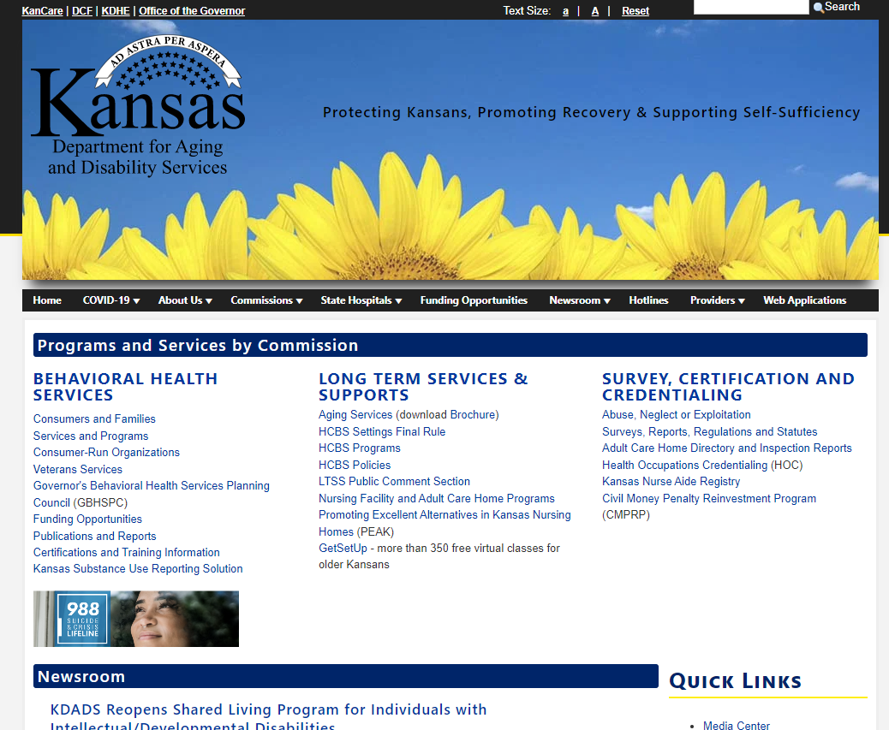
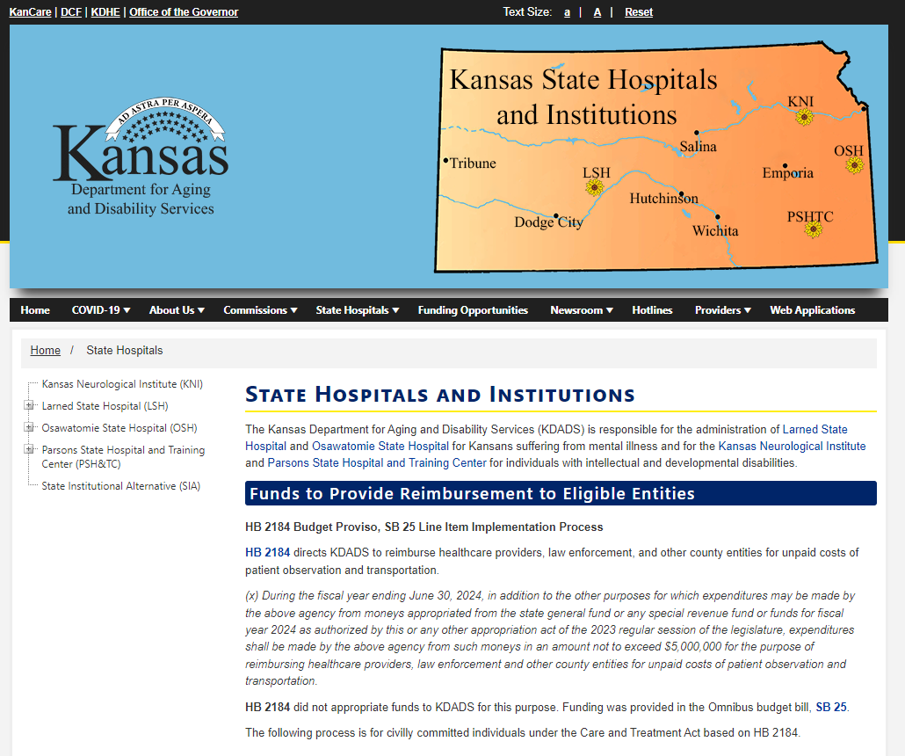
Contact information
KDADS.ks.gov/state-hospitals-and-institutions

Slide 13
Contact Information
KDADS.reimburse@ks.gov
Submission of forms
Additional documentation
Questions about the process or status
Suggestions for improvement
Scott Brunner Jason Yeakley
Scott.Brunner@ks.gov jasonf.yeakley@ks.gov
785-296-0237 785-296-4450

