Slide 1
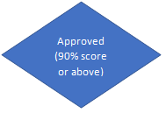
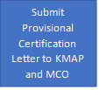
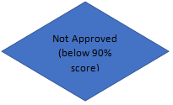
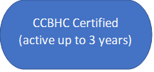
KANSAS CCBHC CERTIFICATION FLOW CHART
Send Letter of Interest to KDADS: kdads.cchc@ks.gov
CCBHC Orientation
Rate Setting
CMHC is issued Provisional Certification
KMAP & MCO Time frame
30-60 days
Onsite baseline survey
KDADS will request missing documentation
Rebasing (1 year after provisional certification)
CMHC will sending missing documentation to KDADS
CCBHC is granted full certification
CCBHC Onsite Survey

