Slide 1
SCREENS FOR CONTINUED STAY (SCS) SCREENER/FACILITATOR TRAINING
Chris Bush, MCJ, GCDF
Behavioral Health Services

Slide 2
Background and History of the SCS
The Nursing Facilities for Mental Health (NFMHs) program began in the1980s as an alternative to regular Nursing Facilities
NFMHs not part of Mental Health Reform
NFMHs are Institutions for Mental Disease (IMDs) and not eligible for Federal funds
Persons in NFMHs without an alternate pay source (private pay/insurance) are supported by State General Funds

Slide 3
Background and History (continued)
NFMHs became a “step down” as people began to move out of State Mental Health Hospitals (SMHHs).
Intensive community-based resources developed over past 15 -20 years decrease the need for institutional care.
KDADS is committed to promoting self sufficiency and ensuring people who have been diagnosed with a SPMI have the opportunity it live in the least restrictive environment.

Slide 4
Annual Screen For Continued Stay Process
The annual screen for continued stay (SCS) process was developed to :
Assess individuals in NFMHs
Evaluate their continued need for that level of care
Provide individuals determined to need a less intensive level of care the opportunity to become integrated into the community with support of community-based services to meet their needs, and assure State General Funds are being directed toward the most effective and appropriate treatment settings based on the level of need

Slide 5
Annual Screen Process, continued
All persons residing in NFMHs require an annual screen for continued stay
CMHCs are responsible for conducting the annual screens and developing plans to assist persons who are screened for discharge
One hundred and twenty (120) days from date KDADS BHS approves a screen with a disposition of discharge/State General Funds to the NFMH will be considered discontinued.

Slide 6
Conducting NFMH Screen For Continued Stay
The resident is the primary source of Information for the screen.
Explain reason for screen/visit .
Utilize facilitator to assist with the process, if available.
Utilize other sources of information such as family and/or guardians, as well as NFMH staff and resident’s chart.
Complete all sections of the form.
If you need help, ask for assistance from your supervisor or from the designated person you are shadowing.

Slide 7
Instructions Section I – Summary Sheet
Identifying /demographic Information
County of Responsibility
Comment Sections

Slide 8
County Of Responsibility Definition
“The County of Responsibility will be the county where the client lived independently or with family (in other than a boarding home, group home, NFMH, or other supervised living program) for six continuous months prior to the latest admission to a state mental health hospital or other institution…”

Slide 9
Instructions Section II – Diagnosis & Treatment History
Primary and Other Diagnosis(es) (formerly Axis I, II, and III)
Hospitalizations
History of High Risk Behavior
Reason for referral to the nursing facility (PASRR letter)

Slide 10
Instructions Section III – Services & Resources Available
Identify formal and informal resources and services used by the NFMH resident in course of his/her treatment.
Check whether the person has ever lived independently or semi-independently and identify where, how recently, and for how long.
Identify community support services used in the past and the specific type of services used.

Slide 11
Instructions Section IV– Assessment Of Functional Limitations
This section is designed to determine if the individual has one of the five conditions indicating nursing facility level of care
Consider options and resources available as alternative to nursing facility level of care
Conditions are indicators of need for intensive level of service, but not necessarily indicate where the service would be provided

Slide 12
Assistance Needed For Activities Of Daily Living
Indicate the level of assistance needed by the individual to perform activities of daily living.
Ask the individual and staff as well as review chart records.
Keep in mind that individuals who reside at an NFMH may not have the opportunity to perform all of his/her ADL's independently. Encourage the individual to share their experiences performing these tasks outside of a structured setting.

Slide 13
Instructions Section V – Potential For Discharge To The Community
Strengths Assessment is critical in determining a person’s potential for discharge.
Facilitators are encouraged to complete the Strengths Assessment.
Please reference your case management training material for information on the strengths assessment process.

Slide 14
Home Community
The community where the individual would choose to live. This may be the area where they resided prior to admission or another place they now choose to go.
Community Group Home
Other, etc.

Slide 15
Resources Necessary For Person To Live In The Community
Complete this section regardless of the person’ s choice of living arrangement.
Check services/supports specific to the person being screened (far left column).
Check whether those services/supports are available in the community where the person chooses to live (middle column).
Check if supports needed are not available or not developed (far right column).

Slide 16
Instructions
Section VI– Screening Findings
Mark recommendation for Discharge (“A”) or Continued Stay (“B”) and the reason (1-4).
If there are specific things the individual could/should work on to help them prepare for future community integration, add them in the comments section “Recommendations for additional Community Preparation Skills.”
If person has a guardian, be sure to contact them and indicate on the form that you spoke to them, and whether they agreed with the recommendation or not.
List guardian concerns in the provided comments section.

Slide 17
Instructions
Section VI– Screening Findings (continued)
Utilize the Additional Comments Section to provide any additional comments/information to support the findings of the screen. Also include other recommendation regarding the individual’s future services
SPMI Criteria: Check whether individual meets criteria for SPMI
Obtain all necessary signatures
***A completed sample SCS is available for your guidance***

Slide 18
Roles & Responsibilities
CMHC’s
FACILITATORS
SCREENERS

Slide 19
CMHC’s Responsibilities
Each CMHC will assign a CMHC-NFMH Liaison, who will act as a liaison with the NFMH and other CMHCs, serve as a point of contact with KDADS, and oversee coordination of services for those being discharged.

Slide 20
Facilitator Responsibilities
Accompany CMHC staff to NFMHs for participation in the SCS process
Facilitator will complete the Strengths Assessment portion and contribute to the recommendations of the SCS.
Facilitate the development of one-to-one relationships between consumers living in the community within a given individual’s county of responsibility and those individuals currently residing in an NFMH.
Notes:
*Note-The strengths assessment must be completed by the screener if a facilitator is not available

Slide 21
Facilitator Responsibilities (Continued)
Facilitators will attempt to foster hope and encouragement as well as identify available resources for those residents who wish to move from an NFMH back into the community. This relationship may also help residents identify ways in which the NFMH experience contributes to their recovery process.
Provide peer support throughout the screening process for those consumers scheduled to be screened.
Provide information and resources related to community living not only to residents but also to guardians (as applicable), the NFMH staff, and/or the CMHC screeners.
*Note-The strengths assessment must be completed by the screener if a facilitator is not available
Notes:
*Note-The strengths assessment must be completed by the screener if a facilitator is not available

Slide 22
Screener Responsibilities
The roles and responsibilities of a screener include the scheduling and completion of the Screen for Continued Stay, as well as recommendations and referrals to appropriate services. These assessments will be conducted in a culturally-sensitive manner with provisions for assessments of non-English speaking individuals. The specific tasks are:
The completion of the “Screen for Continued Stay.” This includes completion of a “Consumer Strengths Assessment” which is incorporated into the SCS document. Screeners and facilitators will complete the assessment documents based on information obtained from a variety of sources, including a face-to-face interview with the individual being screened, review of medical records, discussion with NFMH staff, and discussion with family members, guardians, or other individuals as requested by the resident.

Slide 23
Screener Responsibilities (continued)
Following completion of the assessment documents, the screener and facilitator will each make a recommendation for either discharge to the community upon development and implementation of an appropriate plan for community supports, or continued stay in the NFMH identifying the reason that community discharge is not possible at this time.
If discharge is recommended and needed services have been determined, the screener will communicate with the Community Support Services (CSS) program where the resident desires to live (either their own CSS program or another if the person chooses to live outside the county of responsibility; this transition of responsibility should take place after the individual has relocated to the new catchment area). A determination will then be made as to whether the supports necessary for discharge to the community are available.

Slide 24
Completion and Submission of SCS to KDADS
After the assessment has been completed:
Enter the information into the Screen for Continued Stay Document - fillable form.docx form provided by KDADS and available on the KDADS website at https://www.kdads.ks.gov/provider-home/providers/screens-for-continued-stay.
Save the document in either .doc or .docx format.
The signature page (the last page that requires the QMHP’s signature), the strengths assessment, and the facilitator’s portion of the cover sheet can be filled out by hand, scanned, and sent as an additional file, but the screen itself must remain in a Word format.
Email the completed forms to diana.marsh@ks.gov.
After the screens have been reviewed by KDADS, notification letters will be sent to the resident, the NFMH, the CMHC, and the guardian (if applicable).
Once the letters have been received, the CMHC can bill for reimbursement.
For any technical assistance with submitting SCS please contact Diana by email or at 785 296-3471

Slide 25
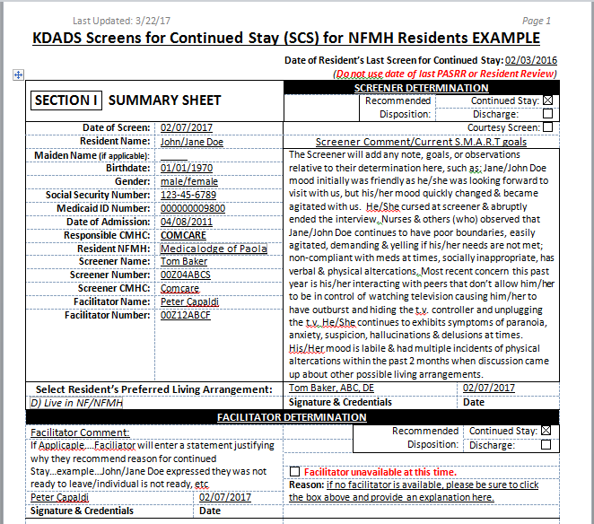
For Your Review, An Example Of A Completed SCS
Notes:
Review of example document should be done by the trainer, based on the example provided by KDADS

Slide 26
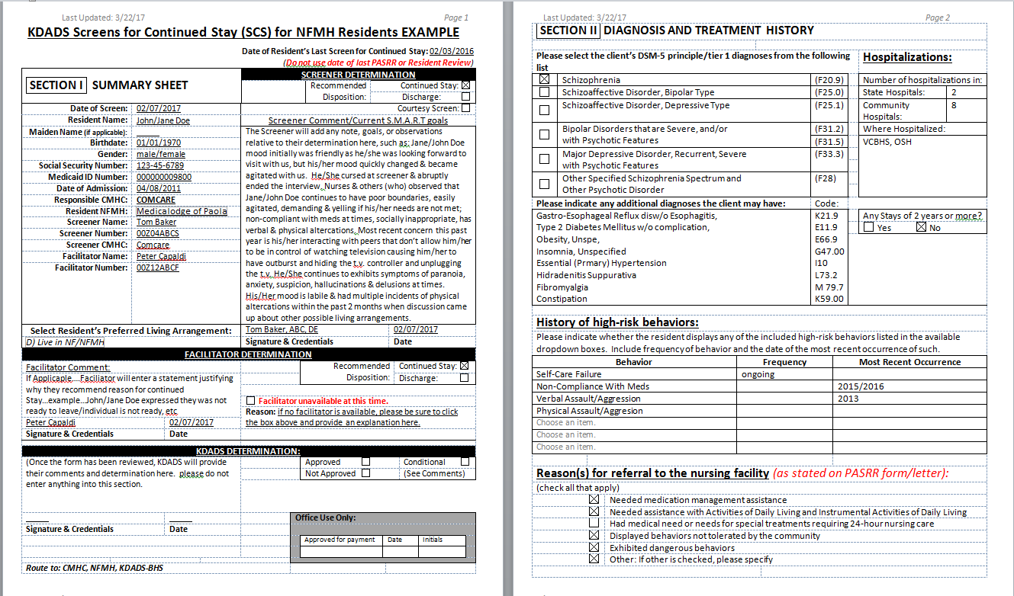

Slide 27
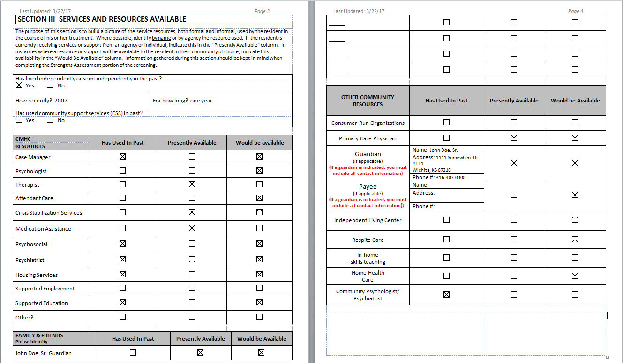

Slide 28
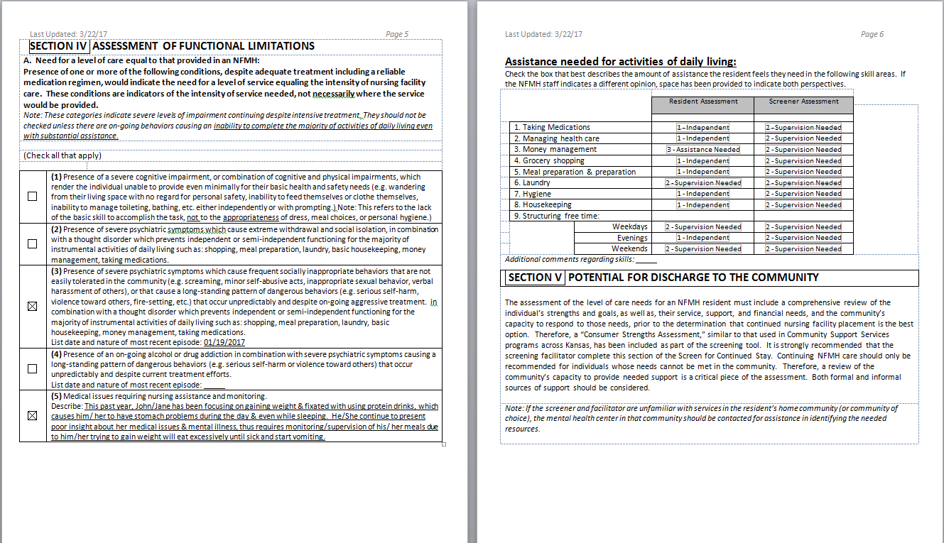

Slide 29
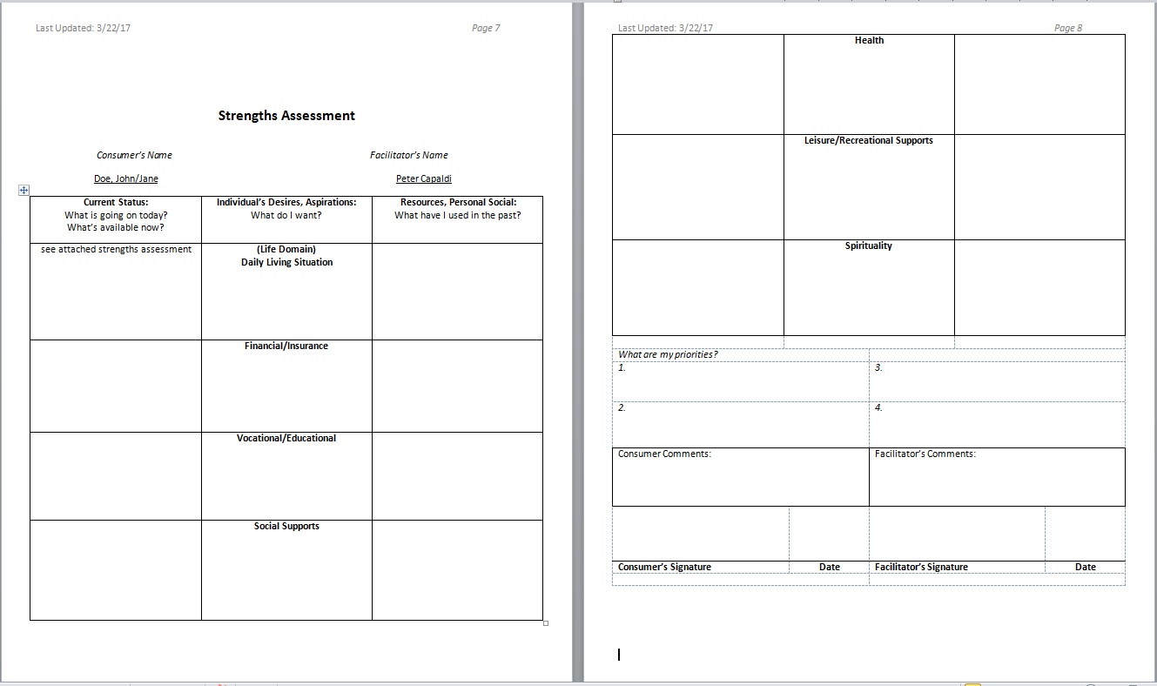

Slide 30
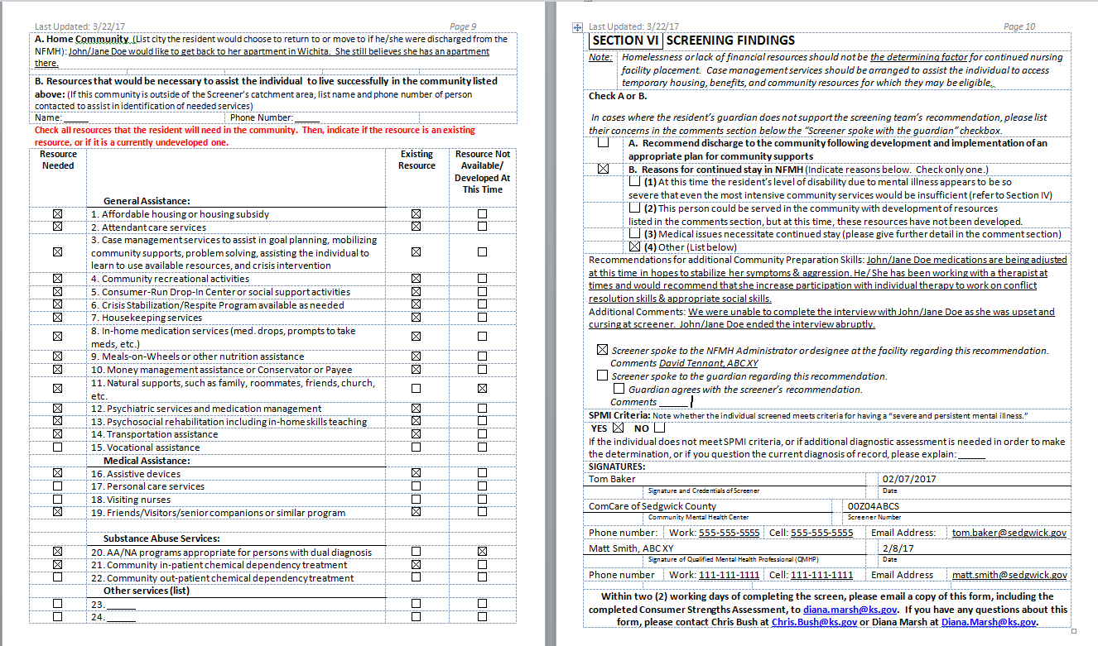

Slide 31
Training Recommendations For Completing The SCS
Team up with a screener who has experience and shadow them at least three times before attempting to complete one on your own
Once you are ready to start completing the form, have the person you shadowed review what you have entered. This should include reviewing the documents and ensuring that they are submitted correctly.

Slide 32
Questions?
If you have questions, please contact:
Chris Bush, MCJ, GCDF, KDADS
Adult Community Program Manager
chris.bush@ks.gov / 785-296-2572

